Slide 2
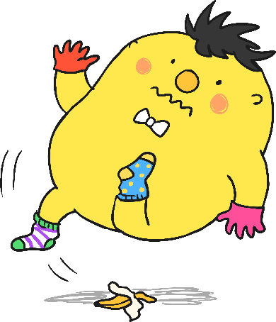
Spot Mr Whoops’ Mistakes Activity 1
My favorite day of the week has always been a Sunday. Even as a young boy, I rimembur Sundays being diferent and speshial. Most weeks, I would visit Granny Whoops’ house, where we would have roast beef, mashed potatos and Yorkshire puddings. Allthough she was famos for her huge portions, I would make every last mouthful disapere. One Sunday lunchtime, I accidentilly tripped while carrying my plate. Luckily, Granny corght it but got covered in gravy! From then on, Granny made me promize never to walk around with crockery ever again. She’s such an over-cautious womin!
Click to reveal misspelled words.
Can you tell me which words do I need to practise?

Slide 3
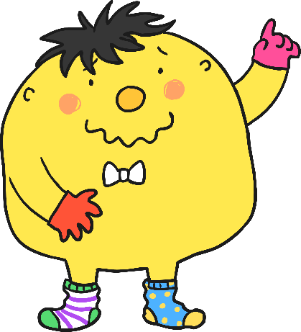
Mr. Whoops needs to practise these words:
favourite
remember
different
special
potatoes
promise
although
famous
disappear
accidentally
caught
woman
Thanks for your help! I’ll get practising these words if only I could find where I’d left my pencil!

Slide 4
Activity 2
Ocasionaly, I like to go for a walk in the countryside and look at the naturel beauty around me. I have a great inturest in wildlife. Theirfore, I often take my binoculars with me in case I nowtise any woodland birds or mammals. On a reacent trek, I herd a familiar call and I was lucky enuff to see ate woodpeckers all perched in one tree. What a wonderful suprise to acktually see such a rare species. Planet Eurth is really a delightful place!
Can you tell me which words do I need to practise?

Slide 5
Mr. Whoops needs to practise these words:
occasionally
natural
eight
interest
therefore
heard
recent
enough
surprise
actually
notice
earth
Thanks for sorting these for me…I do get myself in an awful muddle sometimes!

Slide 6
Activity 3
My most treasured posession is a dinosaur bone fossil, which I found while I was walking throogh caves in Wales. I don’t supposs it’s every day that you stumble upon something almost 65 million years old! It must have been there since the days of eurly man. At first I thought it was just some kind of stranje reflection from the water. I just couldn’t beleave that such an inportant piece of hisstory was right there in front of my eyes! The dinosaur probobly died in the shallow water and then got buried in the mud. The wayght of the mud and the preasure of the water caused the fossil to be formed over thousands of years. I considur it to be a fantastic find!
Can you tell me which words do I need to practise?

Slide 7
Mr. Whoops needs to practise these words:
possession
through
early
believe
important
suppose
probably
weight
pressure
consider
history
strange
Oooooo…didn’t I spell these correctly? It’s not like me to get myself mixed up!

Slide 8
Activity 4
I have a very bizzy year this year. There are lots of dates with a big sircle drawn around them on my calinder. In Feburary, I am going on an exstream sports holiday to take part in lots of sports, including hang-gliding, abseiling and water-skiing. It should be a fun expeareance! Hopefully in May, there will be a very special occatian when I finally move house. It has taken such a long time to bild. I am so looking forwerds to having a new addrres. In June, Grandad and Granny Whoops will arreave in England to stay for a few weeks. Hopefully, my new spare room will be compleet by then so that they have somewhere to sleep!
Can you tell me which words do I need to practise?

Slide 9
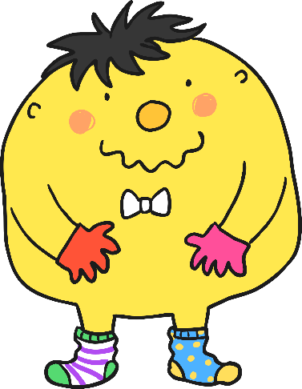
Mr. Whoops needs to practise these words:
busy
February
experience
forwards
arrive
extreme
calendar
build
occasion
address
complete
circle
Oops! I’ll get straight on with practising these!

Slide 10
Activity 5
Dear Diary,
What a day! It all started well…I was out happily riding my bisycle but I couldn’t deside whether to go up Badger’s Hill or take the oposite route into town. I thort that pedalling up the hill would give me more exersize so I turned left up the hill. A minuut later and in a blink of an eye, a nawty squirrel scampered strait into my path. I swerved to avoid the silly animal, got my shoelaces caught in my spokes, and ended up splat in the center of a cow pat in a nearby field. Can you imigine how embarrassed I was? It’s not like me to be so acsident prone,
I am sertain that I’ll have better luck tomorrow,
Mr. Whoops x
Can you tell me which words do I need to practise?

Slide 11
Mr. Whoops needs to practise these words:
bicycle
opposite
exercise
naughty
centre
imagine
decide
thought
minute
straight
accident
certain
It’s not like me to make mistakes. Are you sure?

Slide 12
Activity 6
Last week, I took part in a grammer and spelling competition at my local libry. You needed to posess very special skills to be crowned ‘English Expert of the Sentury’. Even thogh spelling is a big strenth of mine (as you already know!), going into the final round I was in eigth posision out of a groop of ten contestants. My hart was pounding and I could barely breethe as I read out my final sentance. Unfortunately, I only won a bronze medal. Maybe I’ll do better next year.
Can you tell me which words do I need to practise?

Slide 13
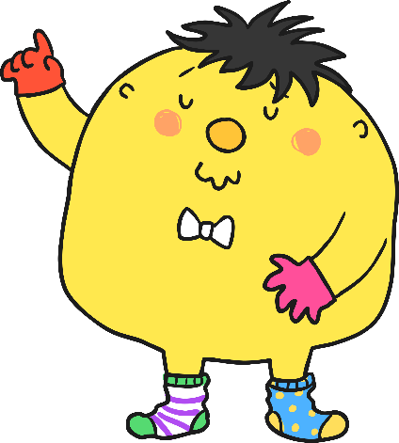
Mr. Whoops needs to practise these words:
grammar
possess
though
eighth
heart
group
library
century
strength
position
sentence
breathe
Oooooo…have I got myself in a jumble?

Slide 14
Activity 7
My most memorable day of school has to be the one particlar day when I almost blew up the science block. It started off as just an ordenary chemistry lesson where our teacher wanted us to lurn about how to seperate solid matereal from liquids. During the experement, a strange mist started to appeare from my test tube. Not to mension, the very piculiar smell. The next thing I knew…BOOM! There was an aktual explosion. I didn’t know it was even posible for liquid to reach such a great hight. It looked like a volcano exploding. Whoops!
Can you tell me which words do I need to practise?

Slide 15
Mr. Whoops needs to practise these words:
particular
learn
experiment
material
peculiar
possible
ordinary
separate
appear
mention
actual
height
There were some tricky words in this one. I’ll keep trying!

Slide 16
Activity 8
Last year, I was lucky enough to visit a popuwler Caribbean iland. While I was there, I went on a tour of a local rainforest. All around me were trees filled with exotic frut and stunning wildlife. Our tour gyde was full of knowlege about the forest and there wasn’t any qwestion that he couldn’t anser. He talked at lenth about deforestation and how a qwurter of the trees had sadly already been cut down. This is a terrible shame as some plants found there are of great importance for making medcine which kept the island in buziness. If they continuw to destroy it, then I might not ever get to return to that fabulous place.
Can you tell me which words do I need to practise?

Slide 17

Mr. Whoops needs to practise these words:
popular
business
guide
length
question
medicine
island
fruit
knowledge
answer
quarter
continue
Whoops-a-daisy! Did I make a little mistake?

Slide 18
Activity 9
Dear Diary,
Well today was far from a reguler day… I went to London with the sole purpoze of seeing The Queen. Her Majesty is one of the most famous womin in the world. Today was the great Trooping The Colour parade where the raign of Her Majesty is celebrated as well as her official birthday. Purhaps every person in London was there, or at least it felt like it with all the crowds and cheering. It was dificult to see and hear when the gards marched past and the noise began to increese even more when the crowd caught sight of The Queen herself. Varyous flowers were thrown onto her carriage and she offten waved at the onlookers. When she smiled directly at me, I can’t discribe the feeling that came over me - it took my breth away.
What a memorable day!
Mr Whoops x

Slide 19
Mr. Whoops needs to practise these words:
perhaps
various
difficult
increase
purpose
reign
breath
describe
guards
often
regular
women
Thanks for all your help…you’re spelling geniuses!

