Slide 1

Aim
I can use prepositions for time, place and cause.
Success Criteria
I can describe what a preposition is.
I can identify a preposition in a sentence.
I can sort prepositions into categories of time, place and cause.
I can use a preposition in one of my own sentences.

Slide 2
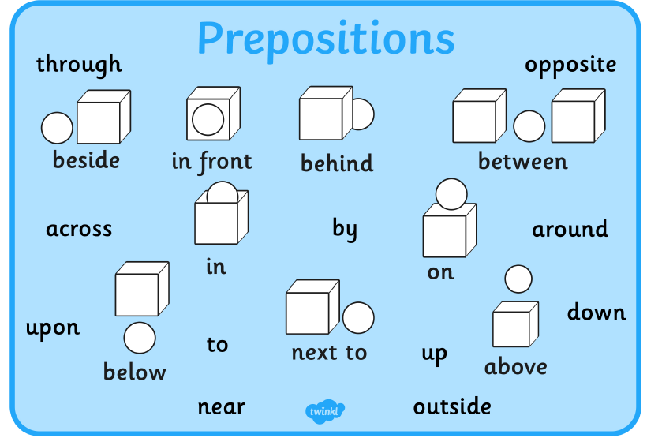
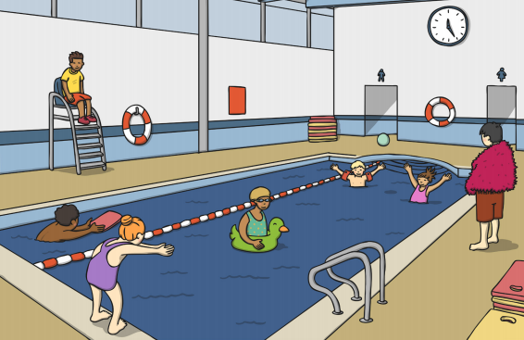
Write 3 sentences using a preposition to describe where the people are in this picture.

Slide 3

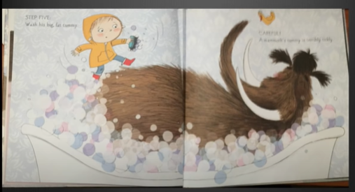
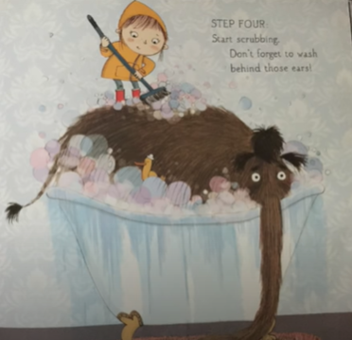
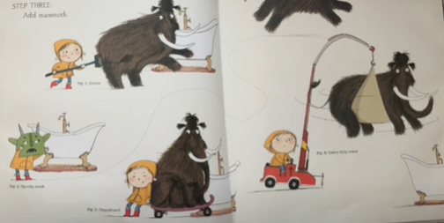
Watch the video: https://www.youtube.com/watch?v=pnO7W3tAlik
Write some sentences using prepositions to describe where the woolly mammoth is in these pictures:

Slide 4

Preposition Types
Together, sort these prepositions into place, time and cause.
under
in
on
because of
at
Time | Place | Cause
Hint: some prepositions might fit in more than one group!

