Slide 1
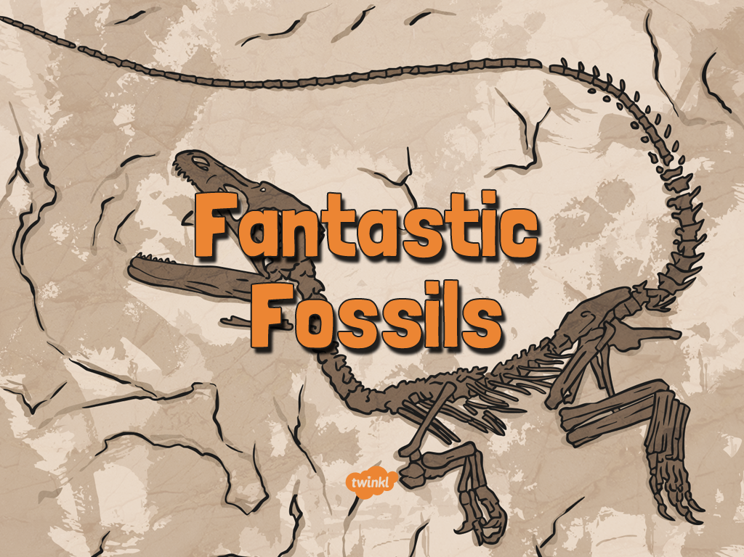

Slide 2
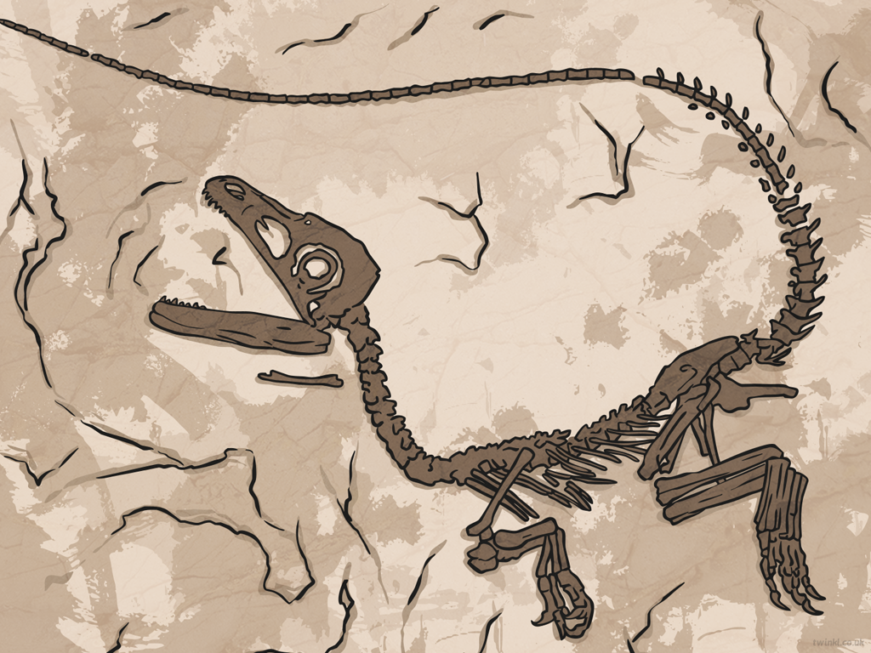
Aim
I can explain how fossils are formed.
Success Criteria
I can explain the difference between a bone and a fossil.
I can order the steps of how a fossil is formed.

Slide 3
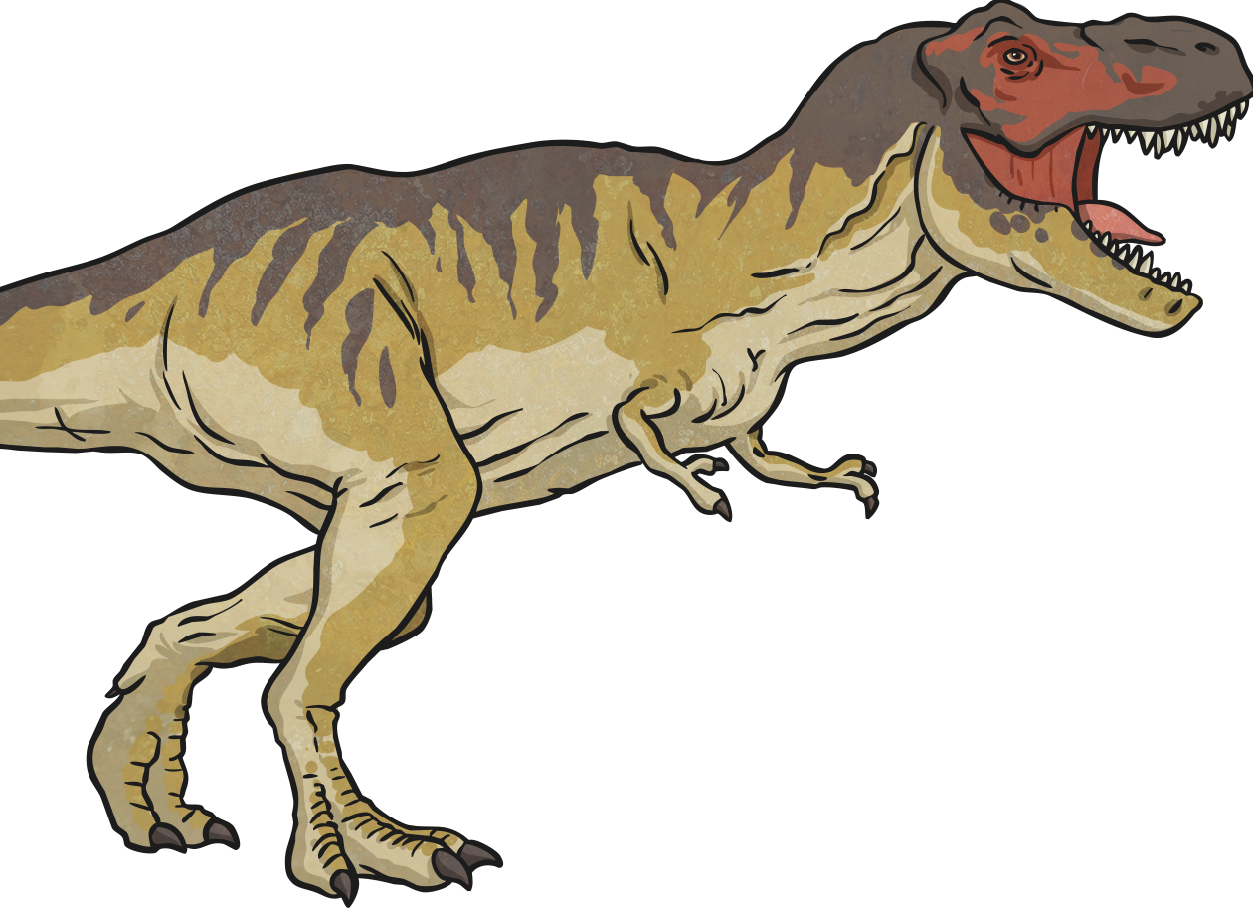
Are Dinosaurs Real?
Discuss the question with your talk partner.
What evidence do you have that they are real or not real?
Where does the evidence come from?

Slide 4
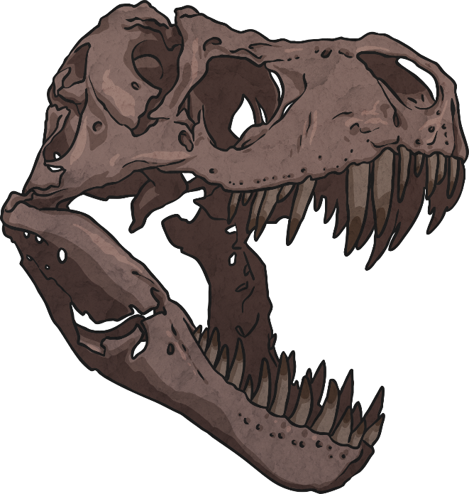
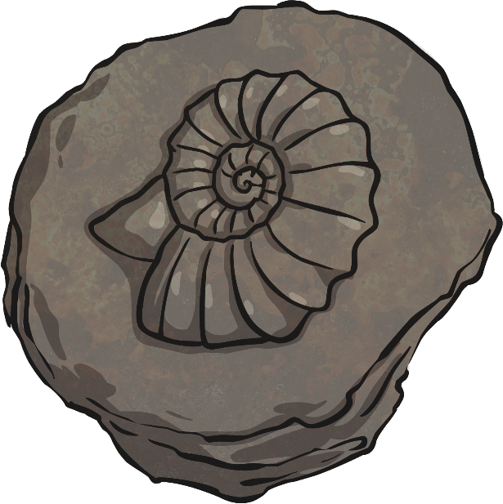
Are Dinosaurs Real?
It is believed that dinosaur fossils have been found for centuries and these gave rise to some of the mythical creatures in ancient cultures. However, without documented evidence we can not know this for sure.
What we do know is that our current knowledge of dinosaurs and palaeontology (the study of fossils) started in the 1800s. So we really have only known about them for the last 200 years! We know about dinosaurs due to the discovery of fossils and fossilised skeletons.

Slide 5
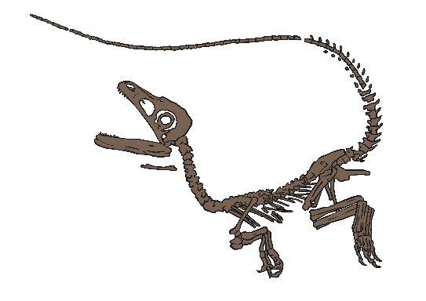
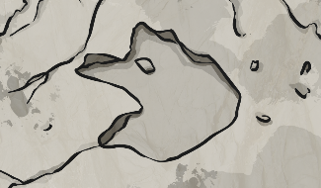
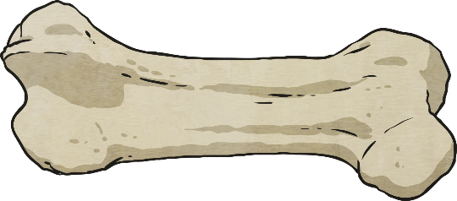
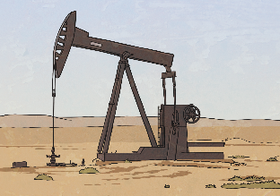
Bones or Fossils?
There are some key concepts we need to know before moving on.
What is the difference between bones and fossils?
Fossils
Fossils are more than
just ancient bones, which
is what many people think.
There are three types of fossils – body fossils, trace fossils and chemical fossils.
Chemical fossils
Chemical fossils contain carbon, which is proof that they must be formed from once living things. Examples of chemical
fossils include coal,
petroleum oil and
natural gas.
Bones
Bones are any piece of the hard whitish tissue that makes up the skeleton in animals including humans.

Slide 6
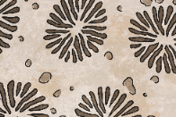
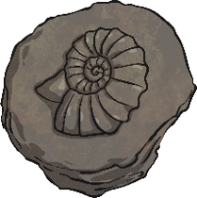
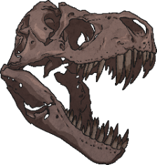
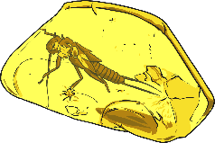
Body Fossils
Body fossils are the remains of an animal or plant such as bones, shells or leaves.
There are three types of body fossils:
Mold and Cast Fossils
Mold fossils form when all the parts (including the bones) have decayed and all that is left is the mold of the animal.
Cast fossils form from mold fossils as the mold fossil is filled up with sediment – so it is not made up of the original matter of the animal or plant.
Replacement Fossils
Replacement fossils form when water dissolves the original hard matter of the bones and replaces them with mineral matter – this is what we think of when we discuss dinosaur fossils. They still look like the original bones but are not made up of the same matter.
Whole Body Fossils
Whole body fossils form when the original body has been preserved – for example a woolly mammoth in ice or a mosquito in amber.

Slide 7
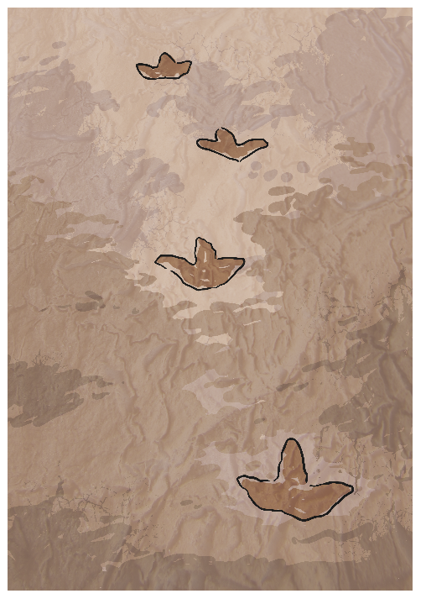
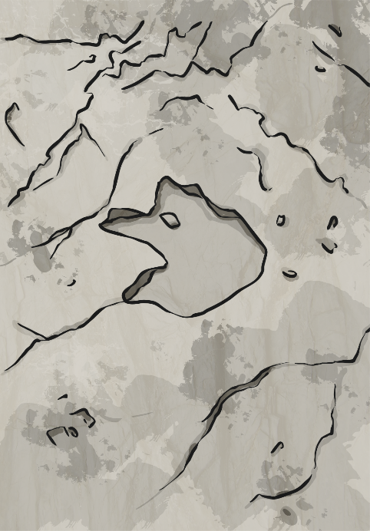
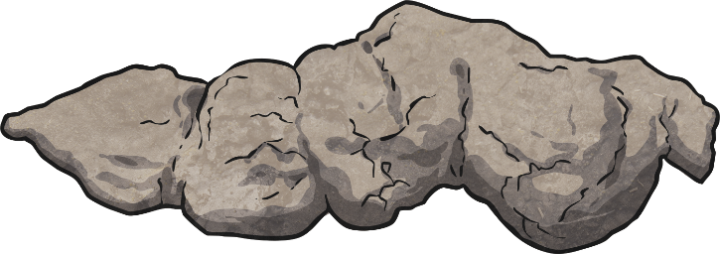
Trace Fossils
These are fossils that record the activity of an animal including:
Footprints
Trackways
Coprolites
(fossil faeces)

Slide 8
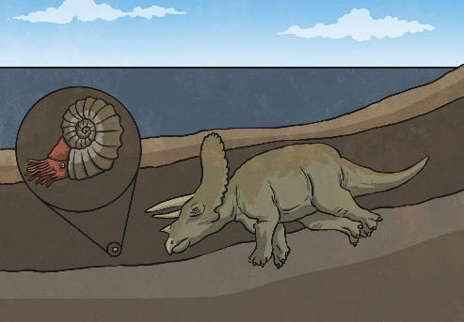
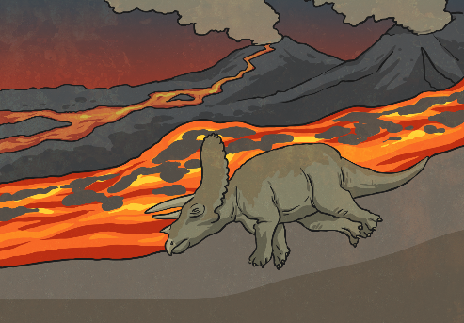
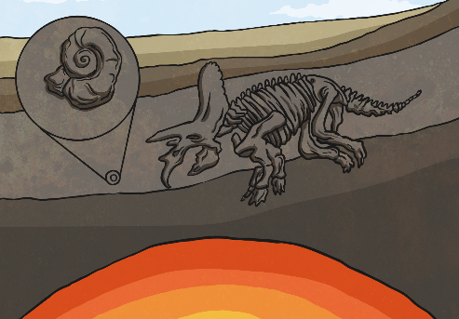
Fossilisation Process
There are many different ways that fossilisation occurs. However, you will focus on how fossils form in rocks (both body and trace fossils).
Fossilisation only takes place in sedimentary rocks as the heat from the lava that creates igneous rocks and changes the structure of metamorphic rocks would be too high for fossils to survive.

Slide 9
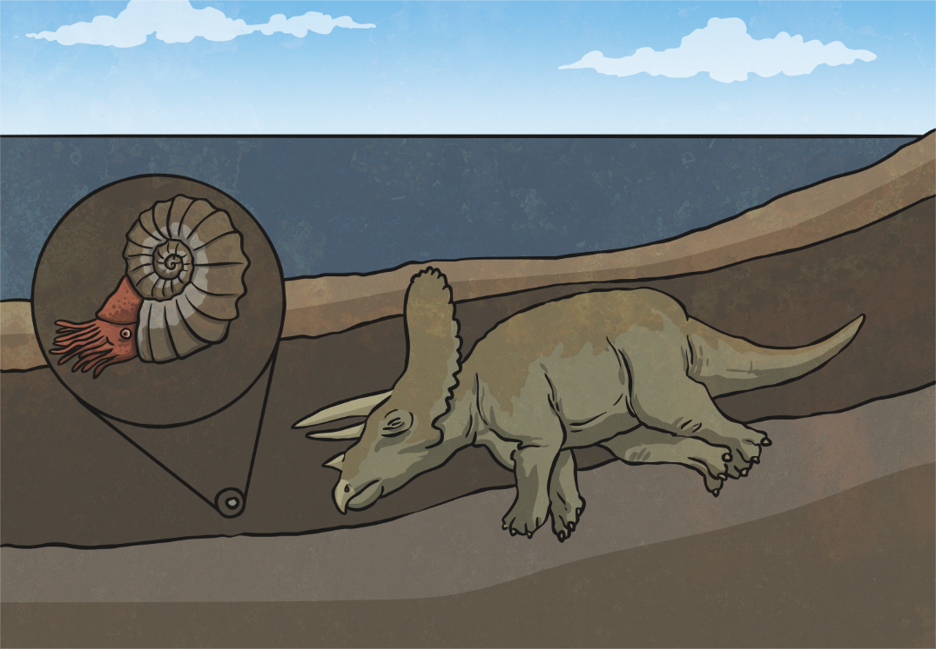
Fossilisation Process; Step 1
An animal or creature dies on land or in the sea and it gets covered by a layer of sediments (e.g. plant material and tiny parts of rock or soil etc). Over time, through compaction and cementation (solidifying), these eventually form a layer of rock.

Slide 10
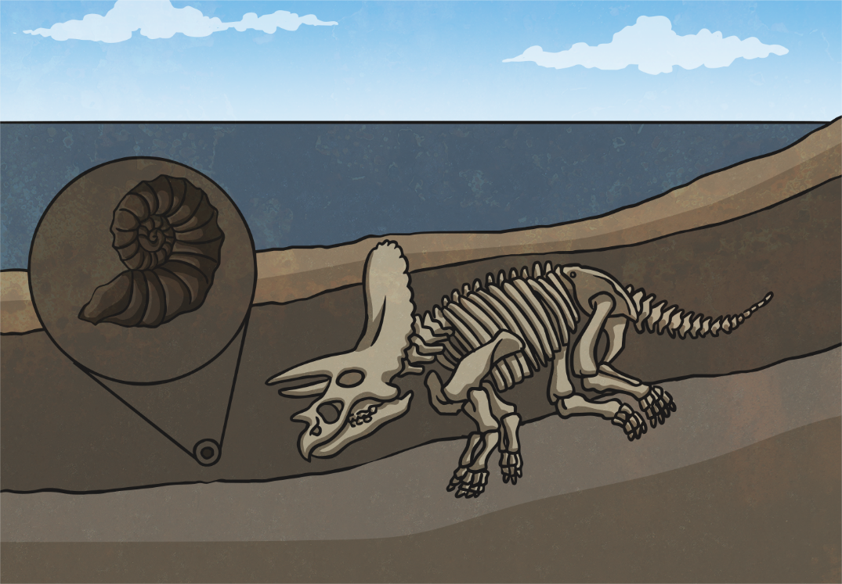
Fossilisation Process; Step 2
Over time more layers of rock are formed which cover it and by this time the only thing to remain of the organism would be the hard parts such as bones, shells and teeth.

Slide 11
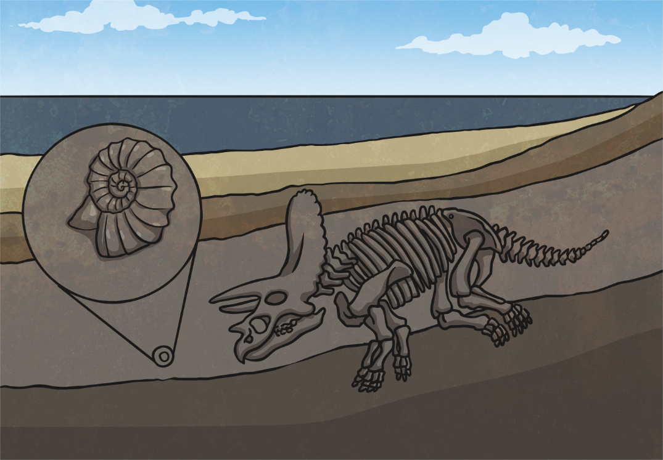
Fossilisation Process; Step 3
Over thousands of years the mold fossil might become a cast fossil with sediment entering the mold. In the case of replacement fossils, the original bone matter changes to mineral matter but this does not affect the shape of the bones.

Slide 12
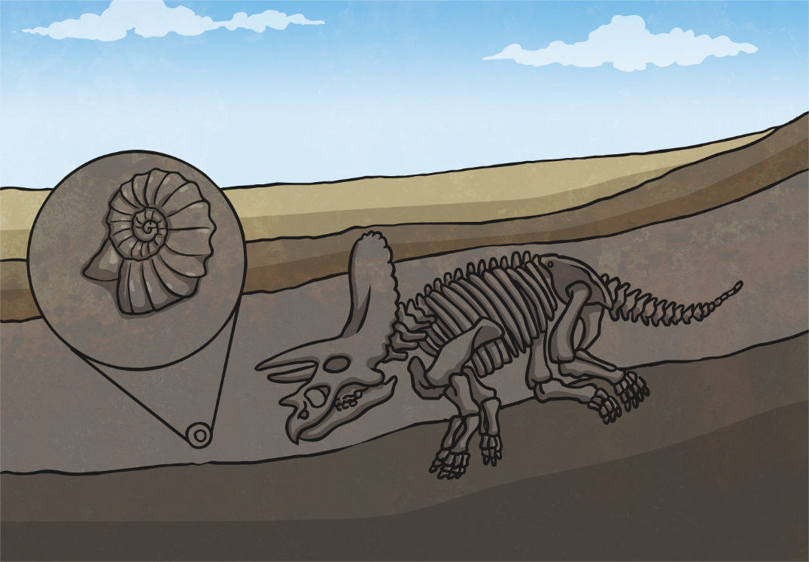
Fossilisation Process; Step 4
Over a long period of time the sea will recede in certain places. The sea level could also be changed quickly through earthquakes and volcanic eruptions.

Slide 13
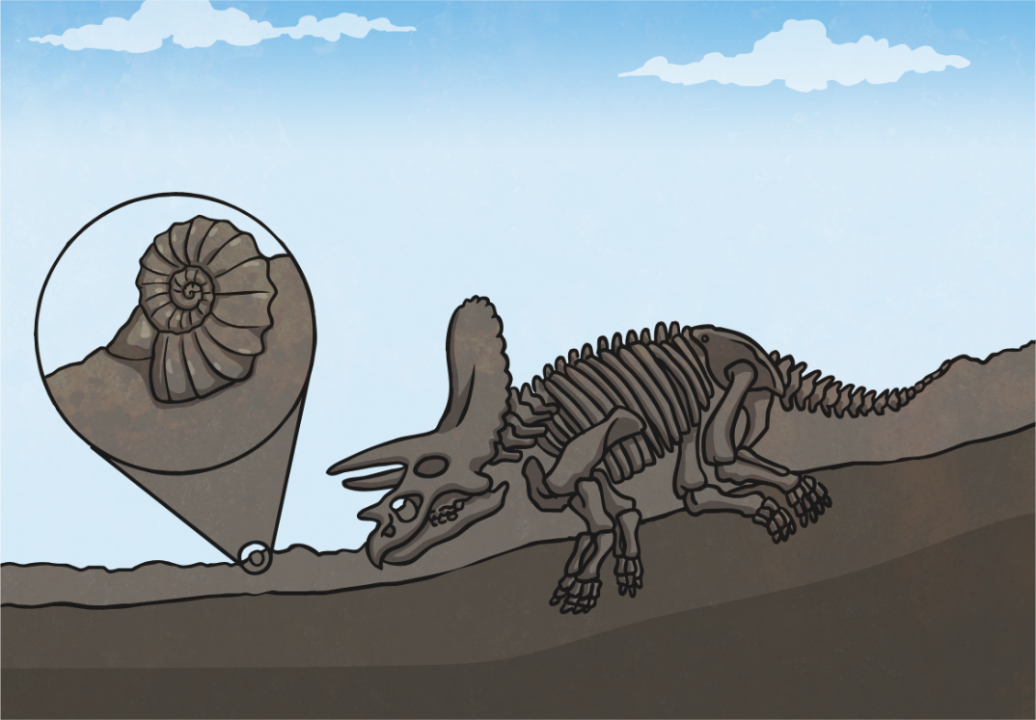
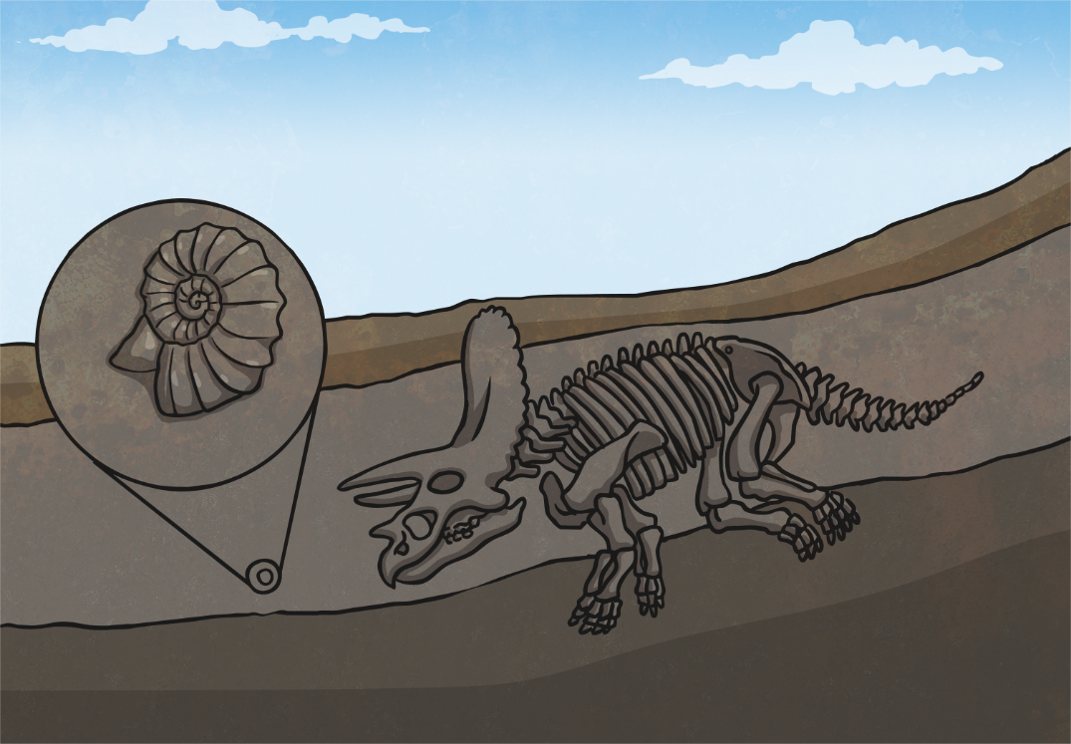
Fossilisation Process; Step 5
As erosion and weathering takes place, eventually the fossils become exposed.

