Slide 2
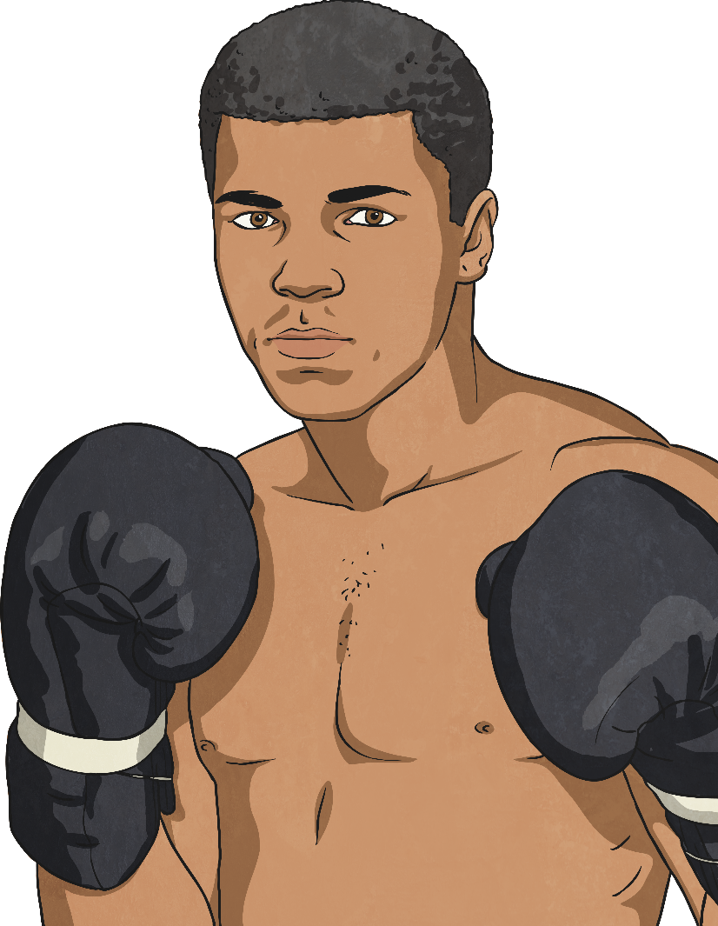
History of Black Athletes
Black athletes have always been part of sporting history, but for some, especially in the 1960s, they have had to compete despite the racial discrimination that was going on at the time. Maybe others were weaker would have bowed
to pressure and not put themselves in the spotlight?
What do you think?
What might it have been like for a black athlete in 1960s America?

Slide 3


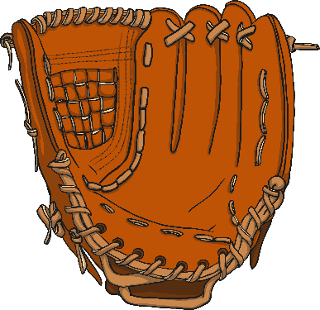
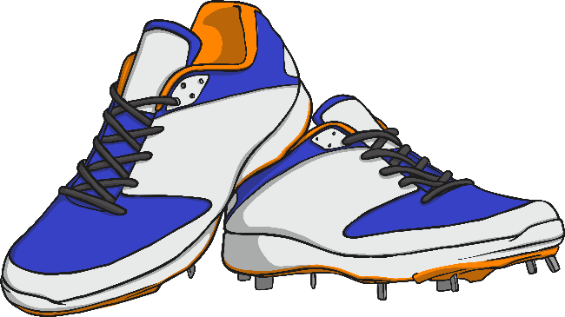
Segregation
Segregation means to be separated and in America in 1903 – 1946, black players were not allowed to take part in organised baseball.
Black leagues were set up and these produced some of the greatest baseball players of all time.
Thankfully now, segregation in sport is a thing of the past.

Slide 4
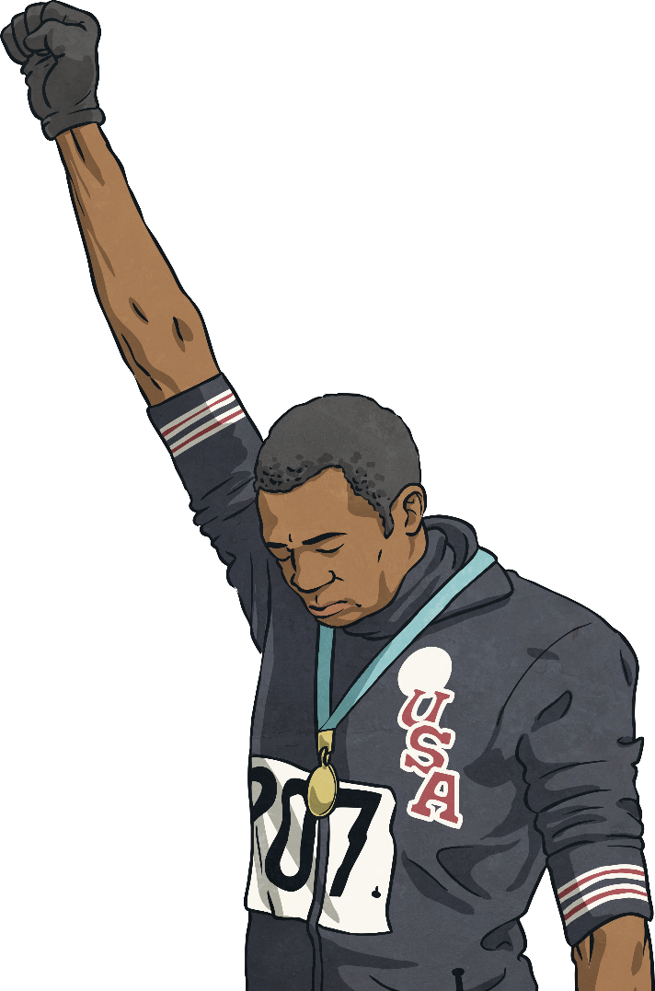
Protest at the Olympics
At the 1968 Olympics in Mexico, two black American athletes called Tommie Smith and John Carlos held a silent protest during the medals ceremony.
They had won gold and bronze medals in the 200m. During the National Anthems, they stood with their heads bowed and one hand raised to protest about the racial segregation in America at that time.

Slide 5
Protest at the Olympics
The Olympic committee condemned the actions and the two athletes were suspended and sent home. Many people were upset that politics had crept into the games.
They received death threats on their return to America, but the Olympic Project for Human Rights carried on and now this action is seen as a significant step forward in the Civil Rights Movement.

Slide 6
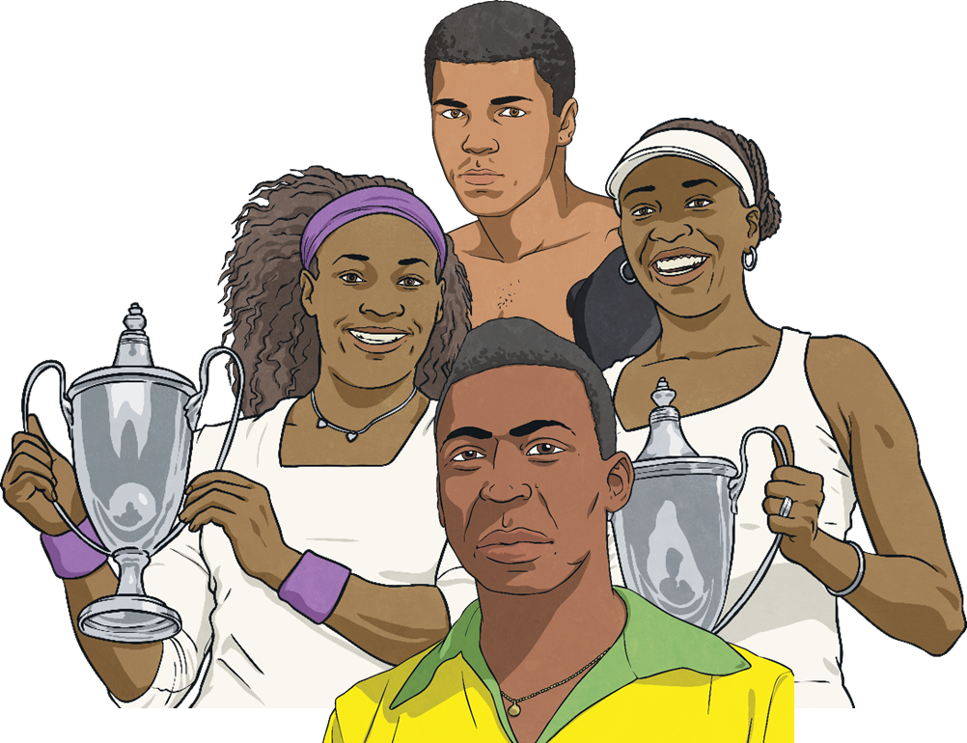
Sporting Firsts

Slide 7
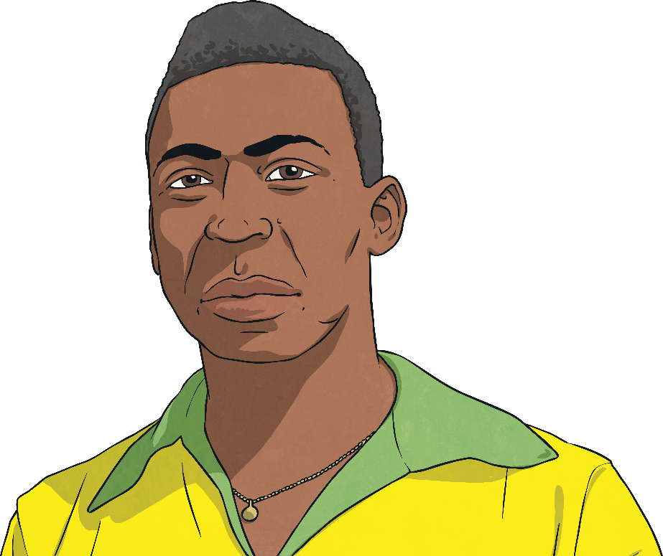
Sporting Firsts
Pelé
Pelé is a retired Brazilian footballer and known to many as the greatest footballer of all time.
He is the most successful league
goal-scorer in the world, with 541 league goals.
During his career, he scored 1281 goals in 1363 games and was listed in the Guinness World Records for most career goals scored in football.
In Brazil, he is a national hero for his footballing career and his work to improve the social conditions of
the poor.

Slide 8
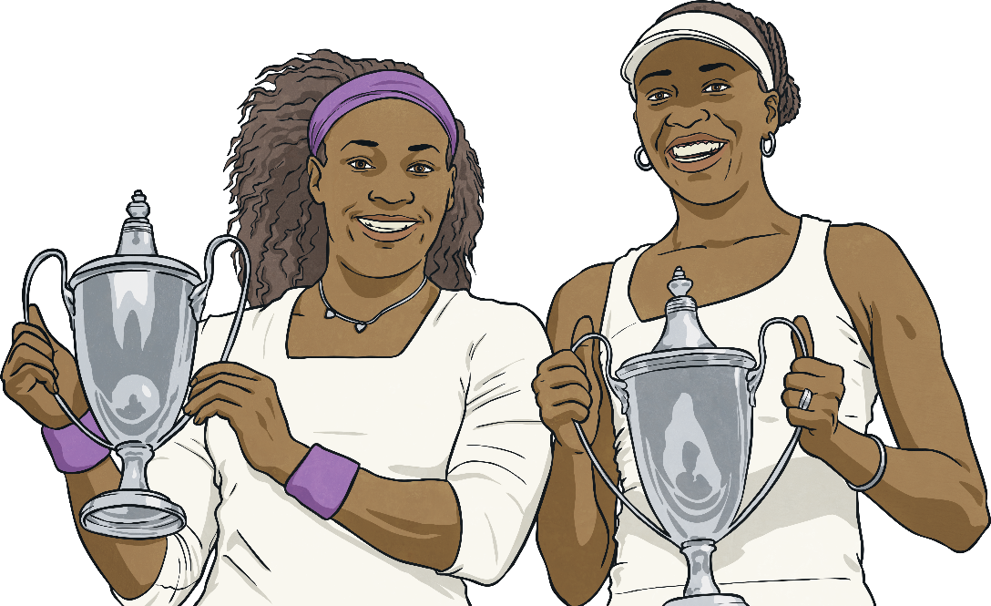
Sporting Firsts
The Williams Sisters
Venus and Serena Williams are American tennis players and both are in the top 10 most successful female tennis players of all time.
They have won Olympic gold medals in doubles tennis as well as numerous grand slam doubles titles. They have even played against each other in nine grand slam singles finals.
Serena has won an amazing 23 grand slam titles, more than any male player!

Slide 9

Sporting Firsts
Muhammad Ali
Muhammad Ali was an American Olympic and professional world-class boxer. He was also an activist and involved in the 1960s Civil Rights Movement in America.
He is regarded as one of the greatest sportsmen of all time and the BBC named him the Sportsman of the Century in 1999.

Slide 10
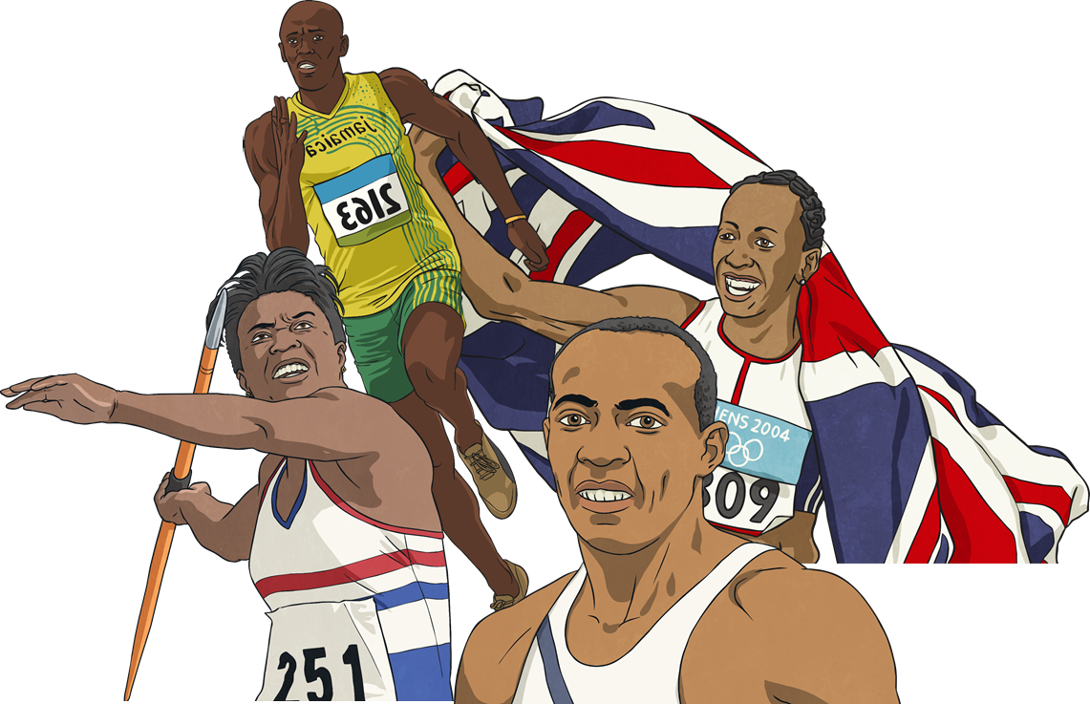
Amazing Olympians

Slide 11
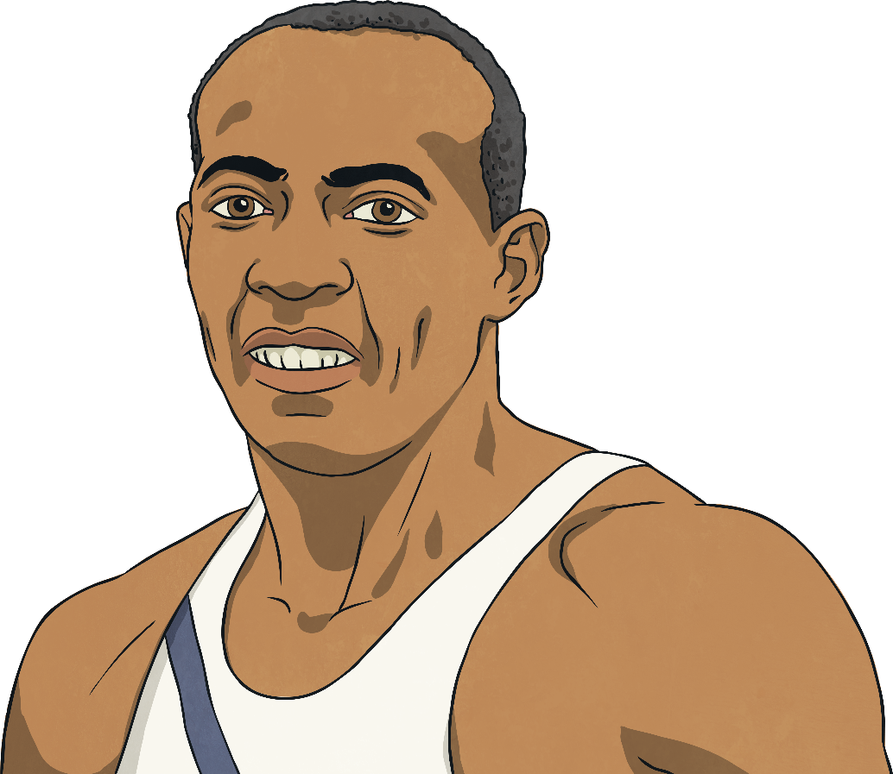
Amazing Olympians
Jesse Owens
Jesse Owens competed in track and field events at the 1936 Olympics which were held in Germany. This was just a few years before the Second World War. Tensions were high and Hitler wanted to use the games to prove that white people were better. Jesse proved him wrong and went on to be the most successful athlete of the games, winning four gold medals.

Slide 12
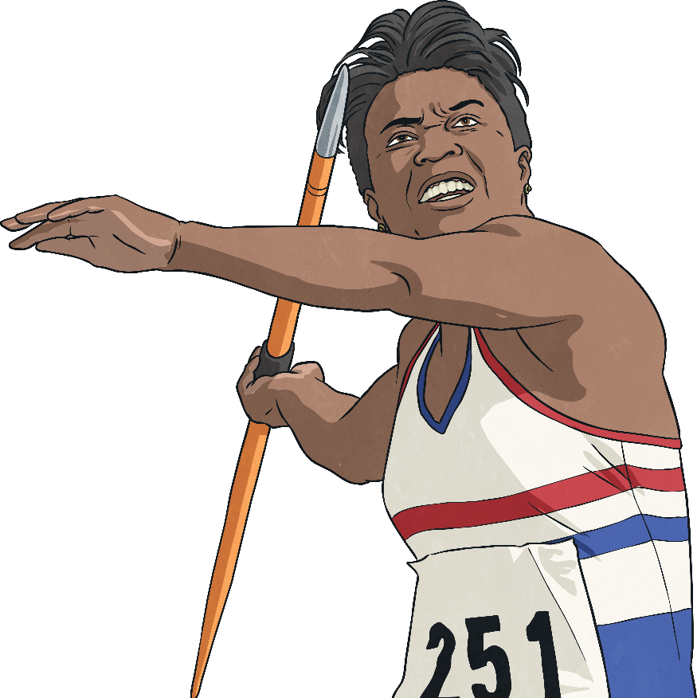
Amazing Olympians
Tessa Sanderson
Tessa is a British javelin thrower who is still the only British woman to win a throwing gold medal when she won at the Olympics in 1984.
She competed in six Olympic Games from 1976 to 1996 and also won three Commonwealth Golds and a World Cup Gold in Cuba in 1990.
In 2004, she was awarded the CBE by Her Majesty The Queen in recognition of her services to sport.

Slide 13
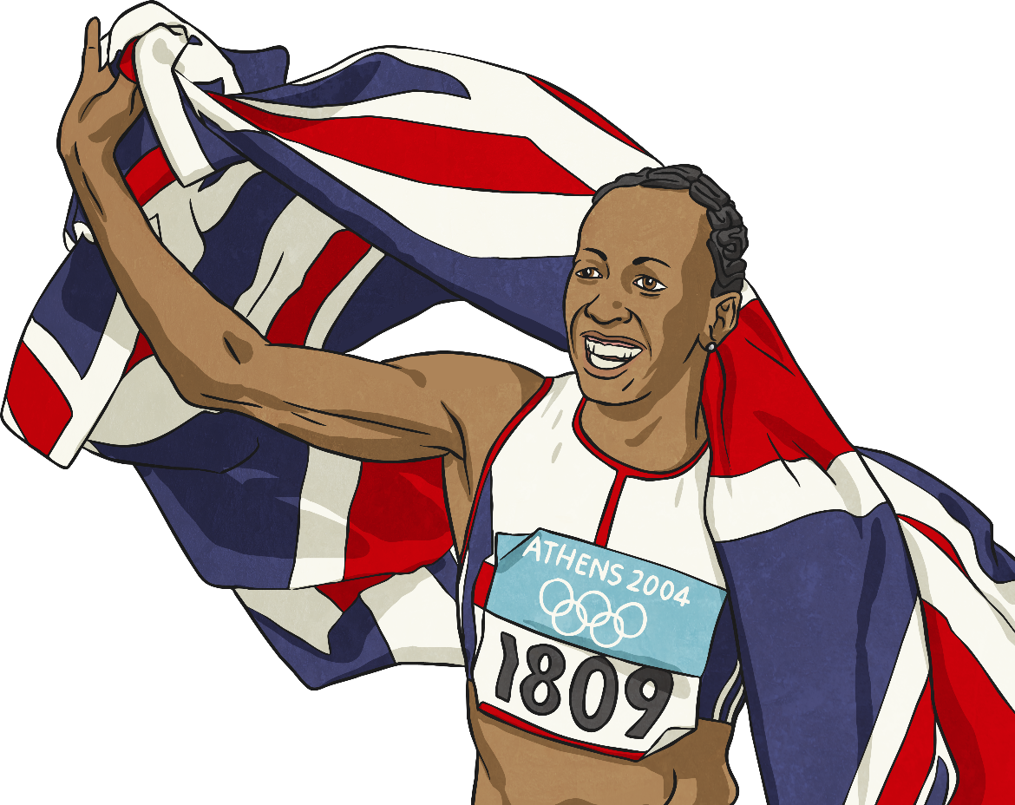
Amazing Olympians
Dame Kelly Holmes
Kelly Holmes became the first British woman to win two gold medals after winning both the 800m and 1500m at the 2004
Athens Olympics.
She was named BBC Sports Personality of the Year in 2004 and made a dame by The Queen in 2005.

Slide 14
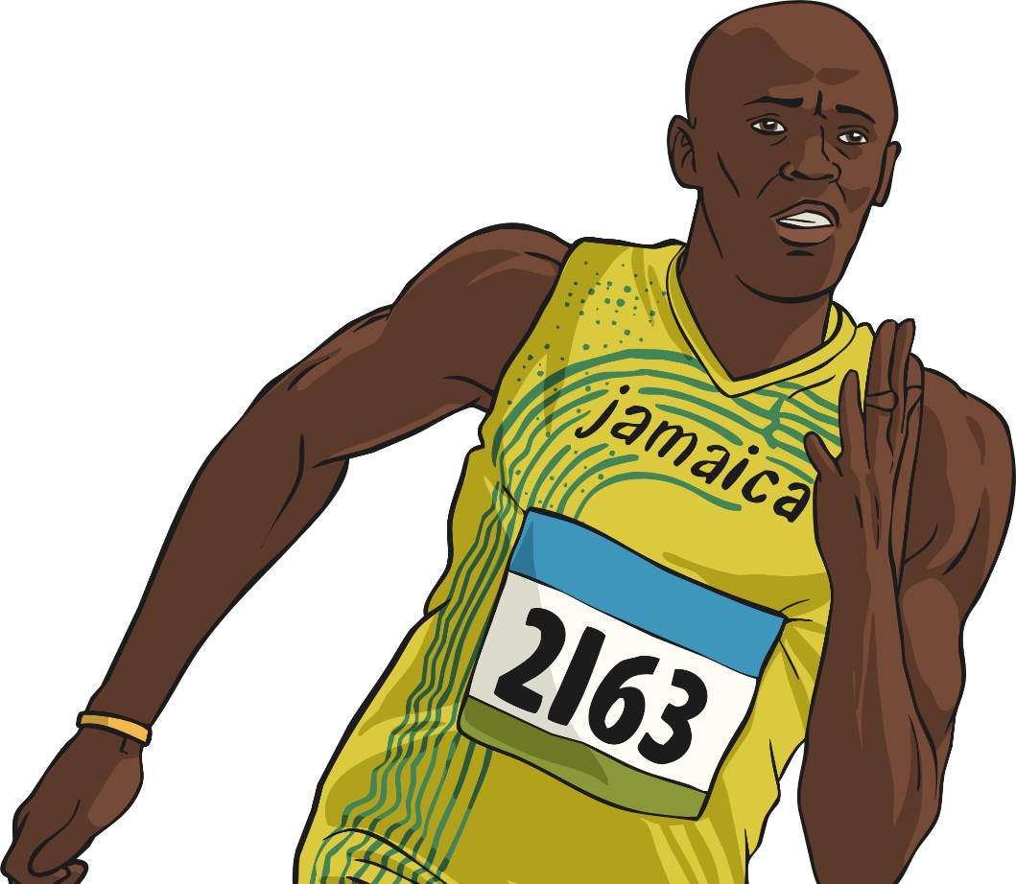
Amazing Olympians
Usain Bolt
Usain Bolt is a Jamaican sprinter. Widely known as the fastest person on Earth, he is the first man to hold both the 100 metres and 200 metres world records since records began.

