Slide 2
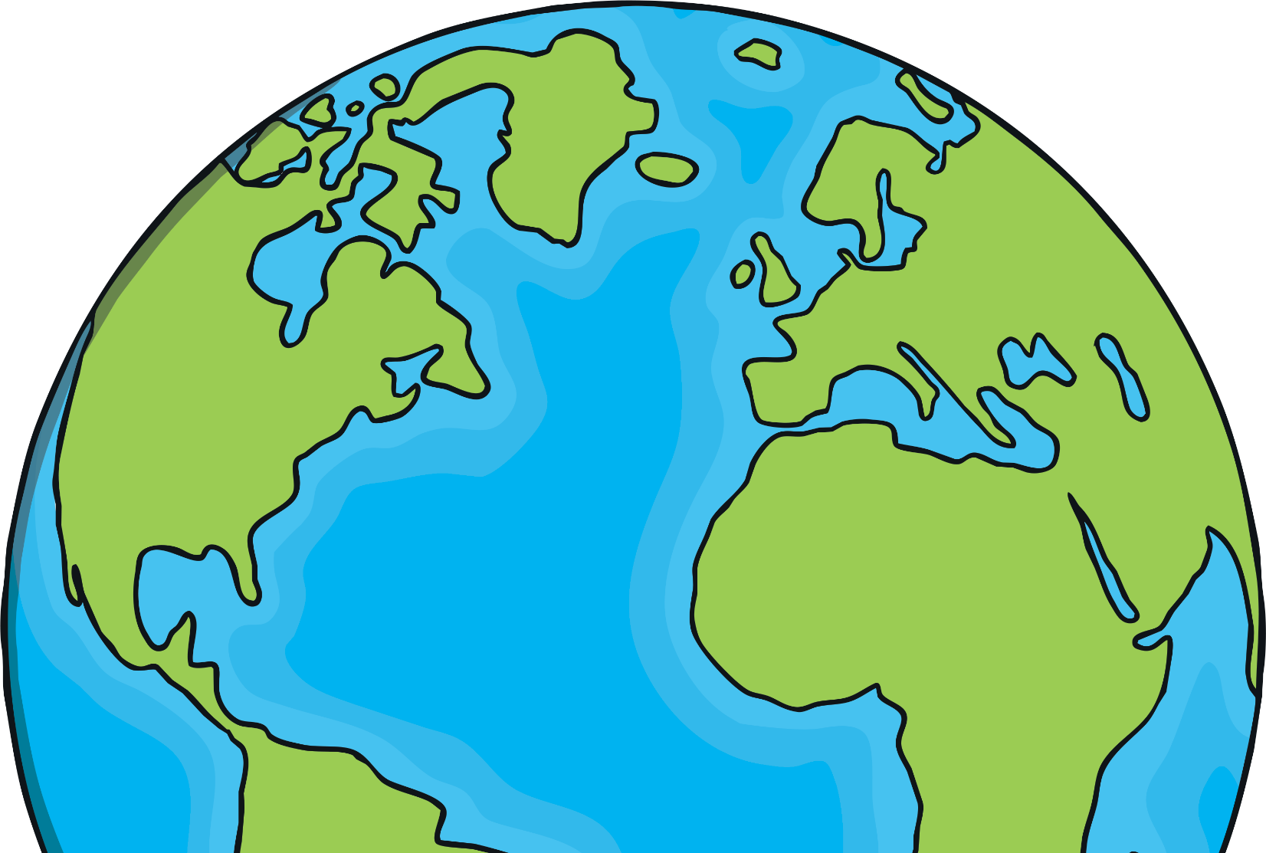
What is a Need?
A need is something which is essential in order to live.
It is necessary for survival and something you can’t live without.

Slide 3

What is a Want?
A want is something you would like to have which would make your life more comfortable or enjoyable.
It is not necessary for survival and you can live without it.

Slide 4
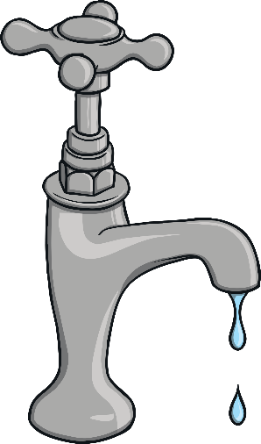

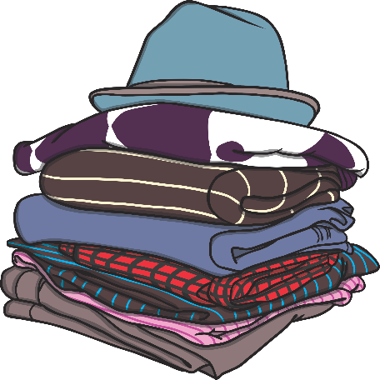


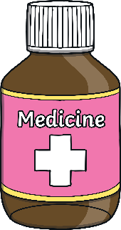


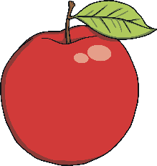
Needs include:
Water
Clean Air
Clothes
Shelter
Food
Medical Care

Slide 5


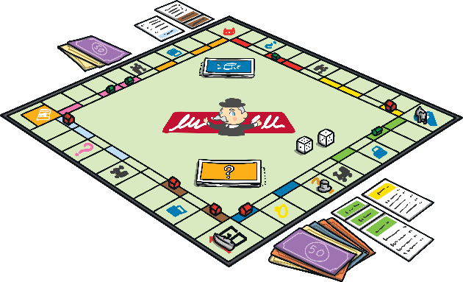



Wants include:
TV
Games
Mobile Phones
Computer Games
Designer Trainers
Sweets

Slide 6
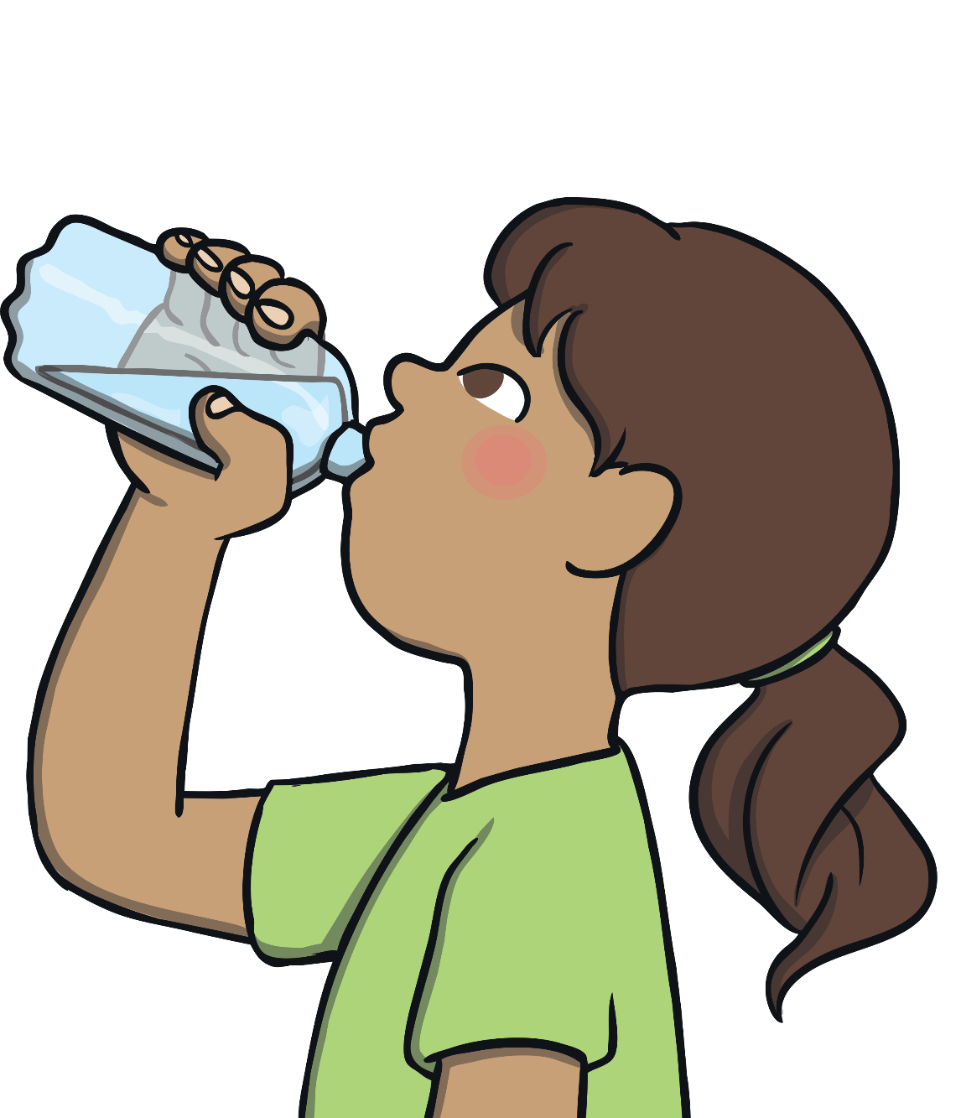
Clean Water
Clean water is needed by all living things to survive.
A person will not live for more
than a few days without it.
It is needed to keep the body
healthy and working properly.
Drinking water makes our brain
work better and faster.
We need clean water to drink,
cook, wash ourselves and
clean our clothes so that we
won’t get sick.

Slide 7

Shelter
Shelter protects people from the weather such as cold temperatures, hot temperatures, wind, rain, snow and ice.
It protects people from
animals and other
human beings.
Shelter is also used to
keep food, clothes and
possessions safe.

Slide 8

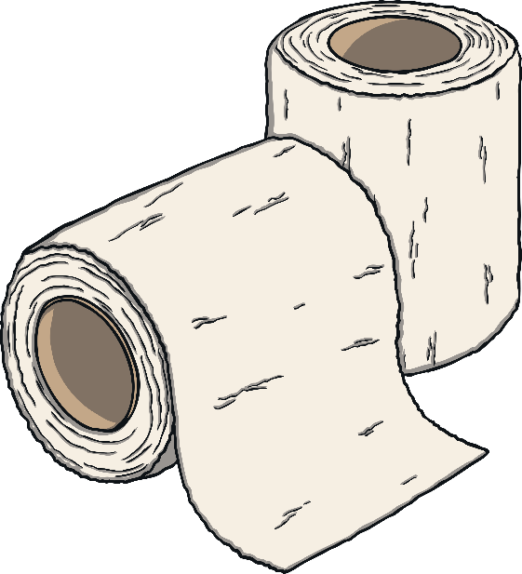
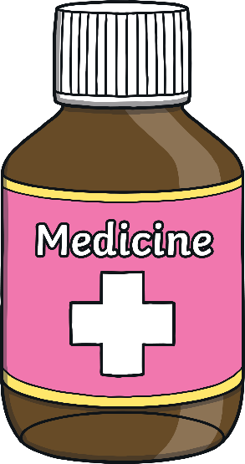
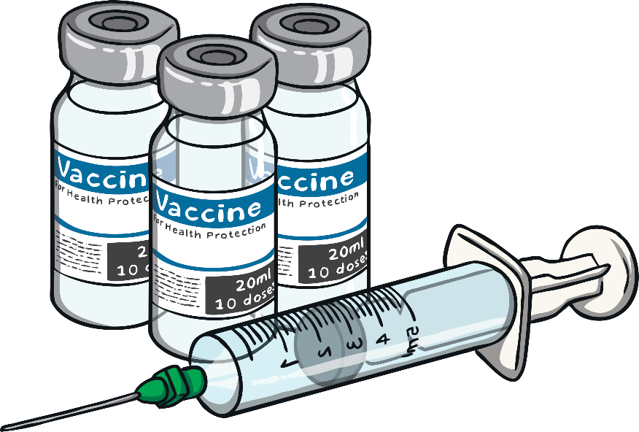
Medical Care
Medicine and medical care are needed if we get ill.
They can stop and cure disease.
The right medicine can stop pain and save lives.
It can help people have a better quality of life and keep them healthy.

Slide 9
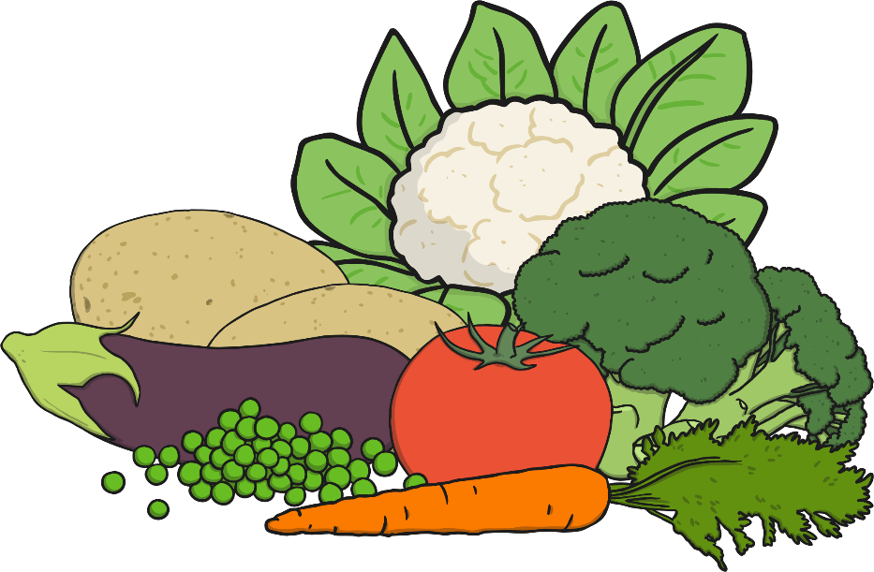

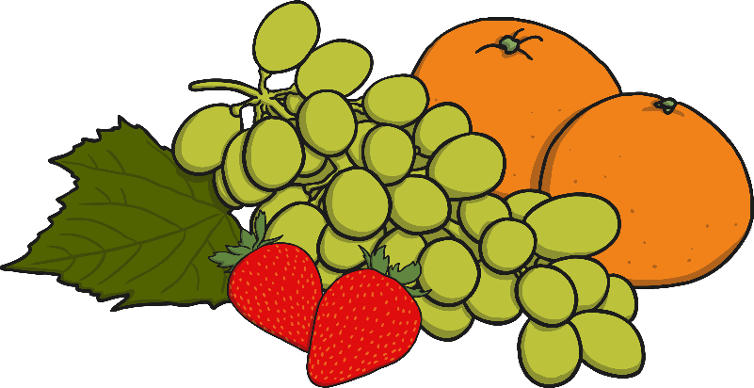
Food
Food is fuel for the body.
We need it to survive and without it we will die.
Food gives the body energy.
It helps the body to grow, repair itself and stay healthy.
A healthy balanced diet will help the body stay strong,
fit and help fight infections.

Slide 10

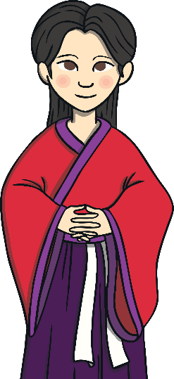


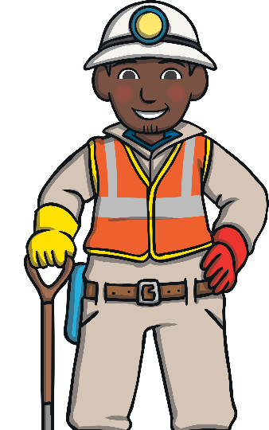
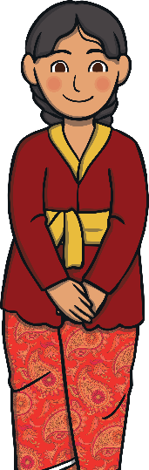
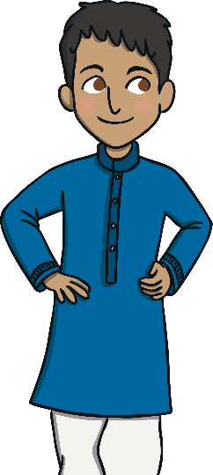
Clothes
Clothing is a basic need.
Clothes keep people warm or cool.
Clothes keep people clean.
Clothes help to protect your skin.
Clothes provide protection from the sun’s harmful rays.
Clothes help people to be comfortable and prepared for daily life.

Slide 11
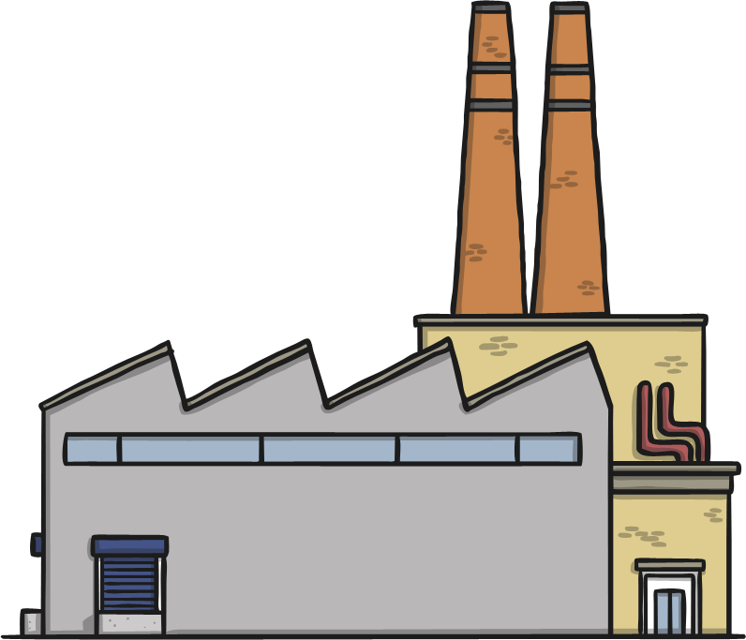
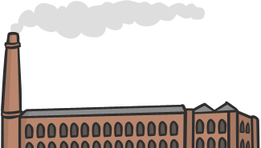

Clean Air
All living things need clean air to survive.
Human beings need to breathe in oxygen in order to survive and the air around us gives us the oxygen we need.
Plants, trees, and grass produce the oxygen we need to breathe and survive.
Breathing clean air helps to keep us healthier.

