Slide 1
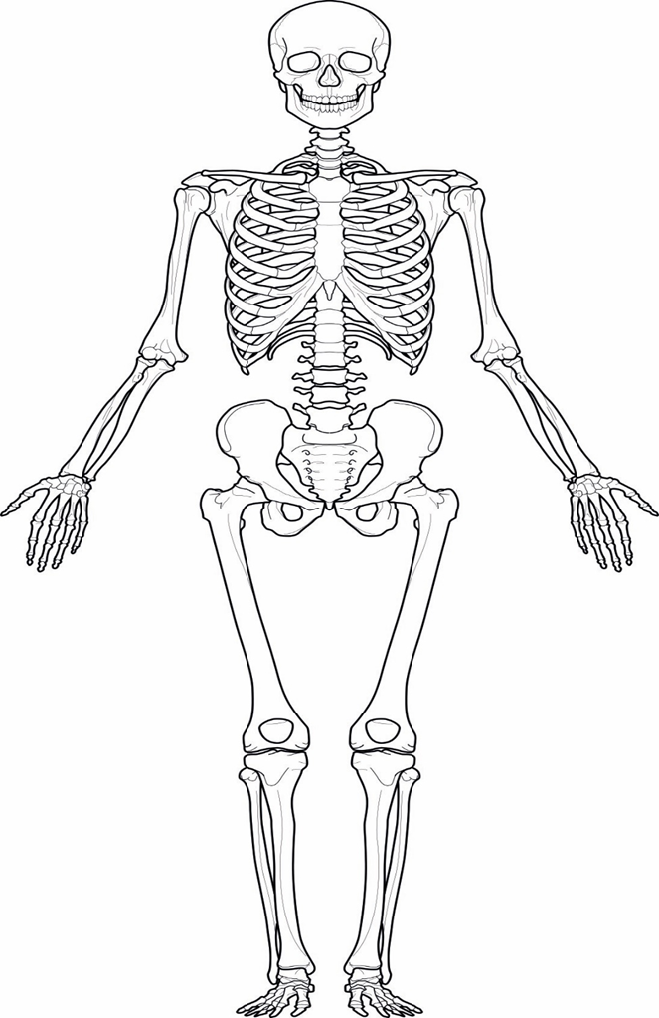
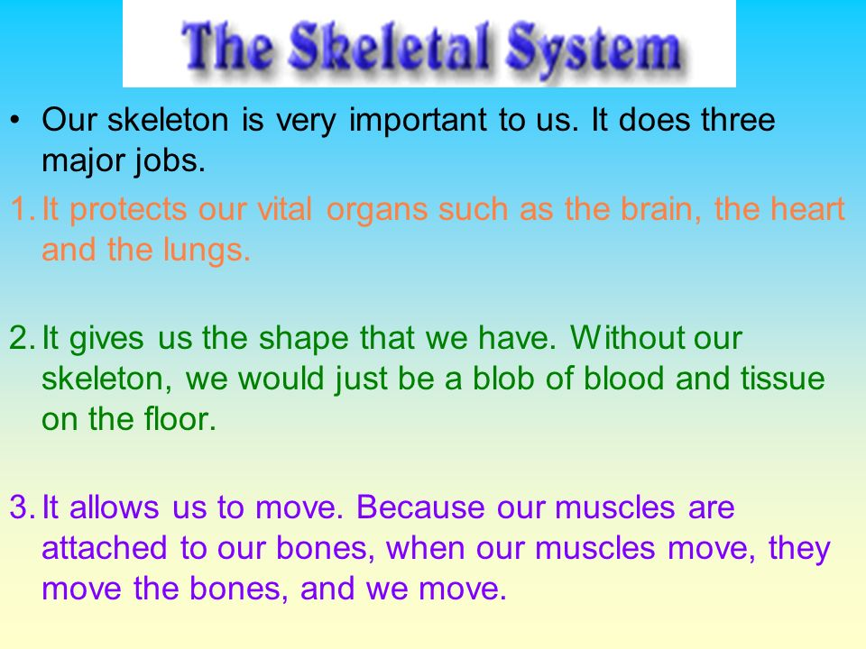
Task:
To list where we have bones in our body
To guess how many bones we have in our body
To guess where in our body we have the most amount of bones
Extension: To self asses your work by using the internet to research the answers
LO: To learn the why the Skeleton is important
*Play ‘The Skeleton Dance’ song on Youtube

