Slide 1


Computing
Online Safety
Year One
Computing | Year 2 | Online Safety | Digital Footprints | Lesson 1

Slide 2
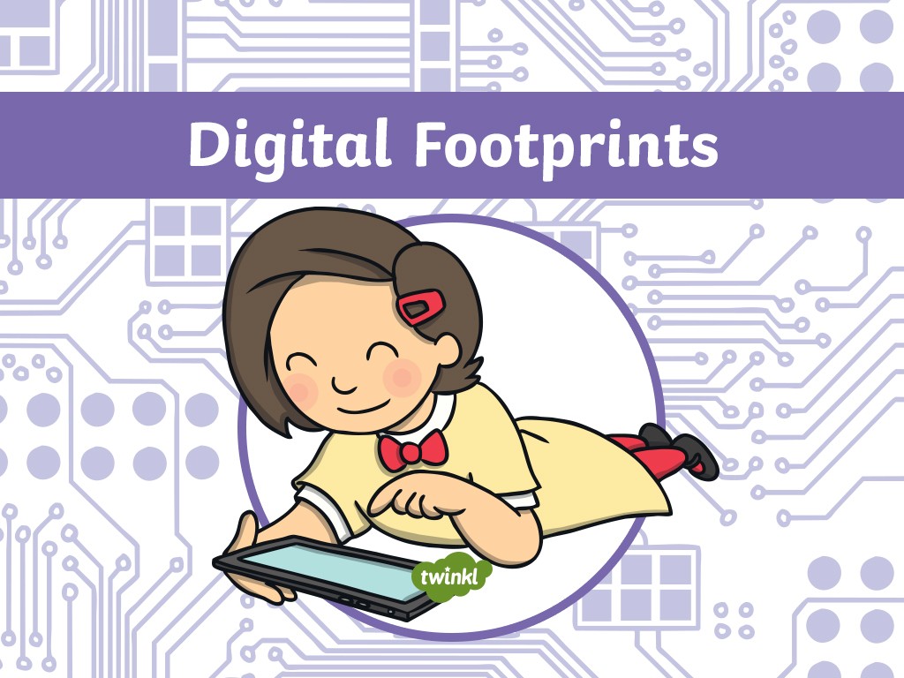

Slide 3
Aim
To understand that the information I put online leaves a digital footprint.
Success Criteria
I can explain what ‘digital footprint’ means.
I can explain how people might use the information I put online.
I can explain how a digital footprint contains information about a person.

Slide 4
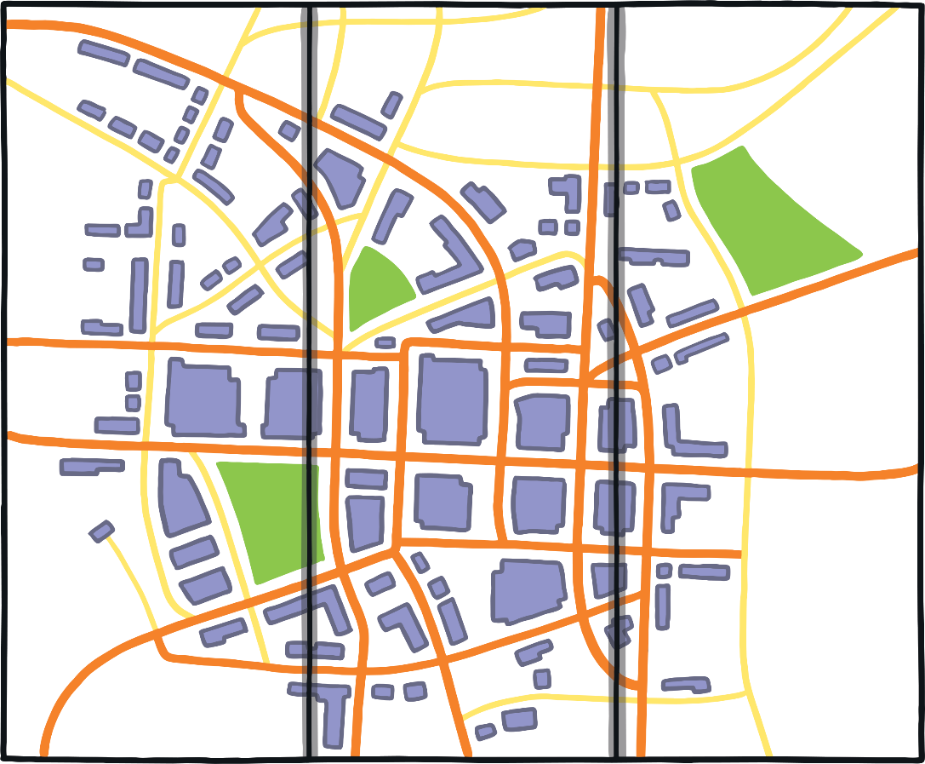
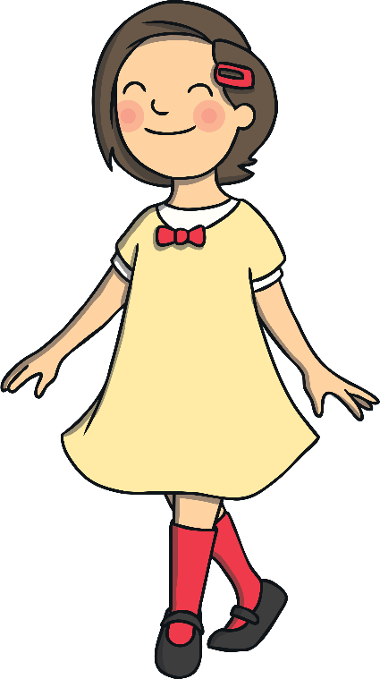
Footprints
Look at Penelope’s footprints. On your piece of paper, list the places she has been.
ice cream
shop
school
swimming
pool
football club

Slide 5





Footprints
We can tell some things about Penelope by looking at where she has been.
What sports might she like watching or playing?
What type of food might she like?
How old could she be?
Tasty Treats Ice Cream
Football Club
Swimming Pool

Slide 6

Digital Footprints
When we go online, everything we do leaves a ‘footprint’ that other people can see, even if it’s not something you have posted somewhere publicly.
What does the word digital mean?
Digital means anything to do with computer technology.

Slide 7


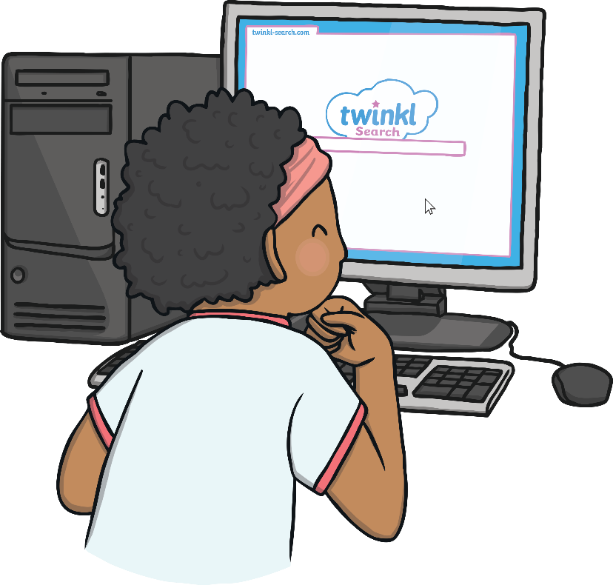
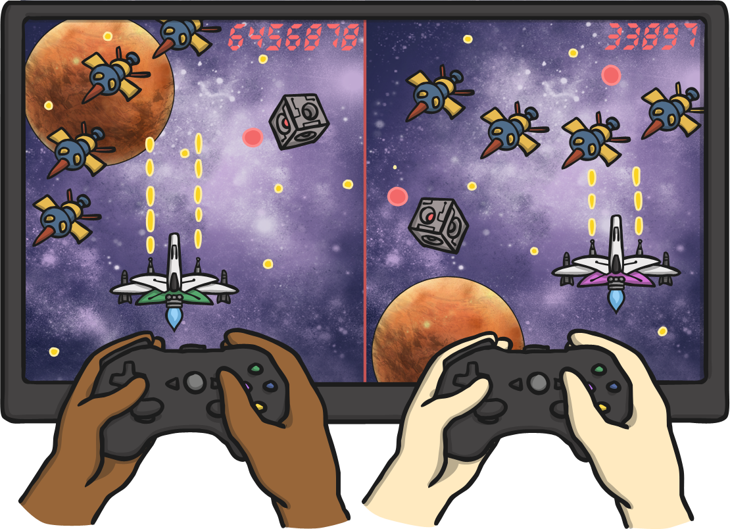
Digital Footprints
Can you tell me something that you have done online in the last week?
What might this tell us about you?
Who can explain what ‘digital footprint’ means?

Slide 8
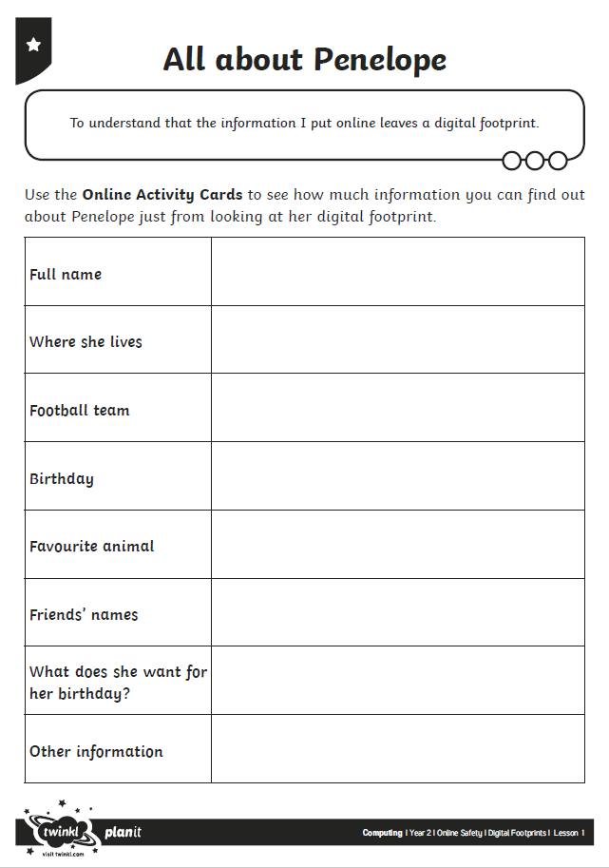

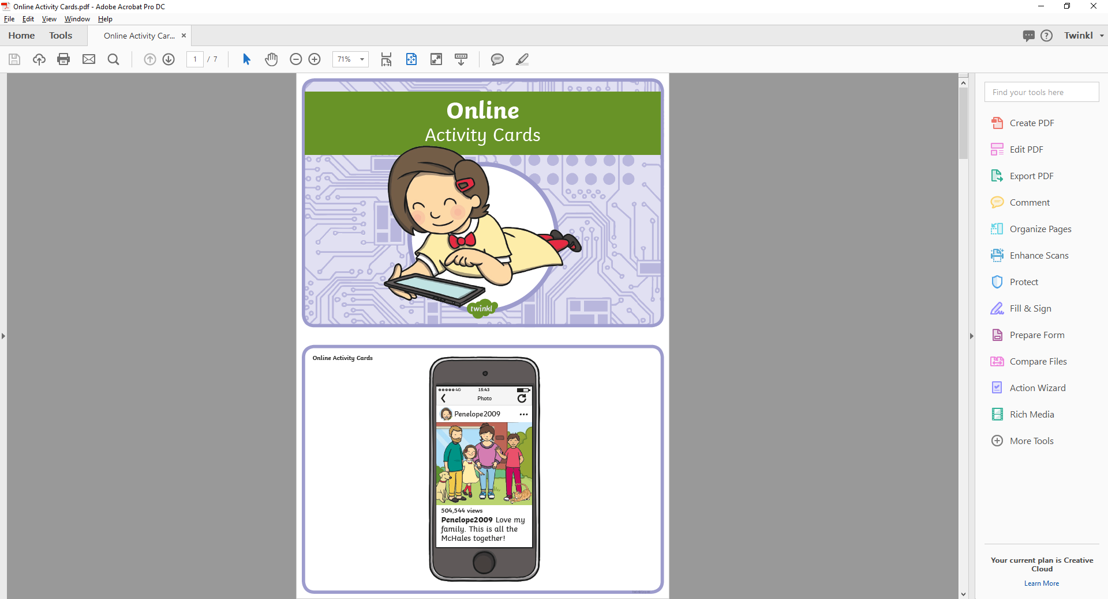
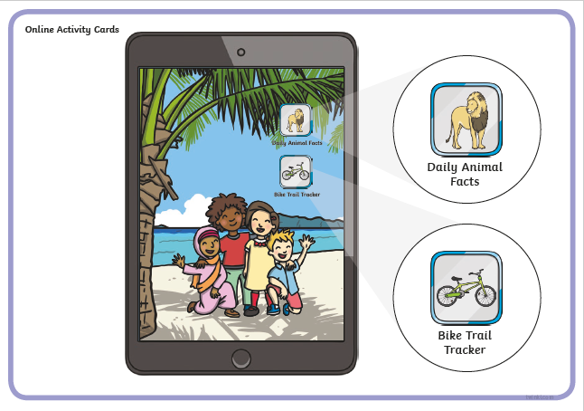
All about Penelope
Look at the Online Information Cards that Penelope has left on her trail.
As you go, use the information that you find out to help fill in the All about Penelope Activity Sheet.

Slide 9

How Much Do We Know?
What do we know about Penelope now?
What is her full name?
What town does she live in?
What house number does she live at?
What football team does she play for?
What might she want for her birthday?
When is her birthday?
What animals is she interested in?
What are her friends called?

Slide 10

How Much Do We Know?
What other information could we work out from Penelope’s posts?
If we know what town she lives in, and the colour of her uniform, what might we be able to work out?
All these tiny bits of information make up our digital footprint and all together, they tell us lots of information about a person.

Slide 11
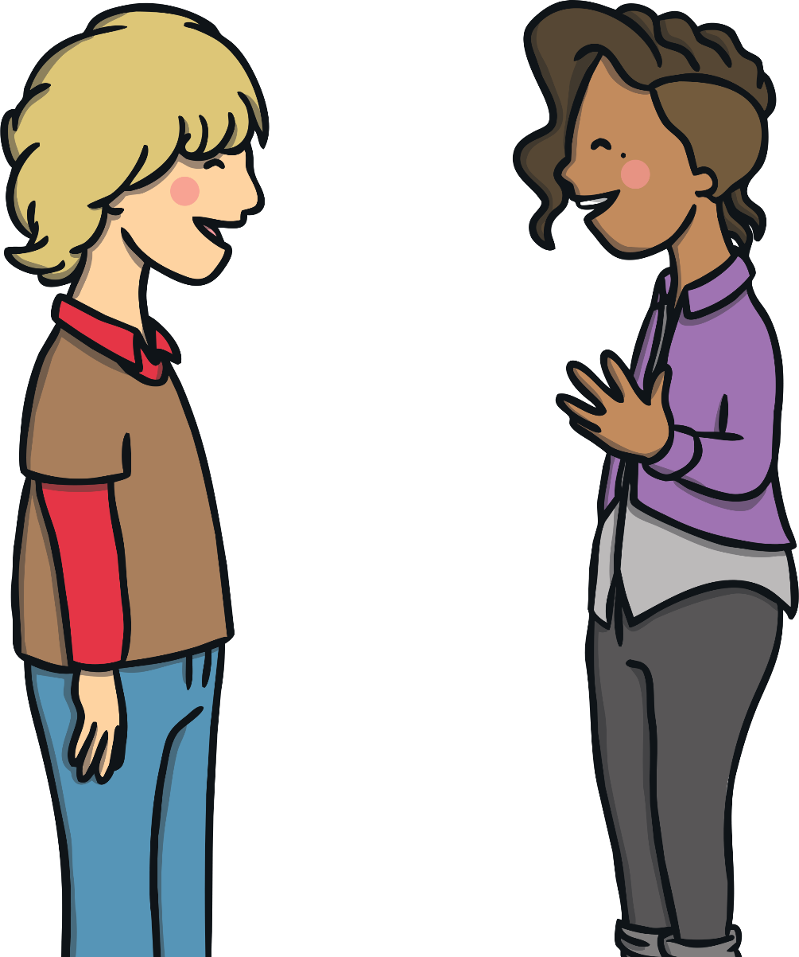
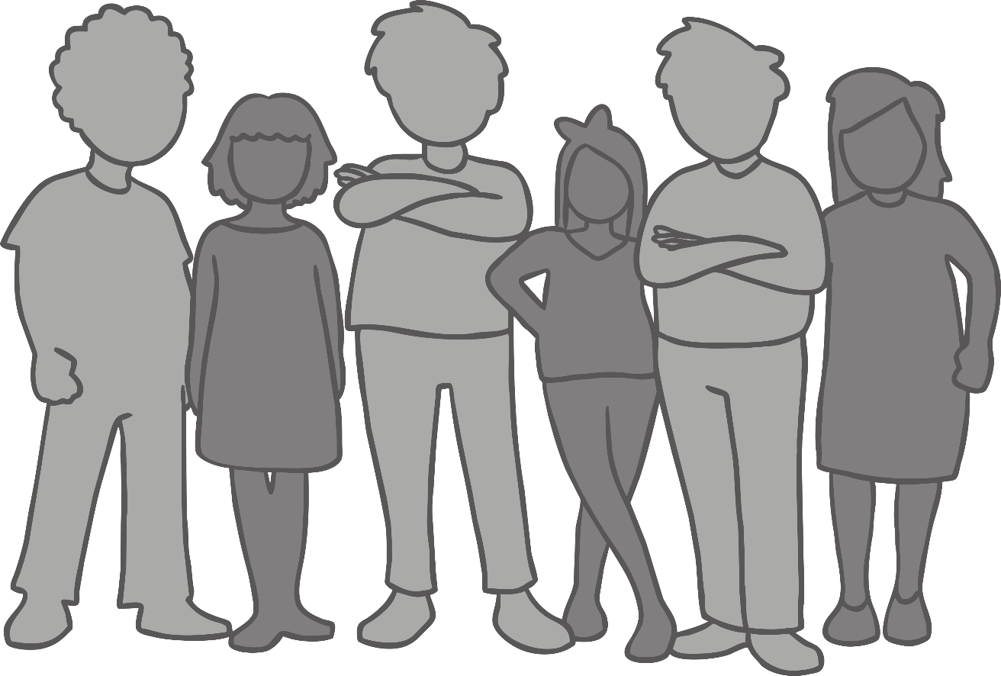
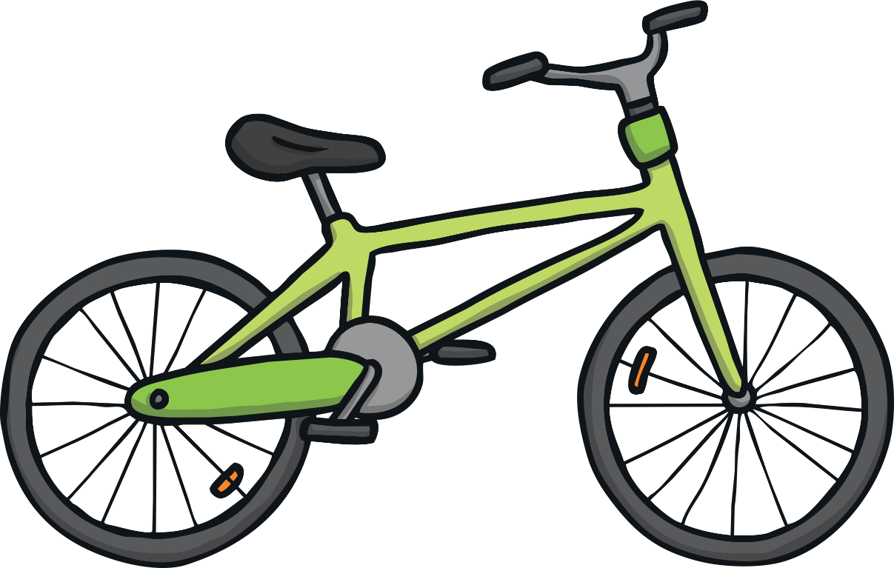


How Can Your Digital Footprint Be Used?
If you write a post somewhere publicly, who can see the information?
If I worked for an online shopping company, what types of things might I put at the top of the page when Penelope or her parents sign in to buy things?
If I was making the adverts for a toy company, what adverts would I show Penelope online?
With your partner, discuss and write down:
who might use your information;
how they might use this information.

Slide 12

Aim
To understand that the information I put online leaves a digital footprint.
Success Criteria
I can explain what ‘digital footprint’ means.
I can explain how people might use the information I put online.
I can explain how a digital footprint contains information about a person.

