Slide 1

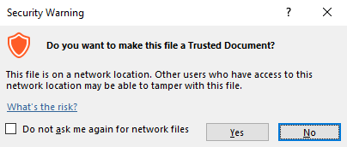
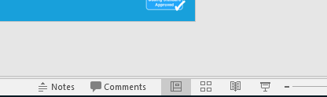
Guidance for macros in PowerPoints
We use macros within PowerPoints to increase the interactivity of our presentations. Follow this simple process to get the most out of this resource.
What to do:
Open the PowerPoint file and enable editing.
A security warning box will appear. Click yes.
Enter presentation mode (start the slide show).

Slide 2


Computing
Online Safety
Year One
Computing | Year 2 | Online Safety | You Be the Judge | Lesson 3

Slide 3
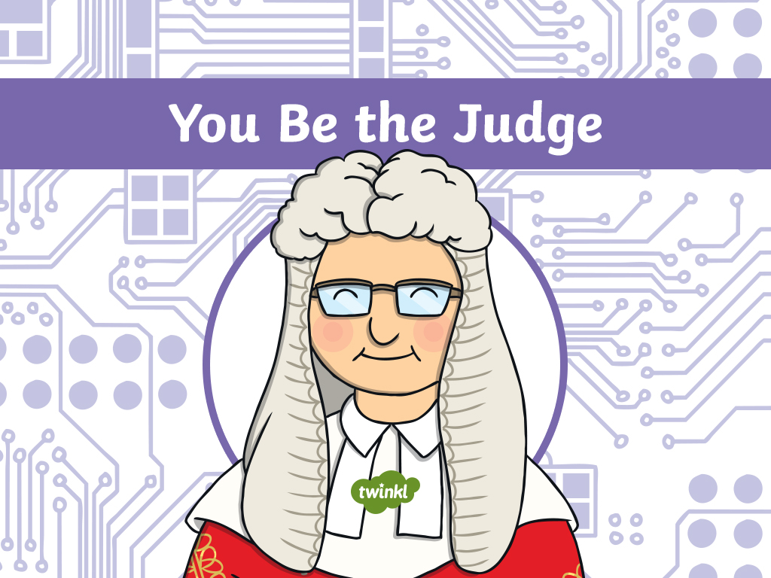

Slide 4
Aim
To recognise whether a website is appropriate for children.
Success Criteria
I can think about how to identify possible dangers or things which might make me uncomfortable online.
I can identify websites that are suitable for my age.
I can identify when to ask an adult for advice about accessing a website.
I know what to do if a website makes me uncomfortable in any way.

Slide 5

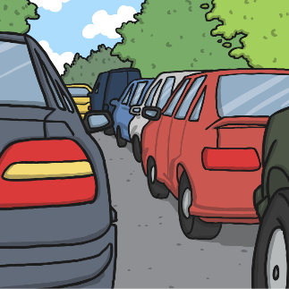
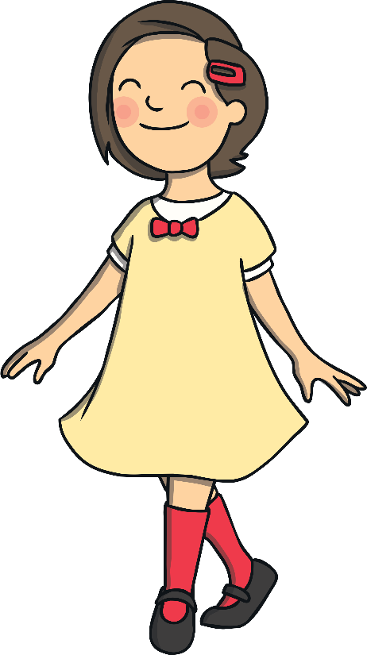


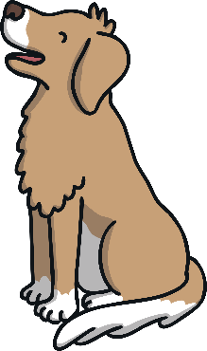


Staying Safe
What potential dangers do we encounter each day? Write down your ideas on your whiteboard.
Remember: these might not become real dangers for us, but they are things to be aware of.

Slide 6

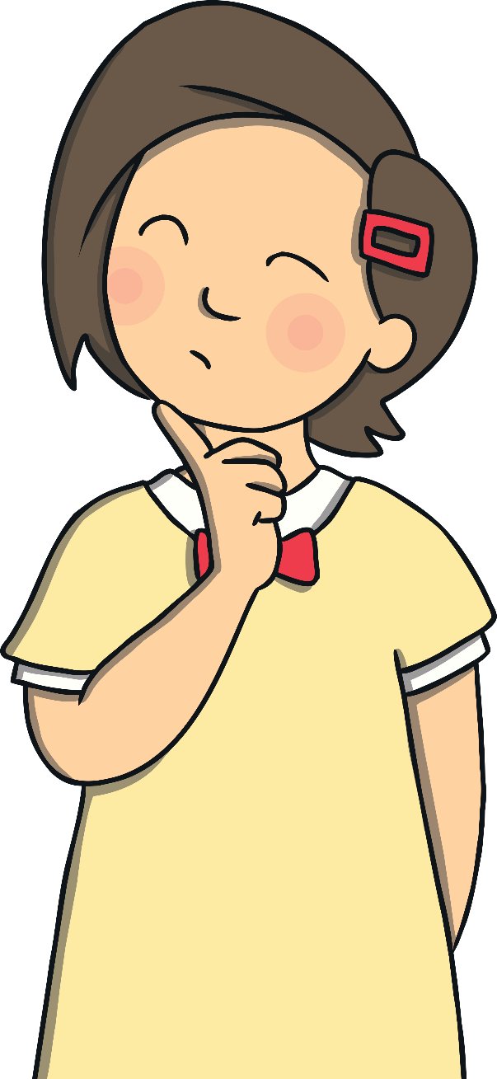


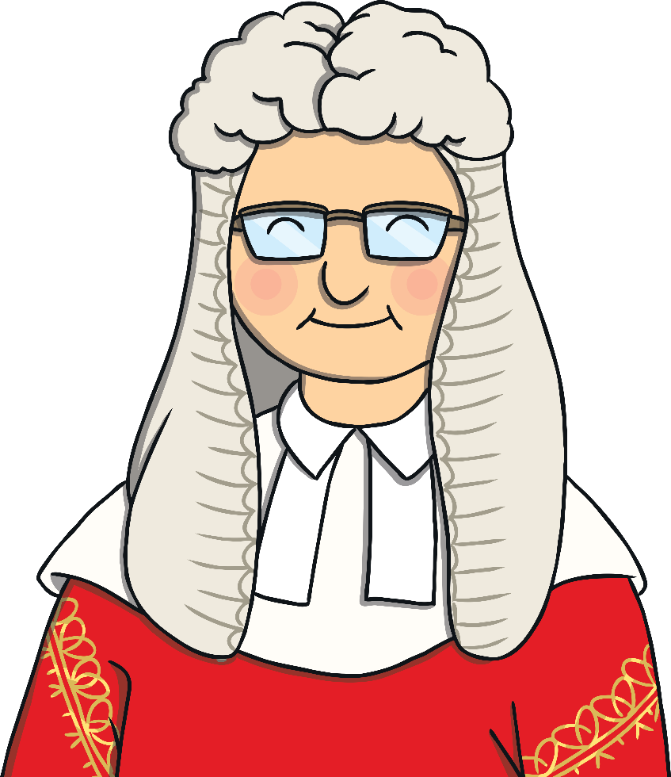
Staying Safe
When we are online, there might be hazards too. Just like in real life, we should think about how we can stay safe and do the right thing to avoid or deal with anything that might make us uncomfortable.
We can judge websites and decide if they are appropriate for us to use.
What things could have been dangerous?
What can we do each day to stay safe?

Slide 7

How to Judge
How can you tell if a website is safe for children to use?
The language should be easy to understand.
There might be fun games or activities.
There shouldn’t be space for strangers to talk to each other.
There might be pictures and illustrations.

Slide 8

How to Judge
How can you tell if a website should be looked at with an adult to help you?
It might ask for bank or card details to access something.
There may be a space for people to chat there.
You might be asked for your personal details.
There could be content you don’t understand; you may find this on a news website, for example.
If you are not sure about a website then stop, ask an adult for help and decide what to do with them.

Slide 9


How to Judge
How can you tell if a website is not appropriate for children?
If anything on a website makes you uncomfortable in any way, look away and tell an adult immediately.
They may want to see the content to check it themselves and report it.

Slide 10
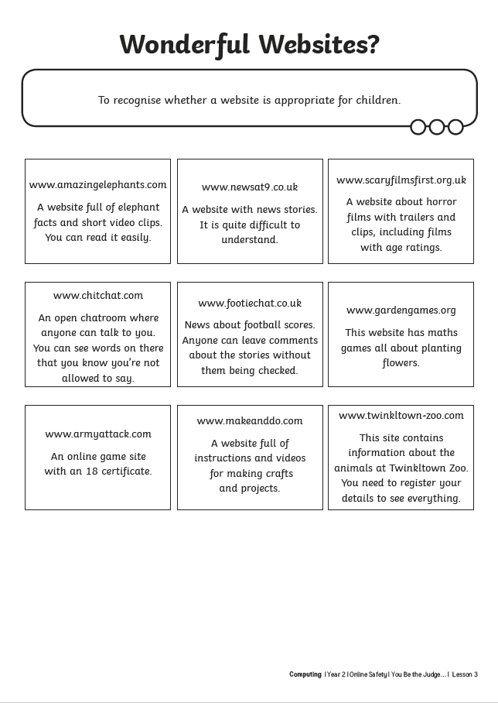
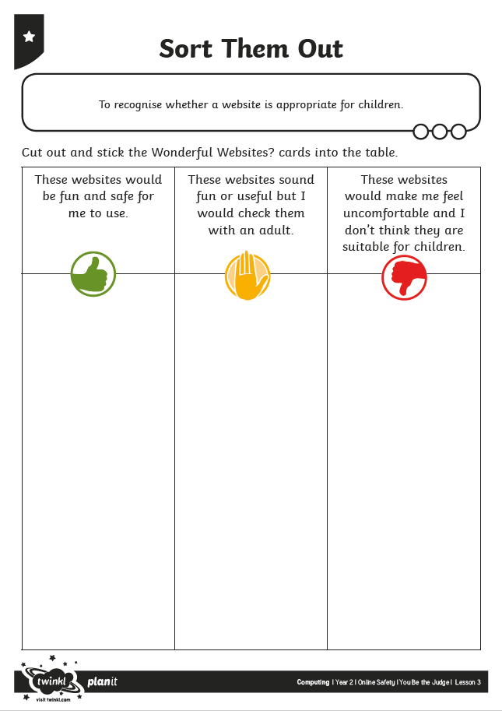
Sort Them Out
Can you use what you have learnt to identify whether a website is appropriate for children or not?
Cut out the Wonderful Websites? Cards and stick them on the correct column on the Sort Them Out Activity Sheet.

Slide 11
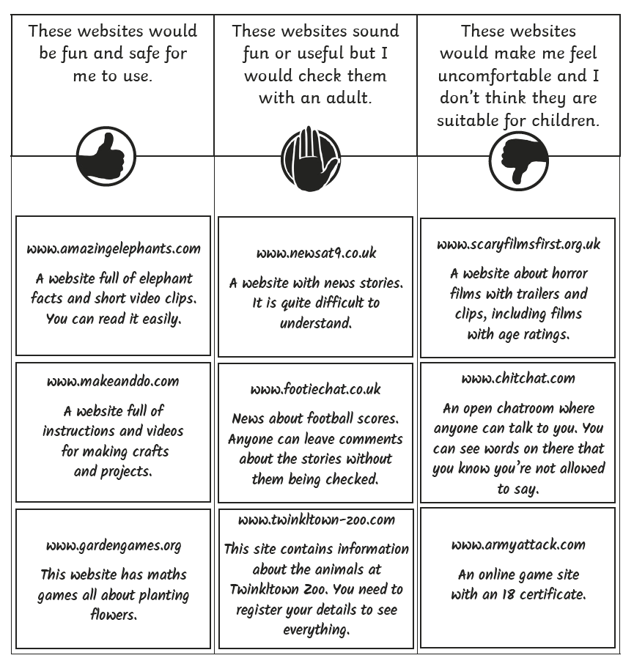
Wonderful Websites
Which of the websites did you think were appropriate for children? How did you decide?

Slide 12

Aim
To recognise whether a website is appropriate for children.
Success Criteria
I can think about how to identify possible dangers or things which might make me uncomfortable online.
I can identify websites that are suitable for my age.
I can identify when to ask an adult for advice about accessing a website.
I know what to do if a website makes me uncomfortable in any way.

