Slide 1

Mindfulness
Mindfulness | Mindfulness for Mental Health

Slide 3
Aim
I can explain what mindfulness is.
Success Criteria
I can recognise when my mind wanders.
I can label my thoughts.

Slide 4
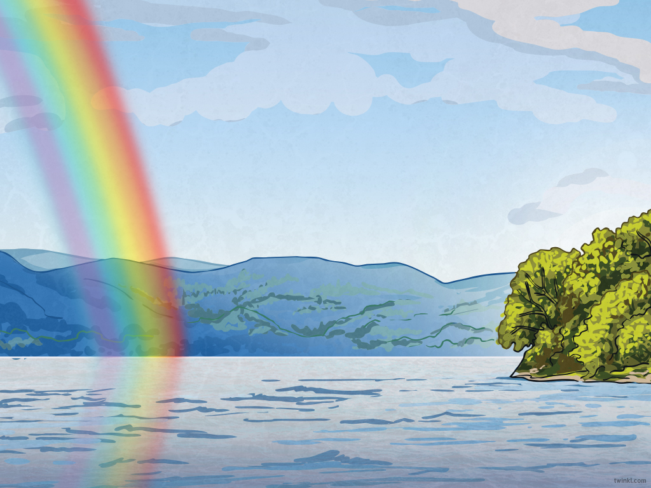
The Big Questions

Slide 5
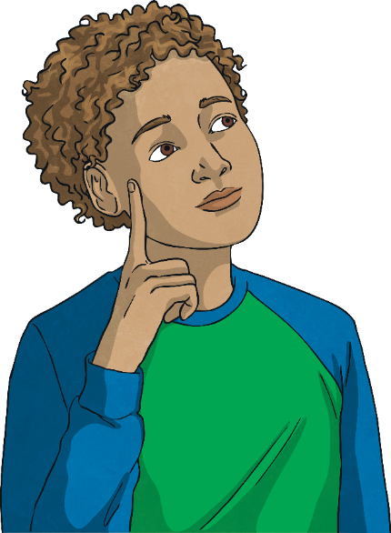
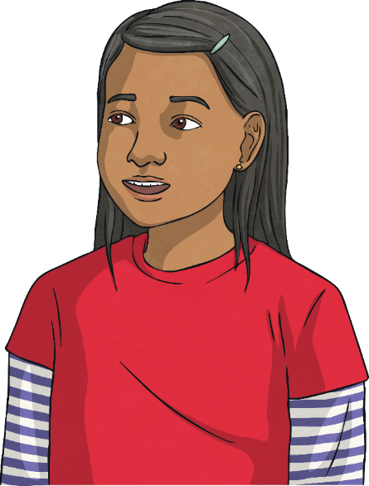
The Big Questions
What is Mindfulness?
Is it easy or difficult to pay attention?
What happens when we do not pay attention?
Talk about these questions with your family.
What a lot of interesting ideas!
Now let’s explore these a little more.

Slide 6
Reconnecting

Slide 7

Stressed, Sad,
Anxious or Angry:
Mindfulness and Mental Health
Today we are going to be exploring a new subject.
This subject is called Mindfulness. We are going to use mindfulness to help us understand how we are feeling and how we can help ourselves be more settled and calm.
Understanding how we are feeling and how this can affect our behaviour is very important. It can help us feel more calm and settled.
It can also help us manage and live with our more difficult emotions such as:
feeling stressed,
feeling anxious,
feeling sad,
feeling angry.
There are no ‘good’ or ‘bad’ feelings!

Slide 8
Stressed, Sad,
Anxious or Angry:
Mindfulness and Mental Health
Feeling this way from time to time is perfectly OK. There is nothing to be afraid of or ashamed of in feeling stressed, anxious, sad or angry.
These feelings are often labelled as ‘bad’ but there is no such thing as a bad feeling or emotion. Worries we have tend to come from our reaction to the emotion or feeling.
Everyone experiences these emotions – friends, family, parents and even teachers!

Slide 9
Stressed, Sad,
Anxious or Angry:
Mindfulness and Mental Health
If we do not understand these emotions and how they can affect us, they can affect our mood and our mental health.
Sometimes, our more challenging emotions can take over our life and we can find ourselves feeling very sad and unhappy.
Mindfulness teaches us to be aware of, and understand our emotions. By practicing mindfulness when we experience challenging emotions, it can help us to let them go.
This helps us to be more happy and content.
There are no ‘good’ or ‘bad’ feelings!

