Slide 1
The Romans
Why was the Roman Army so successful?

Slide 2
The Roman Army
The brilliance of the Roman army was the key to Rome’s success in building its Empire.
By the end of this lesson, you should know:
  What kind of person joined the Roman army.
  How the soldiers spent their time (when not fighting!)
  Why the army was so successful.

Slide 3
What was the army like to begin with?
As Roman power grew, more people were made to join the army. Why?
At first the soldiers were the better-off citizens. (Why did you have to be well-off?)
They copied Greek armies and fought on foot with long spears.
They were sent home when a war ended.

Slide 4
How did things change?
As the Empire grew bigger and bigger the army had to fight further and further away from home.
Being a soldier became a full-time job - they were no longer sent home when a battle ended.
These full-time soldiers were well-trained and disciplined. They had to be tough and confident in the use of a number of weapons.

Slide 5
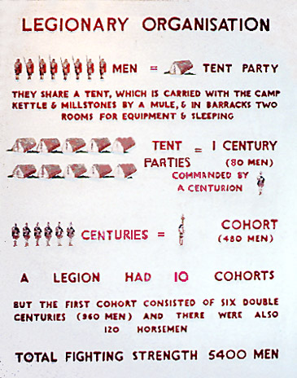
How was the army organised?
Roman soldiers were grouped into large numbers called legions. There were between 29 and 30 of these at different times.
Each legion was divided into 10 cohorts of 480 men.
Each cohort was divided into 6 centuries of about 80 men led by a centurion.
Each century was split into 10 groups of 8 men who shared a tent or barrack room.
What a lot of people!

Slide 6
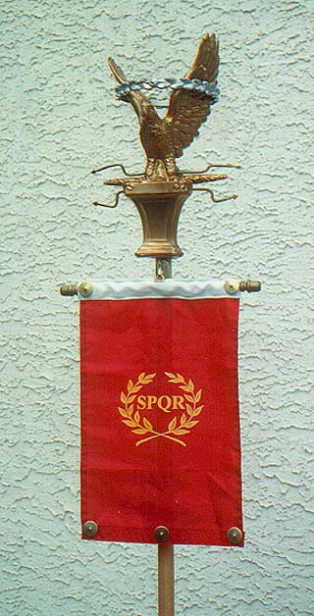
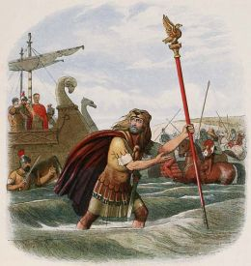
Each legion had a golden eagle carried on a pole. Each century had its own standard, or flag.
To lose your standard, or worse, the Eagle, would bring great shame on the soldiers concerned.
This is why a trusted, experienced soldier was given the role of standard-bearer.

Slide 7
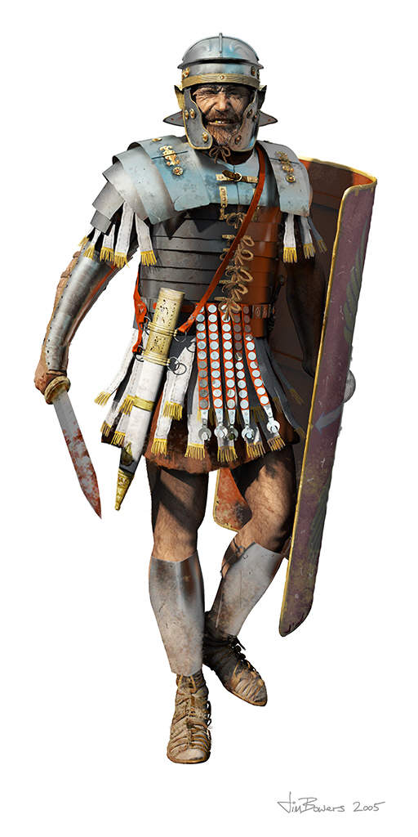
How did you become a legionary?
The legions were made up of male Roman citizens.
To join the army you had to be recommended by someone in the army, physically fit and of good character.
Recruits had to be at least 20 years old.
They joined for 25 years.
They were not allowed to marry whilst in the army.
When they retired they were given money (three gold coins) and land to farm.

Slide 8
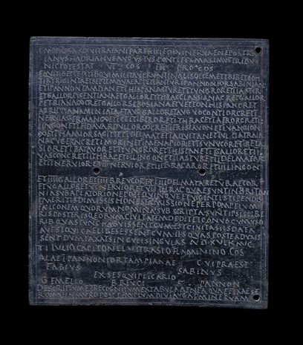
What if you weren’t a Roman citizen?
If you were not a citizen of the Roman Empire, but wanted to join the army, you could do so as an auxilliary. They were made citizens when they retired.
This picture shows a citizenship document giving Roman citizenship to a soldier named Gemellus.

Slide 9
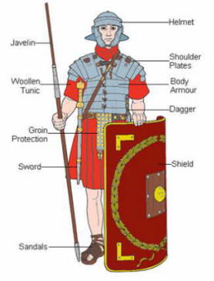
What makes the legionary’s uniform and equipment so effective for a man about to go into battle?

Slide 10
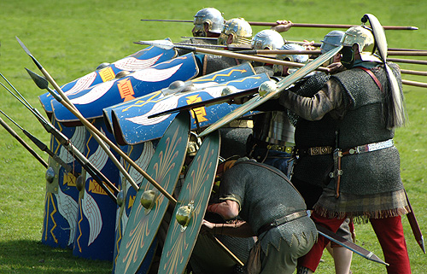
Fighting Techniques: The Repel-Cavalry
Type: DEFENSIVE
When used:
To combat a cavalry charge.
How it works:
- The soldiers form a line, with the men at the front crouching down with their shields in front of them and their spears stick out of the gaps. The men behind put their shields over the top of the men in front, and have their spears ready to throw.
The spears would stop horses from running at the soldiers, often causing them to retreat. Those retreating would then knock into the cavalry behind them, causing a domino effect and making themselves easy targets for archers.

Slide 11

Fighting Techniques: The Wedge
Type: ATTACKING
When used:
Used aggressively to divide the enemy.
How it works:
The centurion is at the front of the ‘V’ and the legionaries form the sides of the ‘V’ . They have to stay close together to stop the enemy from breaking the line.
As the wedge advances, more soldiers join on at the ends to divide the enemy even further.
Breaking the enemy formation was key to winning on the Roman battlefield!

Slide 12
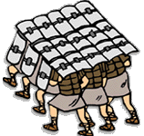
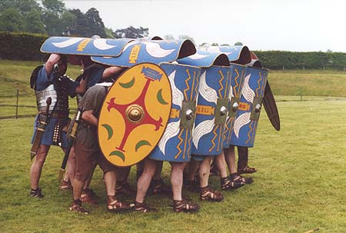
Fighting Techniques: The Tortoise
Type: DEFENSIVE
When used:
- To advance but remain protected from spears, arrows, etc.
How it works:
The Tortoise is square. The men at the front hold their shields in front of them. The men at the sides hold their shields to the sides. The men in the middle hold their shields above them.
The men had to move in close formation to ensure that the shields were touching so that no missiles could get in and injure any soldiers.

Slide 13
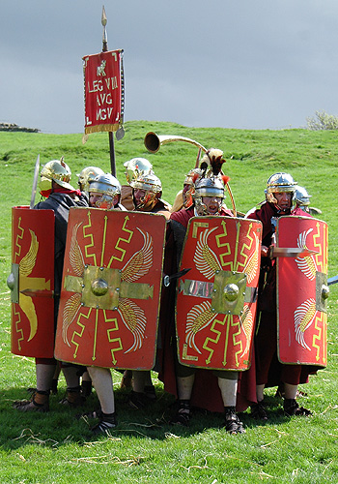
Fighting Techniques: The Orb
Type: DEFENSIVE
When used:
If part of the army had been split off from the main group or encircled by the enemy.
How it works:
The legionaries form a circle around the officers and the archers (these were the most important people!) using their shields as protection.
Seen as a ‘desperate last stand’.

Slide 14
How did they keep so many men under control?
As you have seen, the Roman army was huge. How do you think its leaders managed to keep so many people under control?
Notes:
Watch video – summarises and answers question

Slide 15
Punishments and Rewards
Discipline was very harsh. Centurions carried a vine stick which they used to beat soldiers who had disobeyed an order. Fines were also common, but there were much worse punishments...
  Deserters and soldiers who left their posts or fell asleep whilst on look-out were beaten to death by their fellow soldiers.
  A particularly horrible punishment was ‘decimation’ where every tenth man in a cohort (chosen randomly) was executed by his comrades.
However, on a more cheerful note, for bravery there were awards for different ranks, such as medals, arm and neck bands or torques. Gold crowns and silver spears were given to officers.
Notes:
Video Roman Military Machine 4min 57 http://www.youtube.com/watch?v=yhnWyRvC1dU

Slide 16
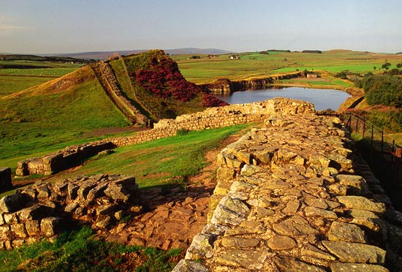
But surely they didn’t spend all their time fighting?
No – as well as fighting major battles, the legions built forts, bridges and roads. When they were on a campaign, they built a camp fortified with banks and ditches at the end of each day’s march.
But they did have time for relaxation as well – what kind of activities do you think they did when they were off duty?
This picture shows part of what is left of Hadrian’s Wall, a defensive wall the Romans built between England and Scotland.

