Slide 1
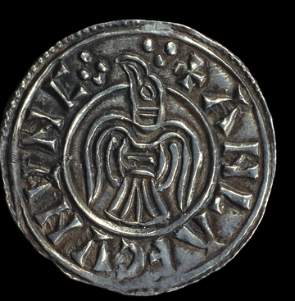
L.O To find out about life in Anglo-Saxon times by looking at artefacts

Slide 2
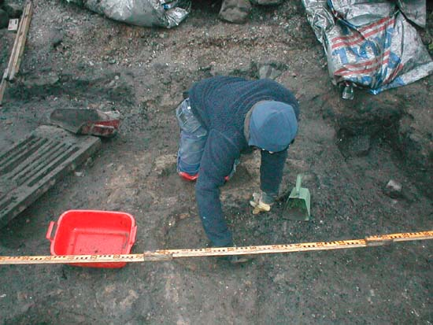
Can you guess what this person’s job is?

Slide 3
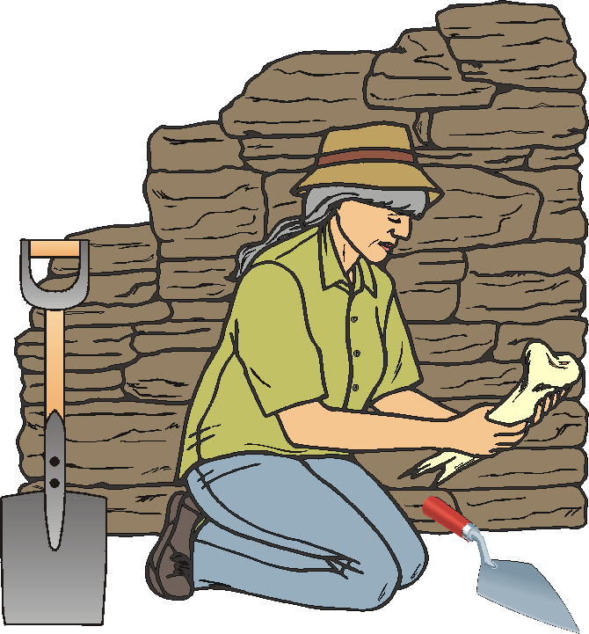
An archaeologist

Slide 4
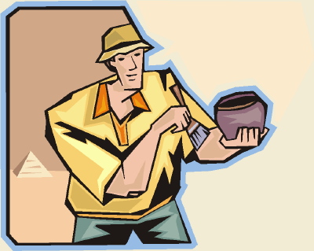
When an archaeologist finds something
from the past , do you know what we call it?
An artefact

Slide 5
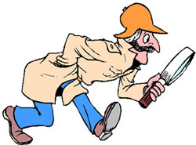
What can an artefact tell us about the past?

Slide 6
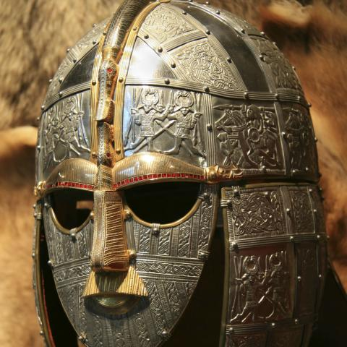
What do you think this is?

Slide 7
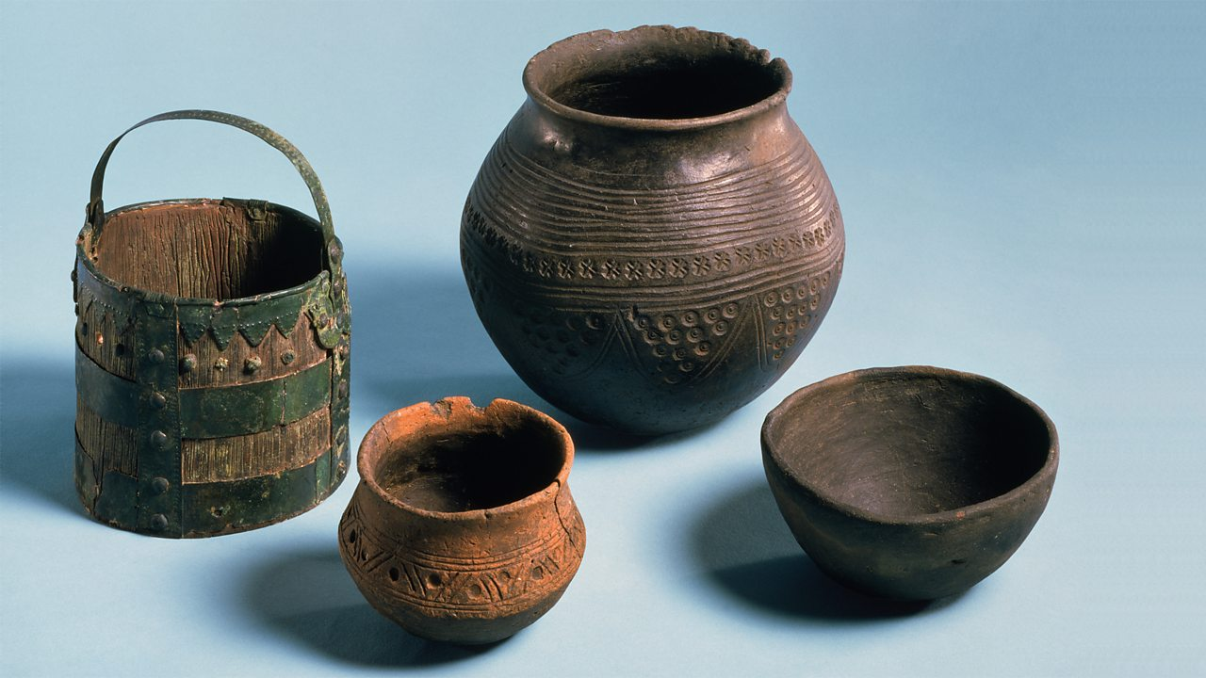
What do you think it is?

Slide 8
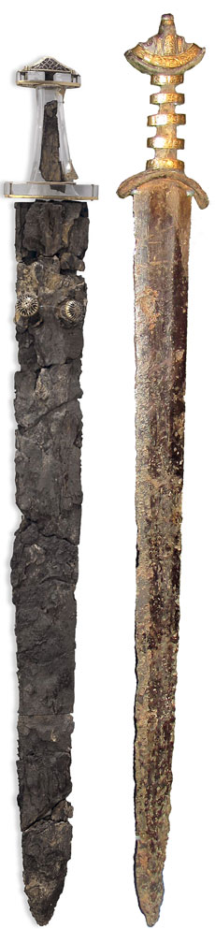
What do you think this is?

Slide 9
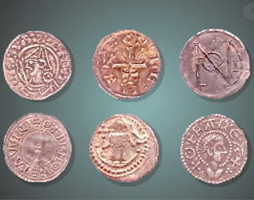
What do you think this is?

Slide 10
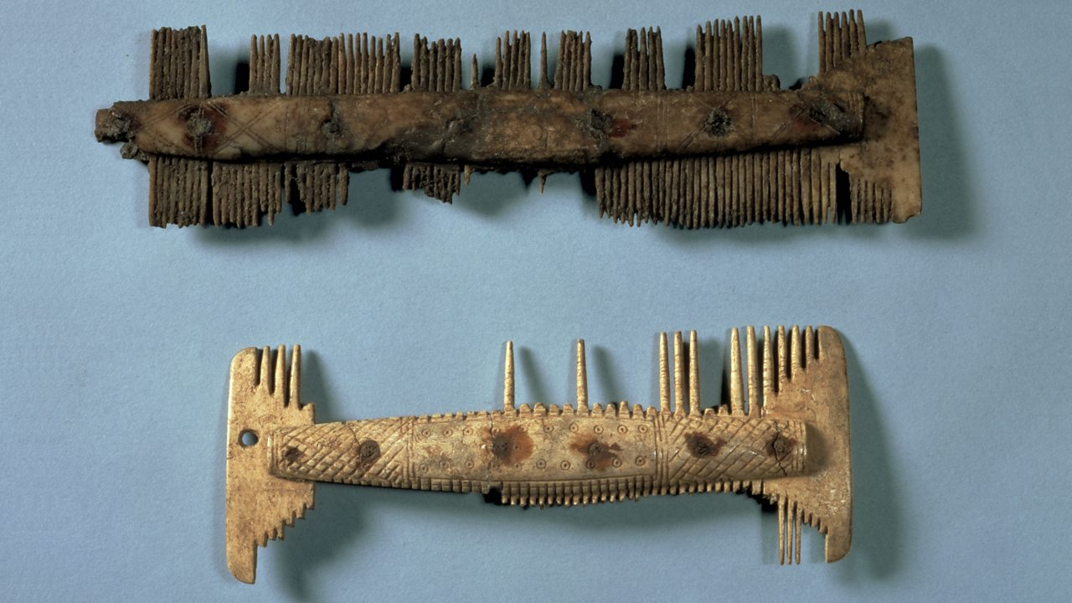
What do you think this is?

Slide 11
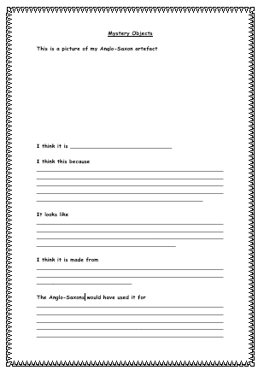
Your Task:
Now you have had a look at the different artefacts, complete the worksheet (saved in Year 4 home learning – topic)
You task is to draw one of the artefacts and say what you think it is and why you think that.
Explain what the artefact looks like, what you think it is made from and what the Anglo-Saxons would have used it for.
.

