Slide 1


Staffordshire
Wednesday 4th May – Friday 6th May

Slide 3
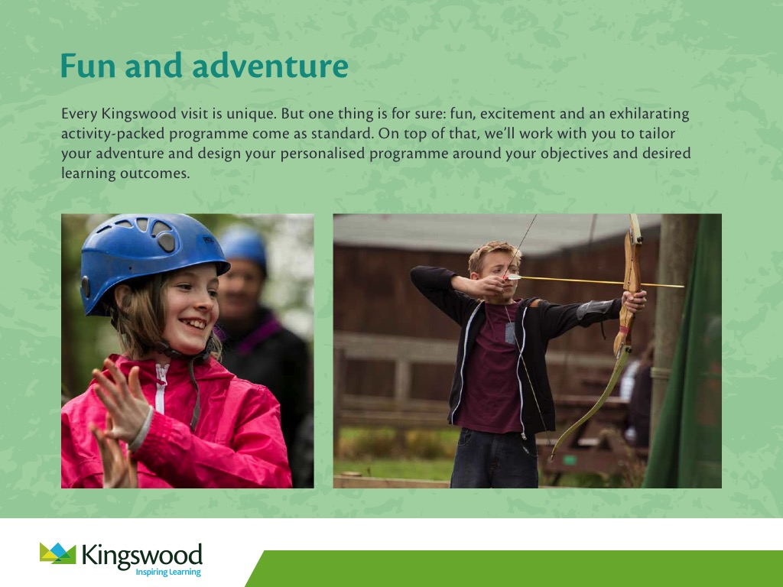

Slide 4
Examples of activities
Abseiling
Caving
Problem solving
Jacobs Ladder
Archery
Scrapheap Challenge
Mini Olympics
Campfire
Movie Night
Quad biking
Low ropes
Bushcraft
Areoball
Laser

Slide 5
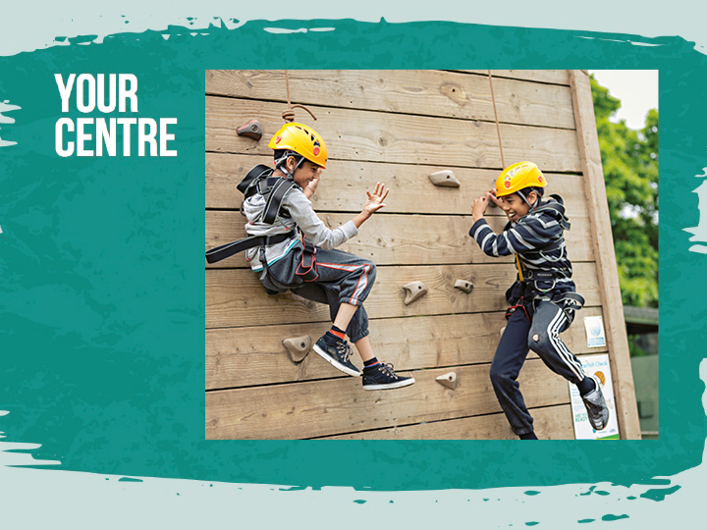

Slide 6
General run of the day
7:00am – Wake up call
8:00am – Breakfast
9:15am – First activity
10:50am – Second activity
1:30pm – Lunch
2:30pm – Third activity
4:00pm – Fourth activity
6:30 pm – Dinner
7:45- 9:00pm – Evening activity
9:00pm – Shower / Time in own rooms
10:00pm – Lights out

Slide 7
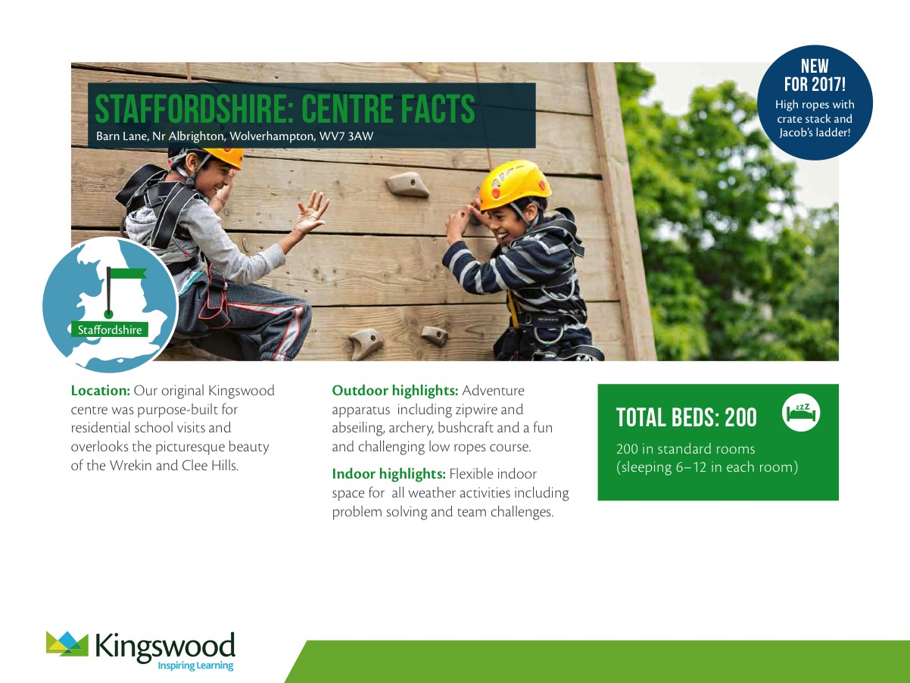
Outdoor highlights: Adventure apparatus including zipwire and abseiling, archery, bushcraft and a fun and challenging low ropes course.
Indoor highlights: Flexible indoor space for all weather activities including problem solving and team challenges.
TOTAL BEDS: 200
200 in standard rooms
(sleeping 6–12 in each room)

Slide 8

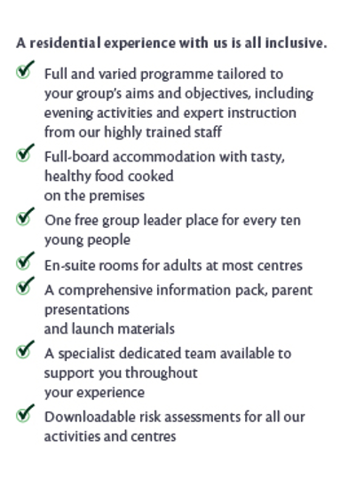
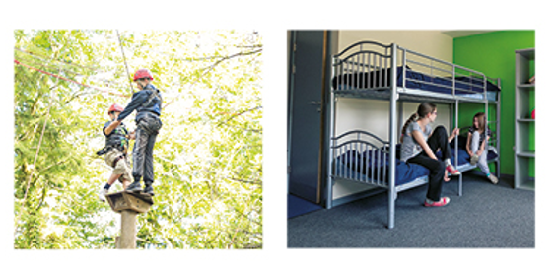
You’ll find welcoming rooms in our comfortable dormitory style accommodation which have bathroom facilities and a daily housekeeping check. All of our dormitories are secure and comfortable and secure with key code access and all bedding is provided. Pupils sleep in gender separated areas, with separate showers and toilet facilities, and teacher rooms are located close by to allow for plenty of supervision.

Slide 9


Slide 10

Food
All food is Halal
Lots of vegetarian options
Breakfast, Lunch, Dinner and healthy snacks provided
Each school at the centre has their own dining room to eat in for all their meals

Slide 11
Clothing and Footwear
Main items to think about;
Waterproof Jacket
Lot of layers
Bring spares of everything, the children may get wet or muddy
Appropriate footwear (trainers)

Slide 12
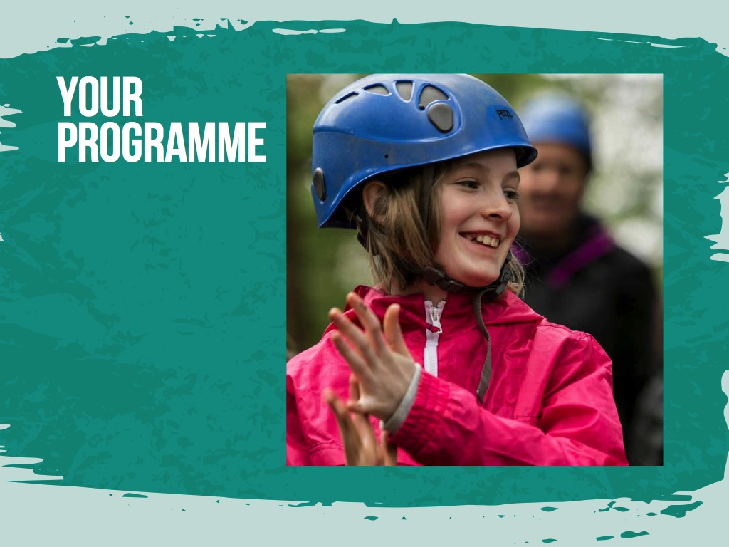

Slide 13
We know how daunting it can be letting your child go on a residential visit, so we do everything we can to make it a safe and enjoyable experience for all.
Our policies and procedures are designed to make sure we adhere to the highest safety standards at all times:
Continual safety and first aid training for all staff
Regular checks on equipment before and after every activity session
Qualified First-Aider on centre 24/7
All staff are fully DBS checked.
We create a warm, supportive environment for students so they quickly feel at home. All our activities are progressive, allowing students to join in at whatever level they’re comfortable with.
We have found the best way to help children cope with being away from home is to keep them busy, having fun from dawn ‘til dusk.
Kingswood cannot guarantee 100% safety for personal items brought onto centre and they will not be covered by insurance. It is therefore advisable to leave valuables – cameras, mobiles, iPods, MP3 players, computer games, jewellery - at home. A clearly named disposable camera is acceptable.

Slide 14
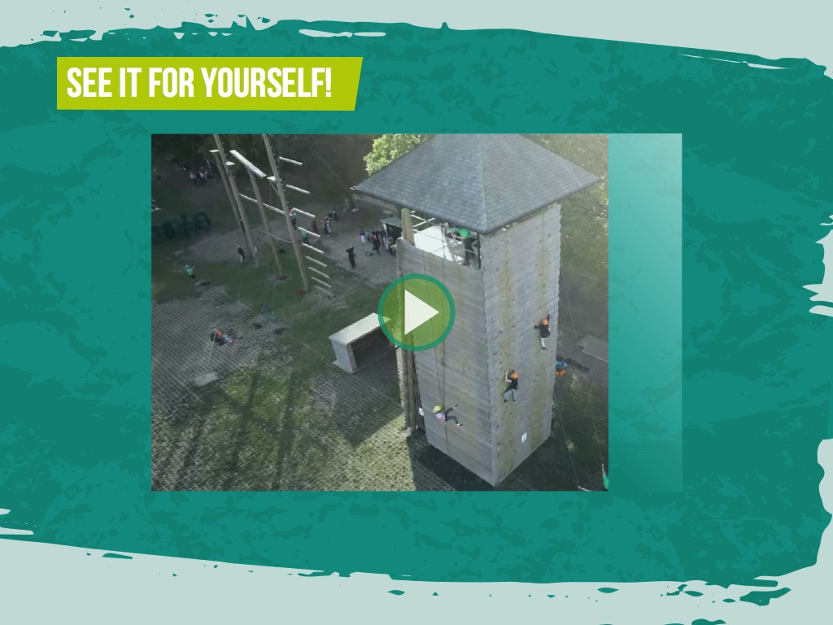
https://www.youtube.com/channel/UCy0___ghMVMWC_5THw2iogg

Slide 15


Slide 17
Price:
£50.00 or
- £30.00 for children who are eligible for Free School meals
What is included;
Transport to and from Kingswood
All meals (Children will need to bring in a packed lunch on the
Wednesday)
Accommodation for 2 nights
Questions or queries to enquiry@rgntpark.bham.sch.uk

Slide 18
Covid Precautions
The centre has clear Covid guidelines in place to ensure all areas are cleaned regularly and hygiene standards are high.
All staff undergo regular lateral flow testing
Social distancing between groups is planned for including during activities and meal time as well as visits to the onsite shop
Regular handwashing is encouraged between activities and at meal times

Slide 19


