Slide 2


ay
Play Sound

Slide 3

ou
Play Sound

Slide 4

ie
Play Sound

Slide 5

ea
Play Sound

Slide 6
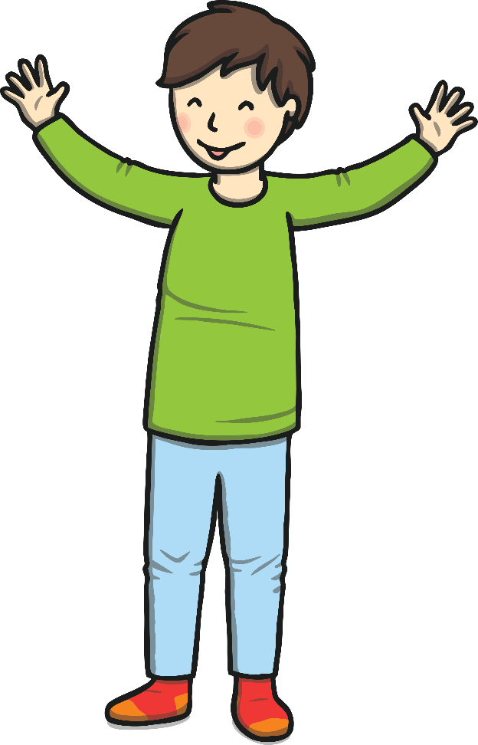
oy
Play Sound

Slide 7
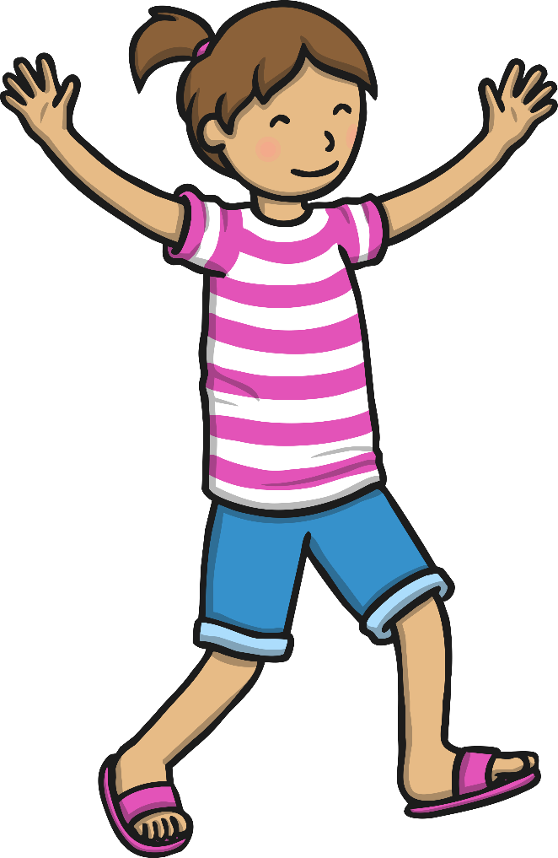
ir
Play Sound

Slide 8

ue
Play Sound

Slide 9

ue
Play Sound

Slide 10
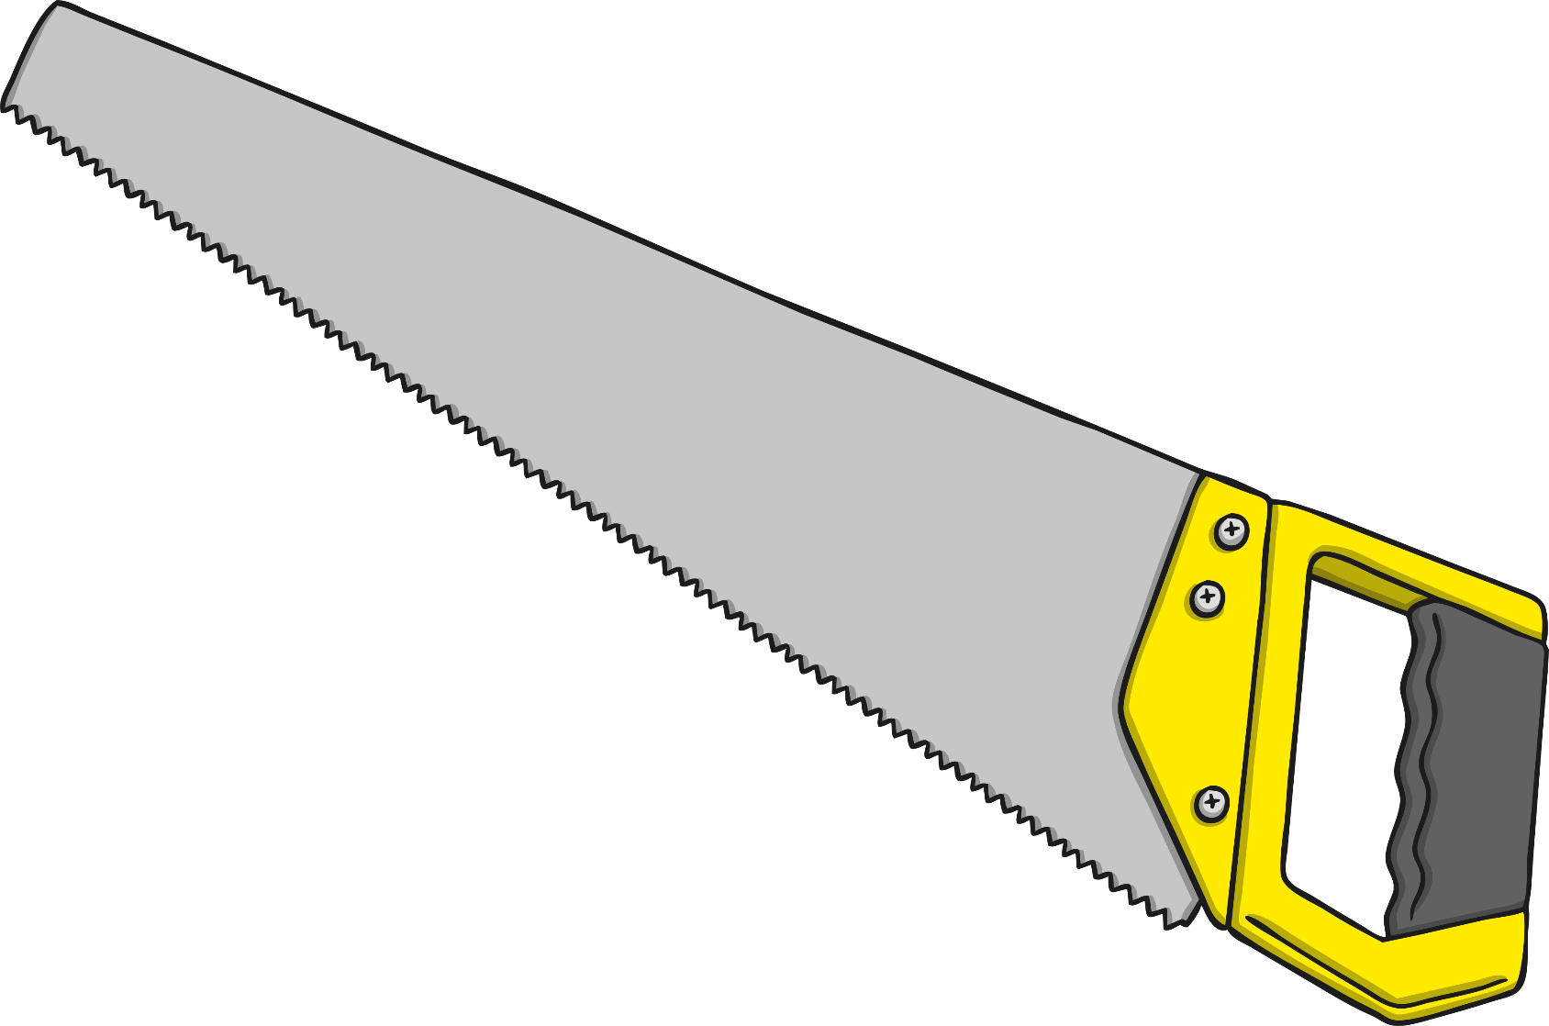
aw
Play Sound

Slide 11

wh
Play Sound

Slide 12
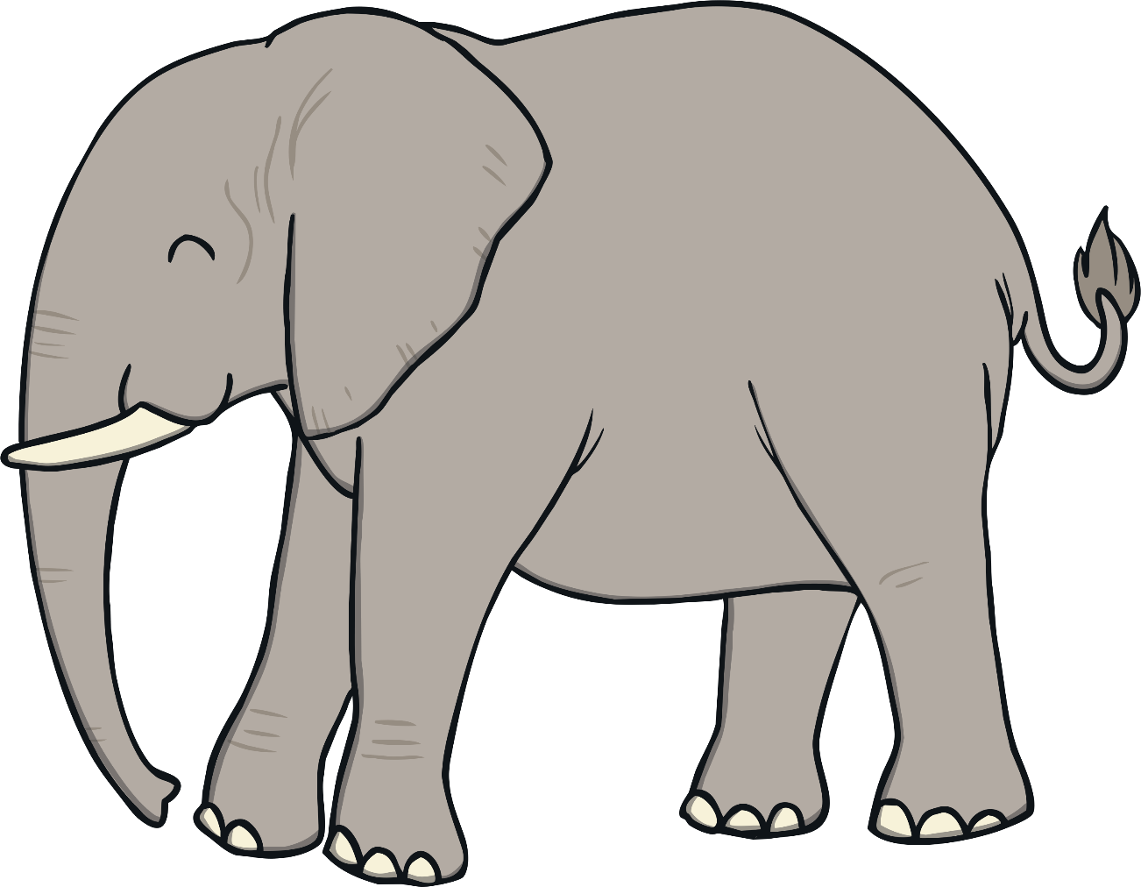
ph
Play Sound

Slide 13
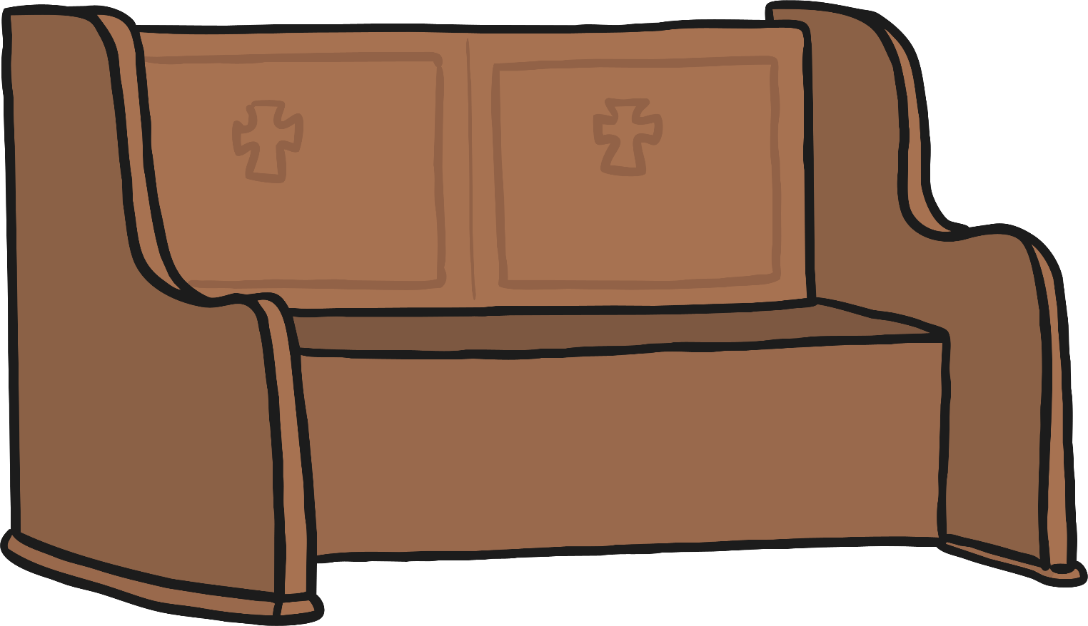
ew
Play Sound

Slide 14

ew
Play Sound

Slide 15

oe
Play Sound

Slide 16
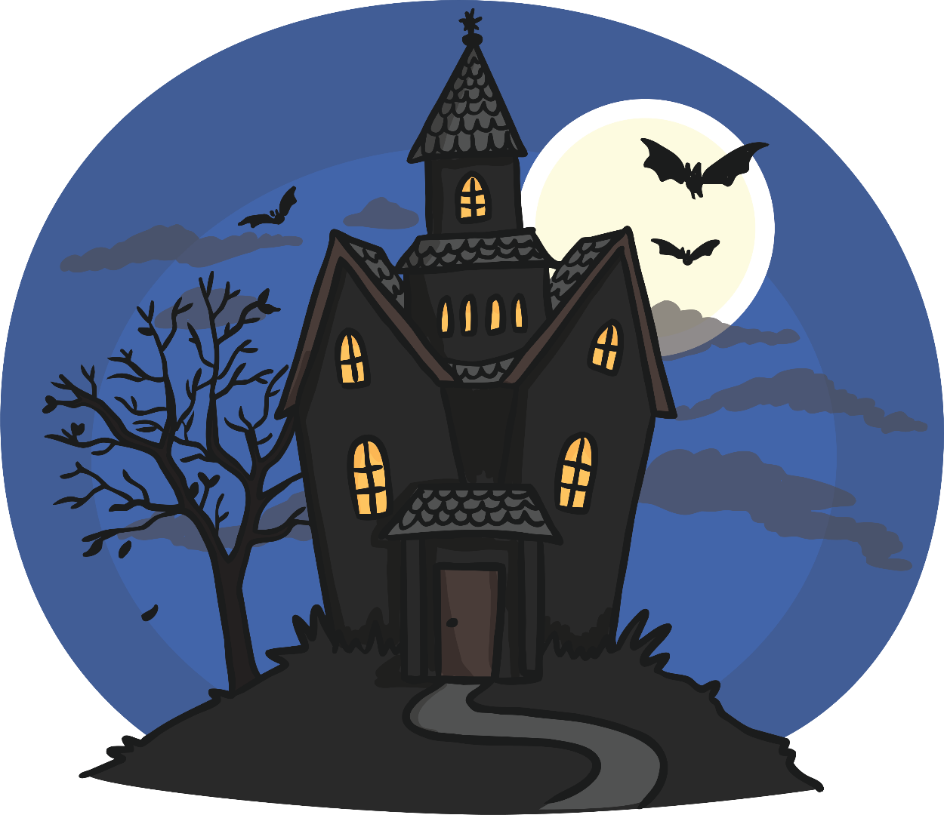
au
Play Sound

Slide 17

ey
Play Sound

Slide 18

a-e
Play Sound

Slide 19
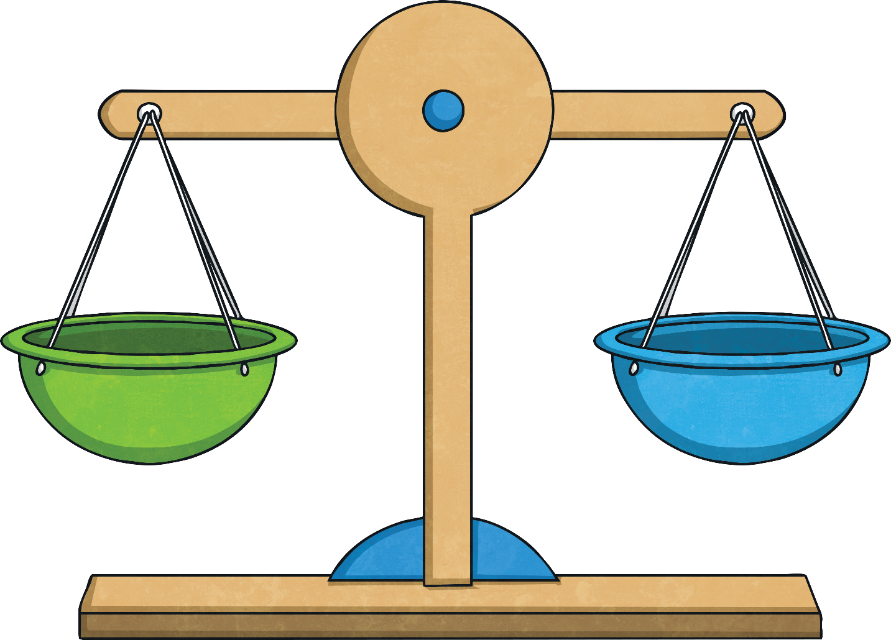
e-e
Play Sound

Slide 20
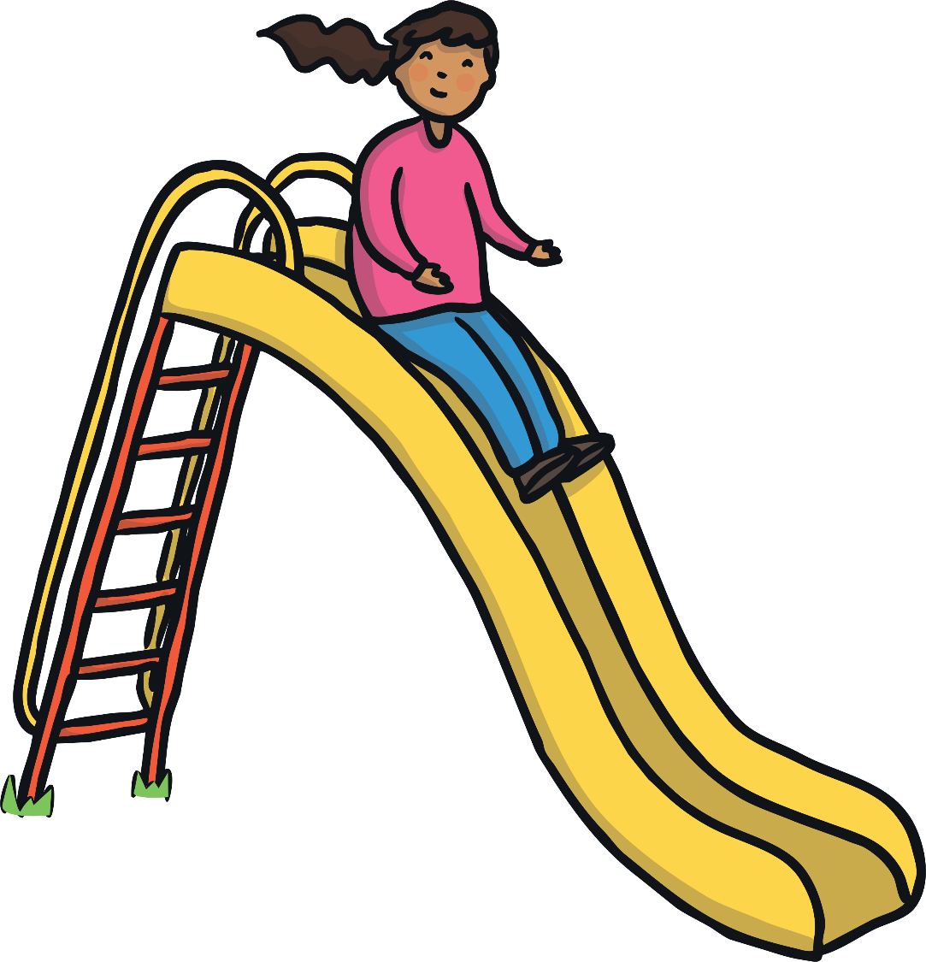
i-e
Play Sound

Slide 21
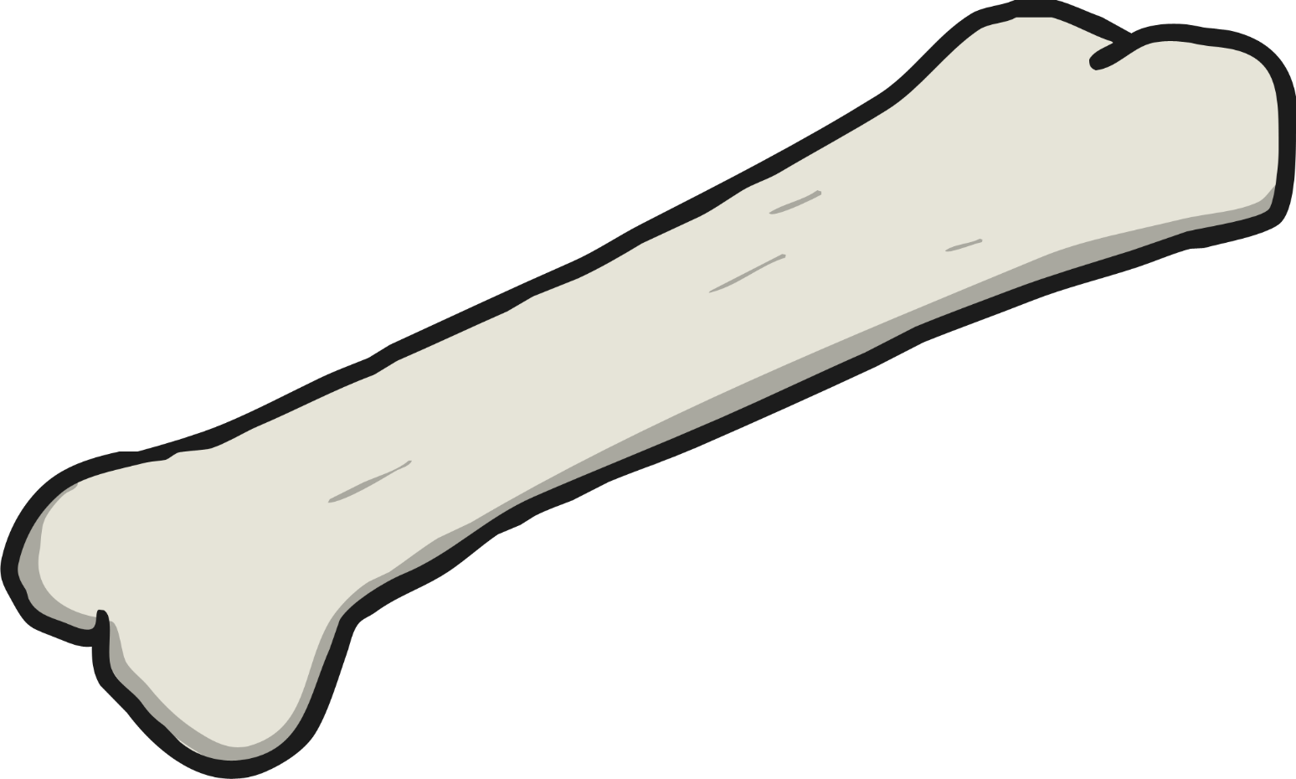
o-e
Play Sound

Slide 22
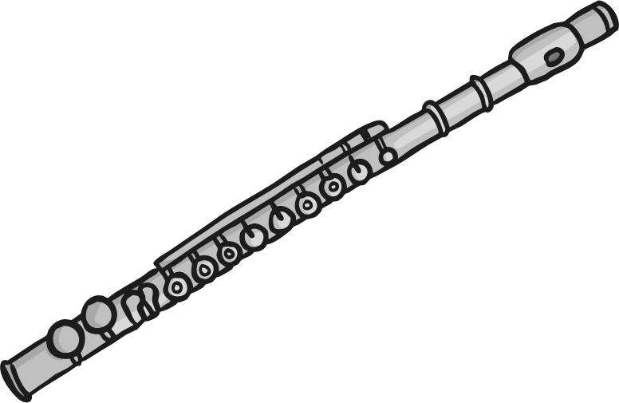
u-e
Play Sound

Slide 23

u-e
Play Sound

