Slide 1
FIND NUMBER BONDS WITHIN 10

Slide 3




1) How many fingers?
2) If then
3) Find the number five on the number line.
4) What is the missing number?
5 + 3 = 8
3 + 5 =
?
5
1

Slide 4
1) How many fingers?
2) If then
3) Find the number five on the number line.
4) What is the missing number?
8
5 + 3 = 8
3 + 5 =
8
6
?
5
1

Slide 6

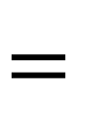
Number bonds
2
$$+$$
3
$$=$$
5
Part
Part

Slide 7

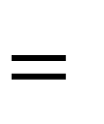
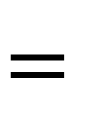

Number bonds
2
$$+$$
3
$$=$$
5
4
$$+$$
1
$$=$$
5
Part
Part

Slide 8


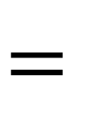

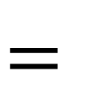
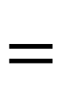


Have a think
Are there any other number bonds?
2
$$+$$
3
$$=$$
5
4
$$+$$
1
$$=$$
5
0
$$+$$
5
$$=$$
5
I am not sure…
Part
Part

Slide 9



Have a think
Pick a number from 1 - 10
$$+$$
$$=$$
$$+$$
$$=$$
$$+$$
$$=$$
Part
Part

Slide 10
Have a go at questions 1 and 2 on the worksheet

Slide 11












Number bonds to 6
5
$$+$$
1
4
$$+$$
3
2
$$+$$
4
3
$$+$$
3
6
$$+$$
0
1
$$+$$
6

Slide 12
Have a go at questions 3 and 4 on the worksheet

