Slide 1


Slide 3


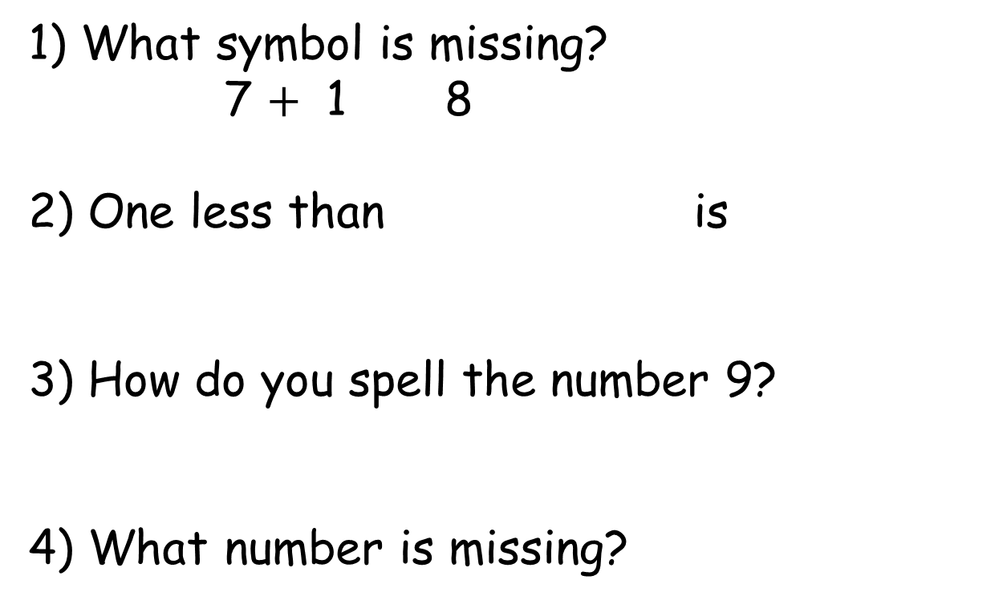
1) What symbol is missing?
7 $+$ 1 8
2) One less than is
3) How do you spell the number 9?
4) What number is missing?
5
2

Slide 4

1) What symbol is missing?
7 $+$ 1 8
2) One less than is
3) How do you spell the number 9?
4) What number is missing?
$$=$$
3
nine
5
7
2

Slide 6





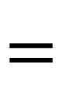

Addition
3
$$+$$
2
$$=$$
?
There are
There are
2
3

Slide 7
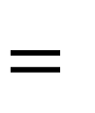

Adding together
There are
3
2
There are
5
There are leaves altogether.
3
$$+$$
2
$$=$$
5

Slide 8
Have a go at question 1 on the worksheet

Slide 9

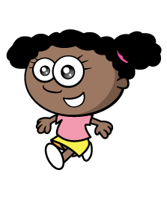
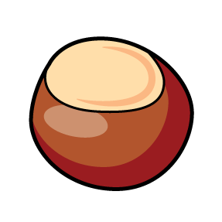


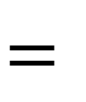
Have a think
5
$$+$$
4
$$=$$
9
Alex found 5 conkers.
Whitney found 4 conkers.
9
They found conkers altogether.

Slide 10




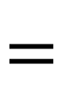

Have a think
Jack and Eva want to play marbles.
I have four marbles.
Me too!
They have marbles altogether.
8
4
$$+$$
4
$$=$$
8

Slide 11
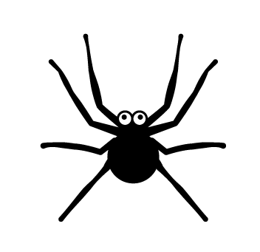
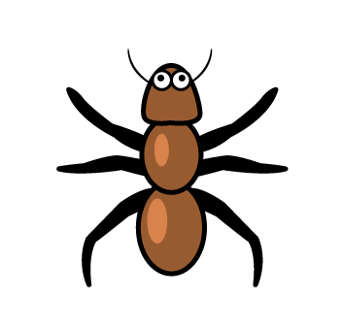

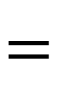
Adding together
There are ants.
3
There are spiders.
4
7
There are insects altogether.
3
$$+$$
4
$$=$$
7

Slide 12
Have a go at questions 2 and 3 on the worksheet

