Slide 1

Year 3
Curriculum Workshop

Slide 2

School starts at 8.40am.
Please ensure children arrive on time.
Children need to be in full school
uniform.
bottle green jumper / cardigan,
white polo shirt, grey trousers, black trousers, no jewellery

Slide 3
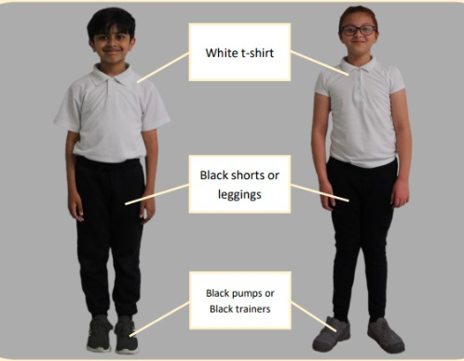
PE is on Tuesday.

Slide 4
Swimming
3W – Monday at 9am
3N – Monday at 10am
Children need to bring their kits in a bag every week.
Swimming suit/shorts, swimming hat, towel, coat, no earrings

Slide 5
Reading:
Children visit the school library every week.
They also have the opportunity to choose a passport book weekly.
There are 30 books the children need to aim to read by the end of the year.

Slide 6

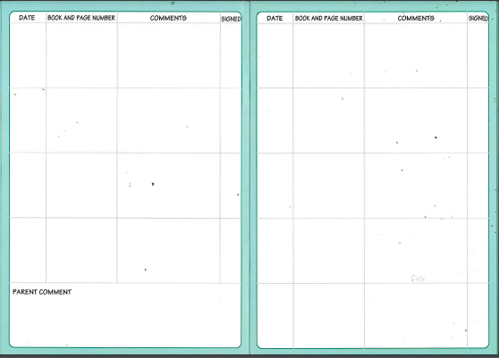
Encourage children to read at home at least 3 times a week.
Their reading journal needs to be filled in and returned to the teacher weekly.

Slide 7
Homework
Is given out on a Friday and is due back on Wednesday.
On paper at the moment but some may be on J2e later in the year.
Reading journals are also due back on a Monday.

Slide 8

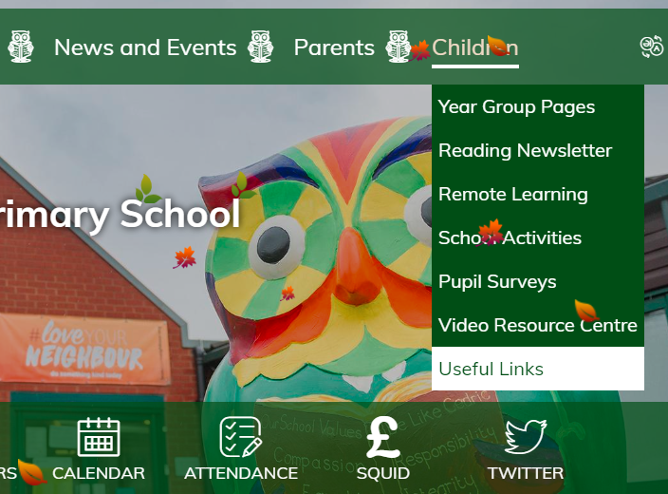

Accelerated Reader
Quizzes need to be completed when a book is finished.

Slide 9
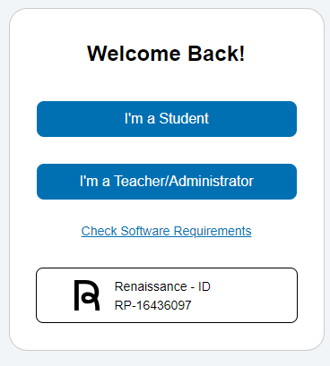
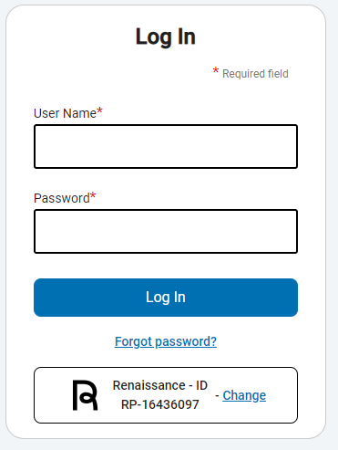
Log in using children personal log in details. These are in the format of:
19h.smith
armarm
Children are familiar with this as it’s the same one they use in school to log into devices.

Slide 10
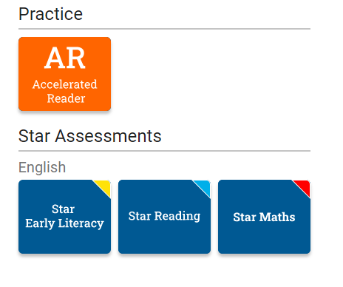
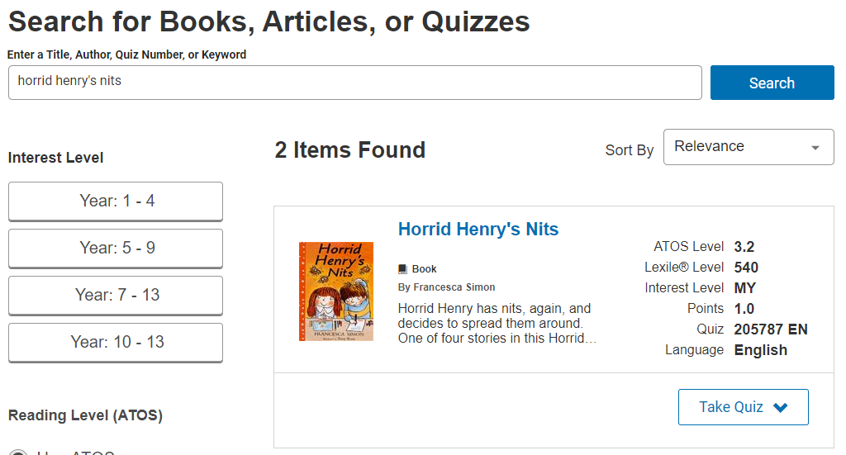
Take quizzes when book is completed (any book)
Can only attempt a quiz once
aim is 1,000,000 words to attend a ‘Million Words’ tea party
In Y3 500,000 words is also rewarded with a tea party
Encourages children to read
Improves comprehension skills and understanding of what is read

Slide 11


Slide 12
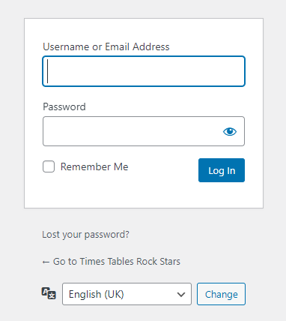


Times table rockstars
Log in using the same details as
Accelerated Reader.

Slide 13

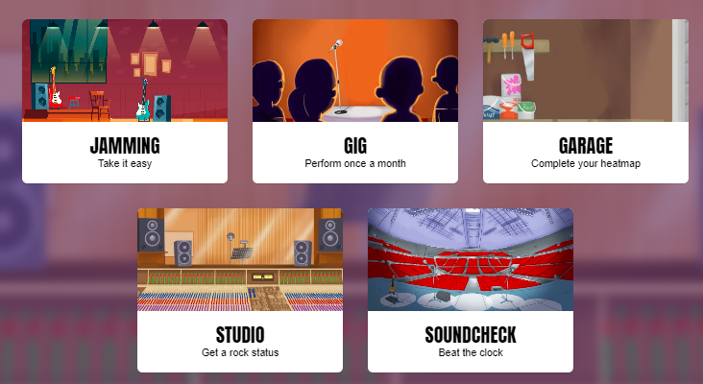
By the end of Y3, children need to be confident with the 2, 3, 4, 5, 8
and 10 times tables.

Slide 14
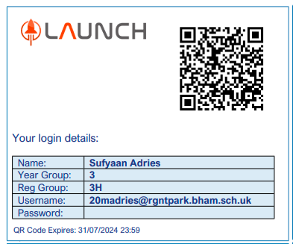
Individual log in details be sent home in the next week.
Keep these safe. Only the child who the log in
details belong to should use them.
These details will allow children to access homework on J2e, Accelerated Reader quizzes
and TTR.

Slide 15
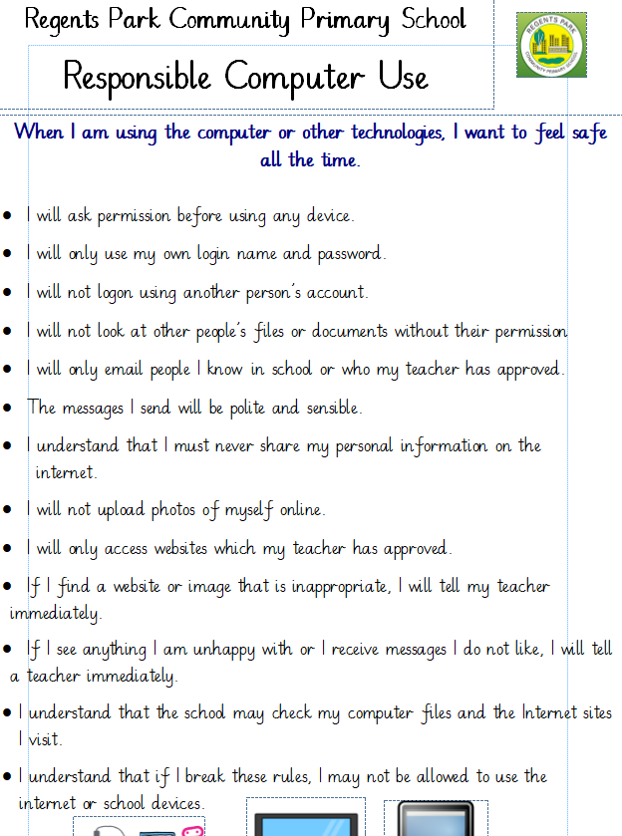

Slide 16
Topics we are learning about this term:
History - Stone Age to the Iron Age
Geography – Our planet
Art - Drawing (cave art)
DT – Food
RE – Sharing and Being Generous, Caring for Others, Animals and the Environment
PSHE – Rights Respecting, Class Charters, Anti Bullying
Spanish – I’m learning Spanish
Music – Let Your Spirit Fly, Glockenspiel Level 1

Slide 17
Any questions?

