Slide 1
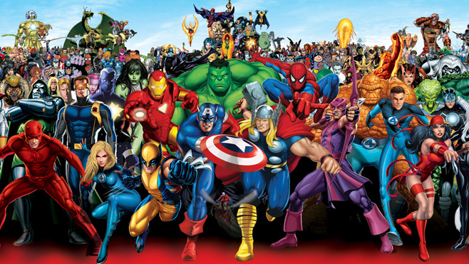

Slide 2
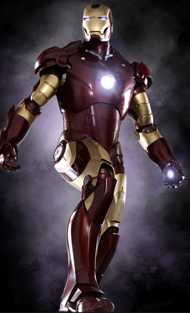
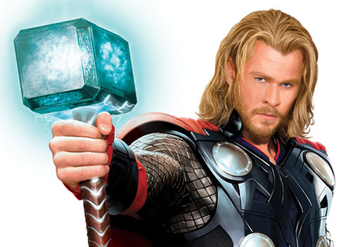
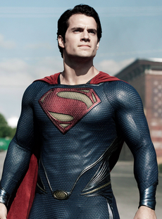
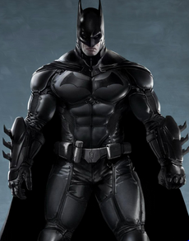


Super Hero Multiplication
Do you have what it takes to take on the most powerful Super Heroes?

Slide 3
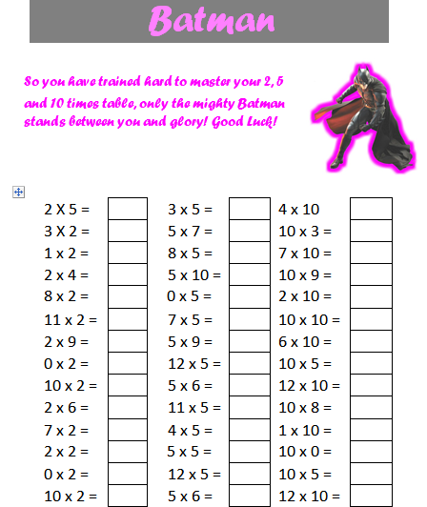
To begin with you will face Batman!
He is an expert at the 2, 5 and 10 times tables.
Do you have what it takes to beat him?

Slide 4
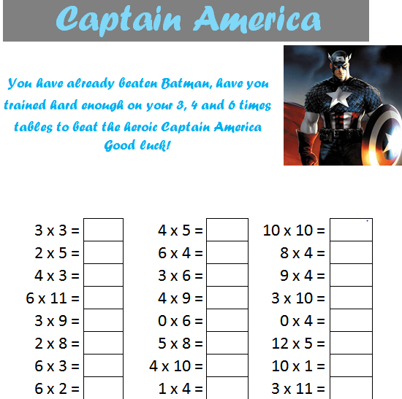
Your second challenge will be to face Captain America. He claims to be unstoppable at the 3, 4 and 6 times tables.
Are you swift enough?

Slide 5
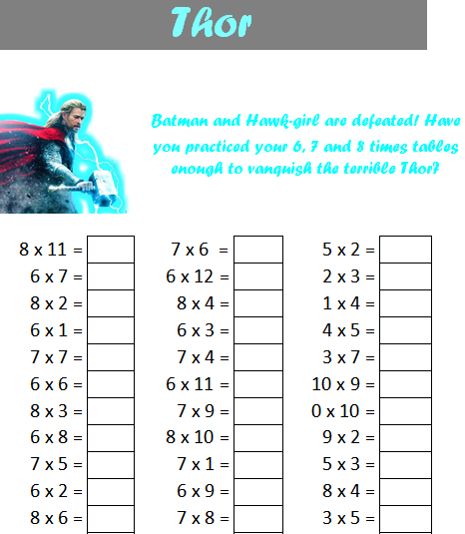
Next up, it’s Thor!
He is lightening fast at the 6, 7 and 8 times tables.
Are you fast enough?

Slide 6
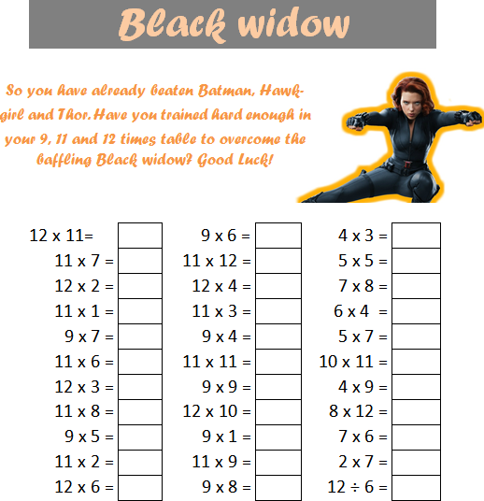
Now it’s time to face Black Widow!
She is going to challenge you with the 9, 11 and 12 multiplication facts.
Are you quick enough?

Slide 7
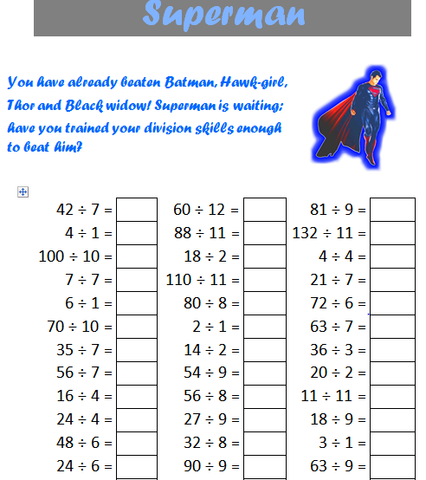
It’s time to face Superman!
To beat his time, you’ll need to have a good knowledge of ALL of the times tables… he’s also going to throw in some division too!

Slide 8
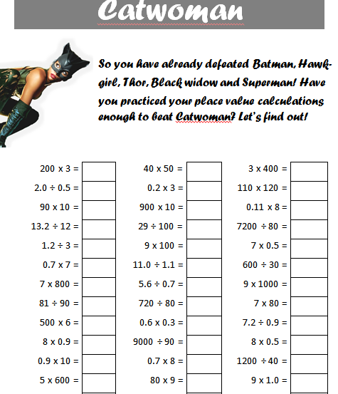
So you’re a times tables pro?
Well Catwoman is outstanding at pace value calculation.
Can you beat her?

Slide 9
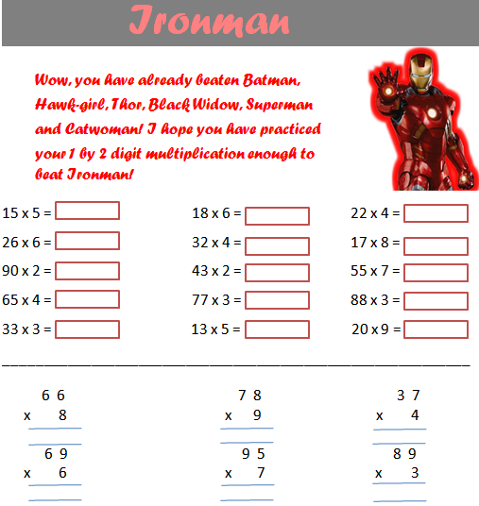
It’s time for Ironman!
He will take on anyone at 2-digit by 1-digit multiplication.
If you come prepared, you can do it!

Slide 10
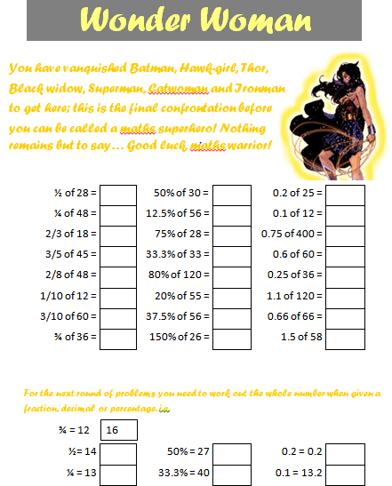
Finally, it’s time to face the queen of mental calculation… Wonder Woman!
The ultimate test will challenge you with fractions and percentages questions.

Slide 11


When will I get the chance to take on the Super heroes?
Everyone will have the chance to take on Batman for the first time next Wednesday! (15.10.14)
You will get the opportunity to complete 2 challenges each half term and everyone in Year 5&6 will be doing it on the same day!

Slide 12

Remember, it’s not where you start that counts, it’s where you end up!
If you train your mind and practice frequently, you can do it!

