Slide 1


Slide 3





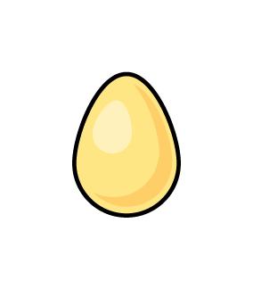



1) Here are 3 _______
2) Compare. What symbol is missing?
3) What shape is the cylinder?
4) Which one doesn’t belong?

Slide 4
cones
1) Here are 3 _______
2) Compare. What symbol is missing?
3) What shape is the cylinder?
4) Which one doesn’t belong?
=

Slide 6

Sorting rules:
What is the same?
What is different?

Slide 7
Sorting rules - shape
Cone Cylinder Cube

Slide 8








Sorting by shape
Have a think
Cone Cylinder Cube

Slide 9

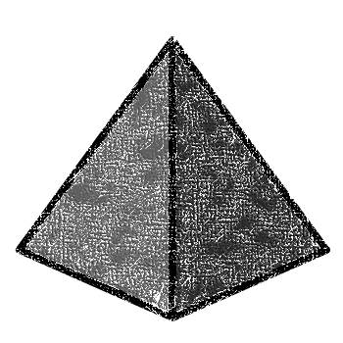


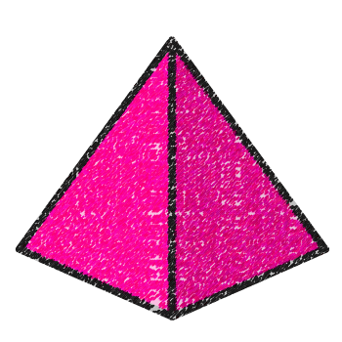
Sorting rules - shape
Sphere Pyramid Cuboid

Slide 10



Sorting by shape
Have a think
Sphere Pyramid Cuboid

Slide 11








Sorting by colour
Have a think
Which ones are not sorted correctly?
The brown and the blue
cylinder
cone

Slide 12
Have a go at questions 1 and 2 on the worksheet

Slide 13
Sorting rules - stacks

Slide 14
Sorting rules - rolls
Have a think

Slide 15
Have a go at questions 3 and 4 on the worksheet

