Slide 1

Year 2
Curriculum Workshop

Slide 2

School starts at 8.40am.
Please ensure children arrive on time.
Children need to be in full school
uniform.
bottle green jumper / cardigan,
white polo shirt, grey trousers, black trousers

Slide 3
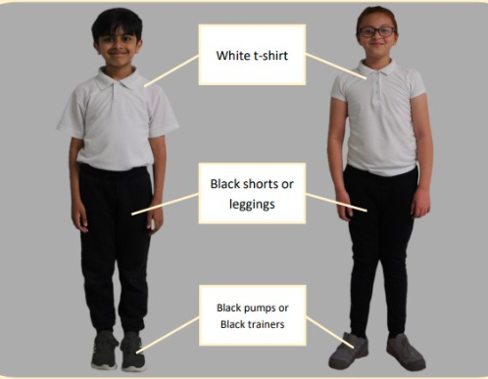
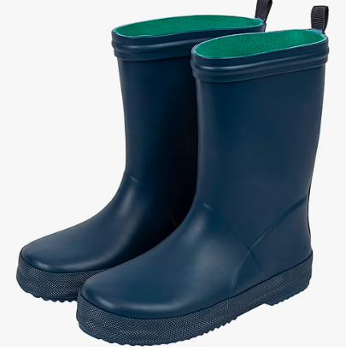
PE is on Tuesdays.
Forest School is on Tuesdays.

Slide 4
Reading:
Children visit the school library every week.
They also have the opportunity to choose a passport book weekly.
Every Wednesday they will be given a reading book which needs to be returned by Monday.
Lost or damaged books will be charged £5 for.

Slide 5
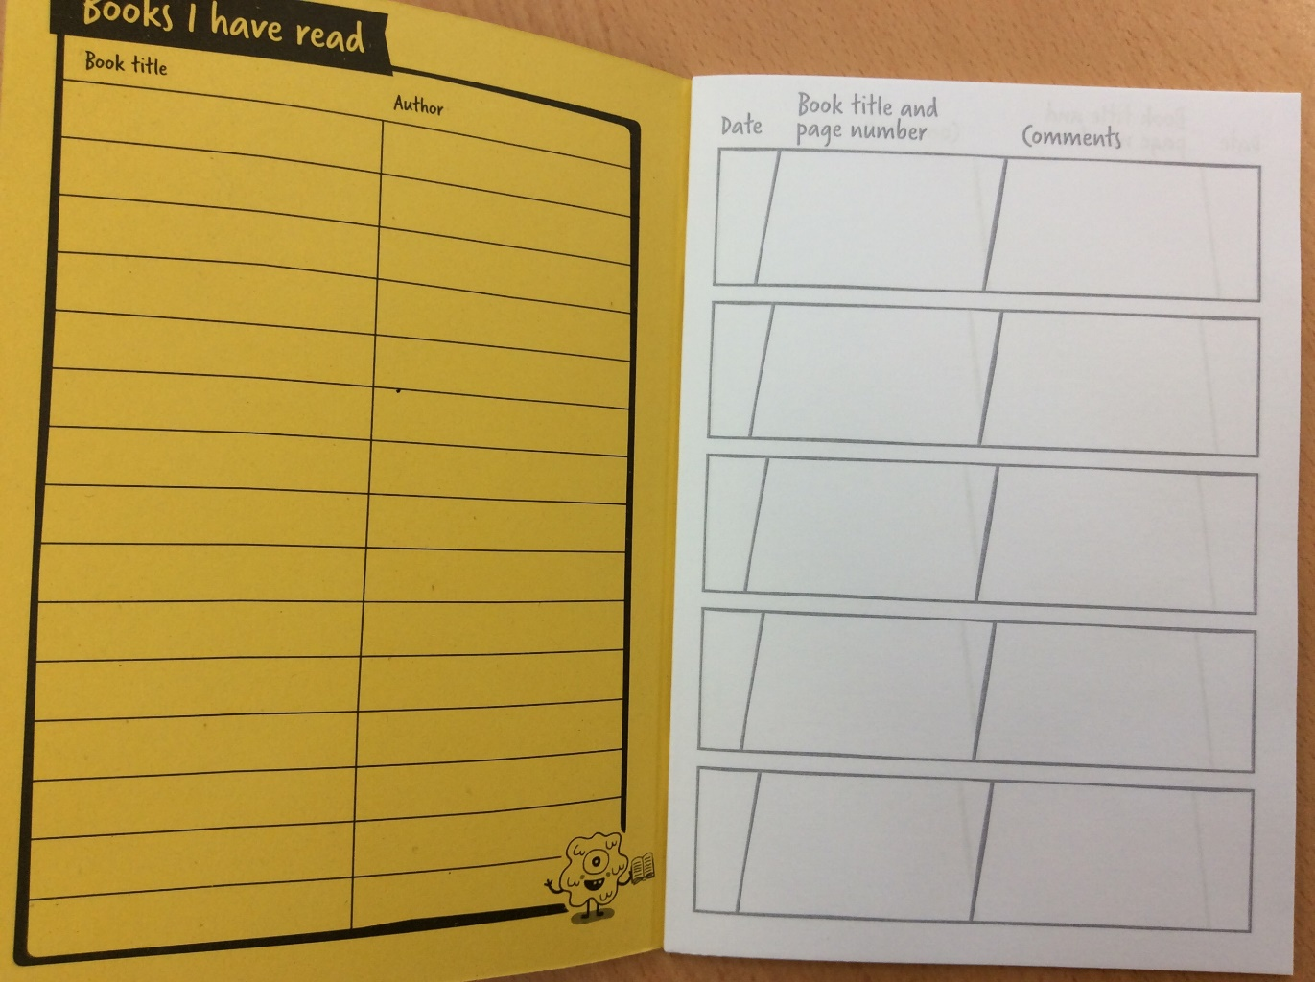
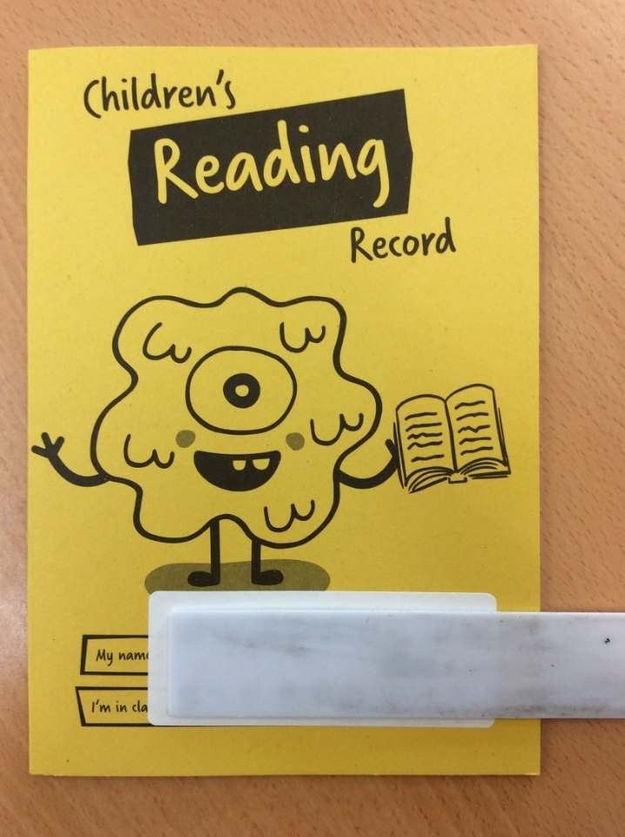
Encourage children to read at home everyday.
Their reading journal needs to be filled in and returned to the teacher Wednesday.

Slide 6
Spellings:
ALL year 2 children must be able to read and spell the Y2 common exception words.
These will be sent home with you today, please spend some time reading and practise spelling these.

Slide 7
Homework
Given out on Friday and it needs to be returned by
Monday
Children will bring home the following homework:
  Phonics
  English
  Maths
  TTRockstars
Sometimes homework may be based on other topics.

Slide 8


Slide 9

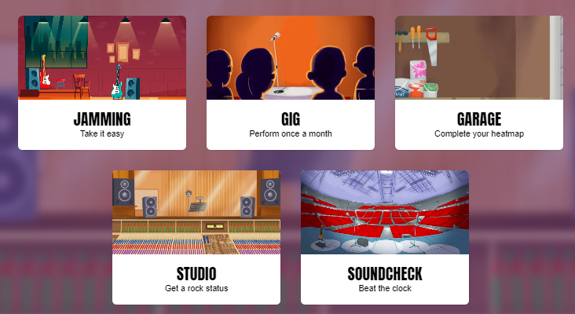
By the end of Y2, children need to be confident with the 2, 5,
and 10 times tables.

Slide 10
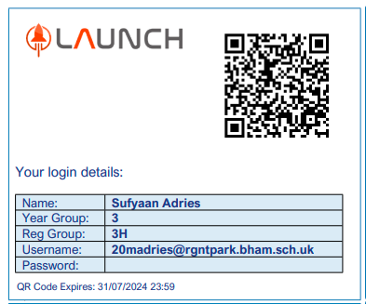
Individual log in details are
stuck into the front cover of the reading journals
Keep these safe. Only the child who the log in
details belong to should use them.
We will let you know as and when you need to start using them.

Slide 11
Topics we are learning about this term:
History – Significant People
Geography – Jamaica
Art - Colour
DT – Food
RE – Living by Rules, Being Temperate, Exercise self discipline and Cultivate Serene Contentment
PSHE – Rights Respecting, Class Charters, Anti Bullying
Science – Animals including Human
Music – If we all belong

Slide 12
Thank you for coming!

Slide 13
Any questions?

