Slide 1


Slide 3


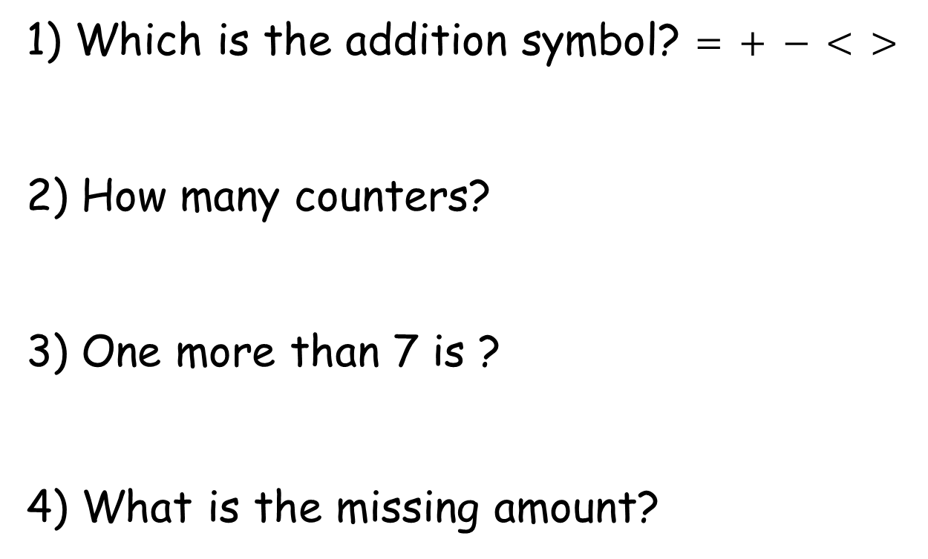
1) Which is the addition symbol? $=$ $+$ $−$ $<$ $>$
2) How many counters?
3) One more than 7 is ?
4) What is the missing amount?
?
4
2

Slide 4
1) Which is the addition symbol? $=$ $+$ $−$ $<$ $>$
2) How many counters?
3) One more than 7 is ?
4) What is the missing amount?
4
8
6
?
4
2

Slide 6


What is a fact family?
8
8
5
3
3
5
5 + 3 = 8
3 + 5 = 8
What is the same?
What is different?

Slide 7
What is a fact family?
8
8
5
3
3
5
5 + 3 = 8
3 + 5 = 8
8 = 5 + 3
8 = 3 + 5
What is the same?
What is different?

Slide 8


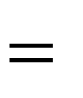

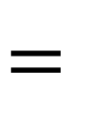
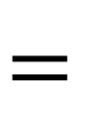


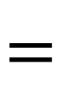

Have a think
7
4
$$+$$
3
$$=$$
7
3
$$+$$
4
$$=$$
7
4
3
7
$$=$$
4
$$+$$
3
I can write 4 facts!
7
$$=$$
3
$$+$$
4

Slide 9
Have a go at question 1 on the worksheet

Slide 10

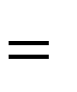

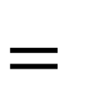
What is a bar model?
8
8
6
2
6
2
6
$$+$$
2
$$=$$
8
2
$$+$$
6
$$=$$
8

Slide 11

Have a think
5
5
4
1
4
1
4
$$+$$
1
$$=$$
5
1
$$+$$
4
$$=$$
5

Slide 12

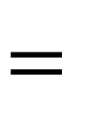
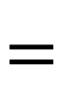


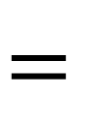

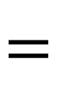
Have a think
9
5
$$+$$
4
$$=$$
9
5
4
4
$$+$$
5
$$=$$
9
9
$$=$$
5
$$+$$
4
9
$$=$$
4
$$+$$
5

Slide 13
Have a go at question 2 on the worksheet

Slide 14
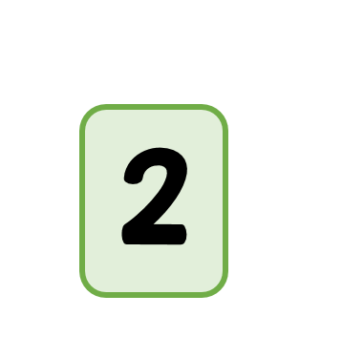









Can you make a fact family?
2
$$+$$
3
$$=$$
5
3
$$+$$
2
$$=$$
5
5
$$=$$
2
$$+$$
3
5
$$=$$
3
$$+$$
2

Slide 15
Have a go at the rest of the questions on the worksheet

