Slide 1
SYSTEMATIC NUMBER BONDS

Slide 3



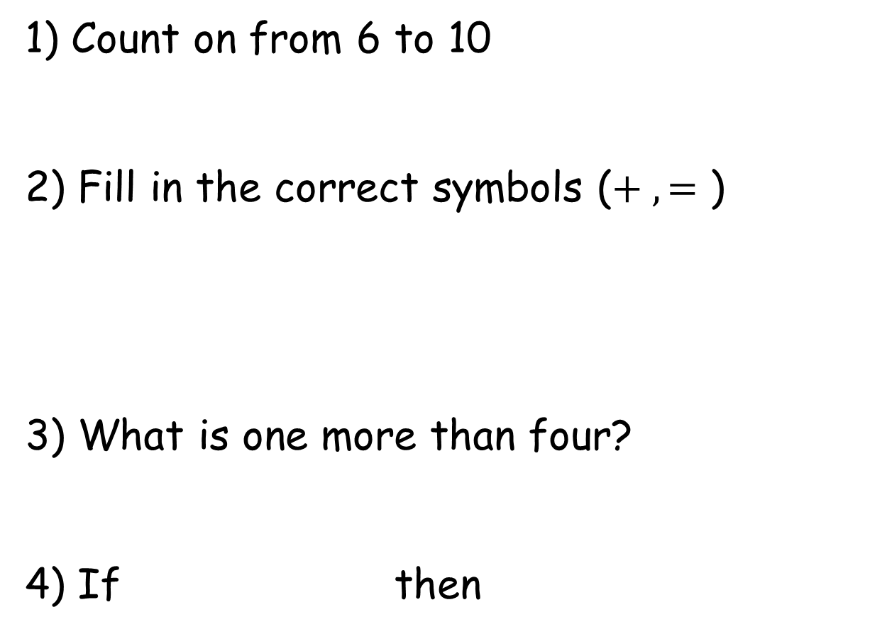
1) Count on from 6 to 10
2) Fill in the correct symbols ($+ , =\text{)}$
3) What is one more than four?
4) If then
4 + 2 = 6
2 + 4 =

Slide 4
1) Count on from 6 to 10
2) Fill in the correct symbols ($+ , =\text{)}$
3) What is one more than four?
4) If then
6, 7, 8, 9, 10
=
+
5
4 + 2 = 6
2 + 4 =
6

Slide 6

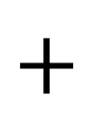
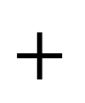
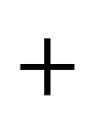
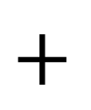
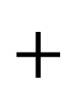
Number bonds to 4
4
$$+$$
0
3
$$+$$
1
2
$$+$$
2
1
$$+$$
3
0
$$+$$
4

Slide 7

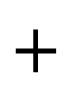

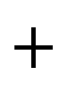
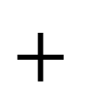
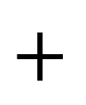
Have a think
What is missing?
2
$$+$$
2
0
$$+$$
4
4
$$+$$
0
1
$$+$$
3
?
3
$$+$$
1

Slide 8
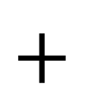
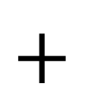

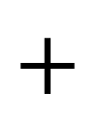
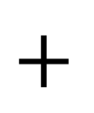
Number bonds to 4
What do you notice?
4
$$+$$
0
3
$$+$$
1
2
$$+$$
2
1
$$+$$
3
0
$$+$$
4

Slide 9
Have a go at question 1 on the worksheet

Slide 10








Have a think
Which has more number bonds?
3
4
$$+$$
4
$$+$$
0
3
0
2
$$+$$
1
$$+$$
3
1
1
$$+$$
2
$$+$$
2
2
$$+$$
1
$$+$$
3
0
3
0
$$+$$
4

Slide 11










Have a think
3
4
3
$$+$$
0
4
$$+$$
0
I wonder if the greater the number, the more number bonds there are?
2
$$+$$
1
3
$$+$$
1
1
$$+$$
2
$$+$$
2
2
0
$$+$$
3
1
$$+$$
3
0
$$+$$
4

Slide 12







Yes! It is TRUE!
3
4
5
3
$$+$$
0
4
$$+$$
0
5
$$+$$
0
2
$$+$$
1
3
$$+$$
1
4
$$+$$
1
1
$$+$$
2
$$+$$
$$+$$
2
2
3
2
0
$$+$$
3
1
$$+$$
3
2
$$+$$
3
We should see how many number bonds for 5!
0
$$+$$
4
1
$$+$$
4
0
$$+$$
5

Slide 13
Have a go at the rest of the questions on the worksheet

