Slide 1


Slide 3


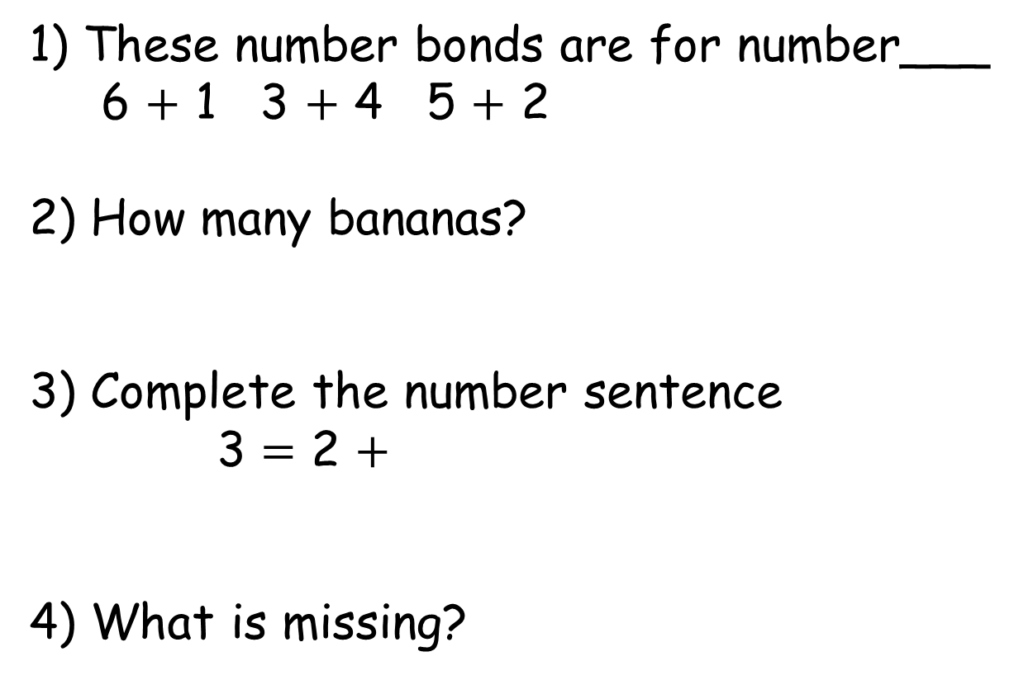
1) These number bonds are for number___
6 $+$ 1 3 $+$ 4 5 $+$ 2
2) How many bananas?
3) Complete the number sentence
3 = 2 $+$
4) What is missing?
4
4

Slide 4
7
1) These number bonds are for number___
6 $+$ 1 3 $+$ 4 5 $+$ 2
2) How many bananas?
3) Complete the number sentence
3 = 2 $+$
4) What is missing?
4
1
5
4
8
4

Slide 6




Number bonds to 10
10
1
9
1
10
9
9
$$+$$
1
$$=$$
10
10
$$=$$
$$+$$
9
1

Slide 7












Number bonds to 10
Have a think
10
$$+$$
0
0
$$+$$
10
9
$$+$$
1
1
$$+$$
9
8
$$+$$
2
2
$$+$$
8
7
$$+$$
3
3
$$+$$
7
6
$$+$$
4
4
$$+$$
6
5
$$+$$
5

Slide 8
Have a go at questions 1 and 2 on the worksheet

Slide 9





Have a think
10 goals were scored at the football match.
We scored
goals!
We scored
goals!
4
6
$$+$$
6
$$=$$
4
10
Which team won?

Slide 10




There are 10 animals
at the pet shelter.
There are the same number of
and
5
5
There are cats and dogs
$$+$$
5
$$=$$
5
10

Slide 11










Rosie had 10 pieces of fruit.
She had more grapes than cherries.
9
$$+$$
1
8
$$+$$
2
7
$$+$$
3
6
$$+$$
4

Slide 12
Have a go at the rest of the worksheet

