Slide 1


Slide 3



1) 8 is ___________ 6
2) 5 is ___________ five.
3) Fill in the symbol to compare 2 3
4) Use to make a fact family.

Slide 4
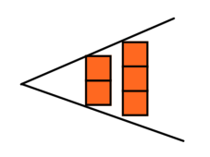
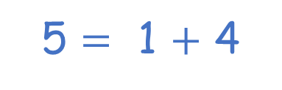
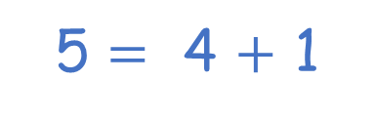

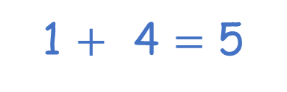
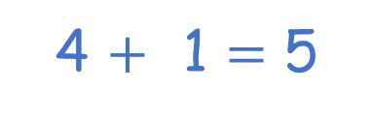
1) 8 is ___________ 6
2) 5 is ___________ five.
3) Fill in the symbol to compare 2 3
4) Use to make a fact family.
greater than
equal to
$$<$$
4 $+$ 1 $=$ 5
5 $=$ 4 $+$ 1
1 $+$ 4 $=$ 5
5 $=$ 1 $+$ 4

Slide 6















We know…
5
$$=$$
5
5
$$=$$
$$=$$
5
$$=$$
4
$$+$$
1
4
$$+$$
1
$$=$$
4
$$+$$
1
4
$$+$$
1
3
$$+$$
2
$$=$$
5
$$+$$
0
$$=$$
2
$$+$$
3

Slide 7






Let’s compare!
Find number bonds that are equal.
Have a think
3
$$+$$
0
5
$$+$$
1
0
$$+$$
4
4
$$+$$
2
3
$$+$$
1
1
$$+$$
2

Slide 8
Have a go at question 1 on the worksheet

Slide 9







We know…
5
$$<$$
6
5
$$<$$
$$<$$
5
$$<$$
5
$$+$$
1
4
$$+$$
1
$$<$$
5
$$+$$
1
4
$$+$$
1
$$<$$
4
$$+$$
2
5
$$+$$
0
$$<$$
2
$$+$$
4

Slide 10











$$<$$
$$=$$
$$<$$
Let’s use symbols to compare!
$$+$$
$$<$$
$$+$$
3
0
3
1
$$+$$
$$=$$
$$+$$
0
9
4
5
5
$$+$$
5
$$<$$
3
$$+$$
3
Have a think

Slide 11
Have a go at questions 2 and 3 on the worksheet

Slide 12









Let’s compare number bonds!
Have a think
Amir rolled
Annie rolled
$$+$$
$$<$$
$$+$$
3
5
6
4

Slide 13



Let’s compare number bonds!
Have a think
Amir rolled
Annie rolled
$$+$$
$$<$$
$$+$$
3
5
6
4
2
$$+$$
4
$$=$$
3
$$+$$
3

Slide 14

Let’s compare number bonds!
Have a think
Amir rolled
Annie rolled
$$+$$
$$<$$
$$+$$
3
5
6
4
2
$$+$$
4
$$=$$
3
$$+$$
3
2
$$+$$
5
$$>$$
5
$$+$$
1

Slide 15
Have a go at the rest of the questions on the worksheet

