Slide 1
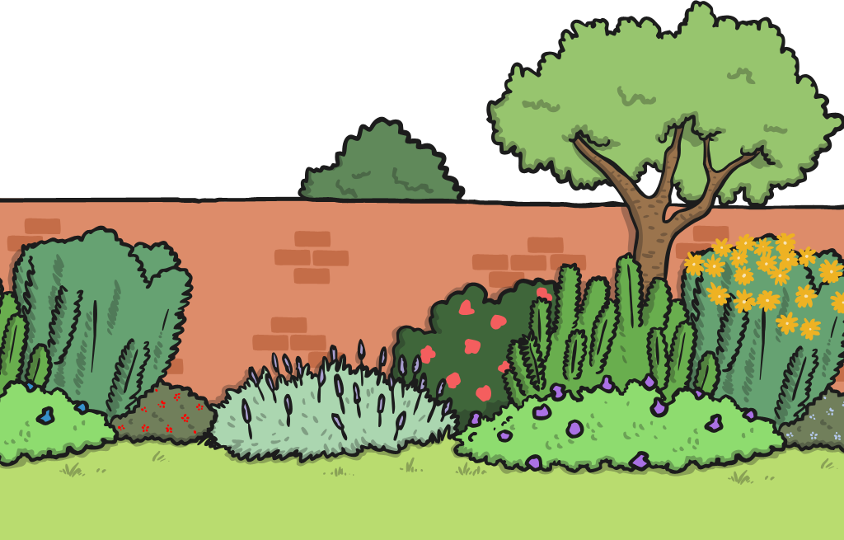
Great Gardens
Today we will be thinking about plants found in gardens.

Slide 2
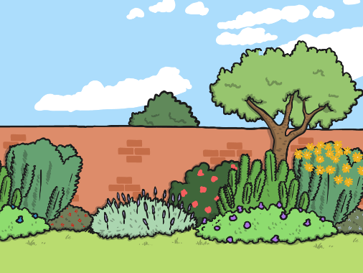
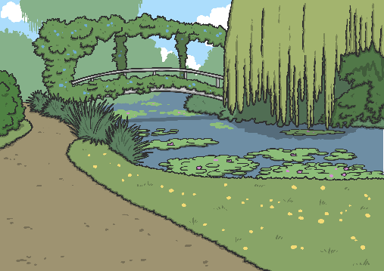
Great Gardens
Gardens are places where people grow plants.
Some people grow plants because they are nice to look at.
Some people use their gardens for growing things to eat.
You can plant your bean plant in a garden when you take it home.
Eventually it will grow tasty beans!
You might have a garden where you live.
A public park is a kind of garden for lots of people to enjoy.

Slide 3


Great Gardens
Think of a garden that you like
to spend time in.
It could be your own garden, a garden that you like to visit, or it could be a public garden or park.
Which garden is a happy
place for you?

Slide 4

Great Gardens
What kind of plants grow in your favourite garden?
On your whiteboard, draw a kind of plant that you like.
Do you know what the plant is called?
If you want to, write your plant’s name.

Slide 5
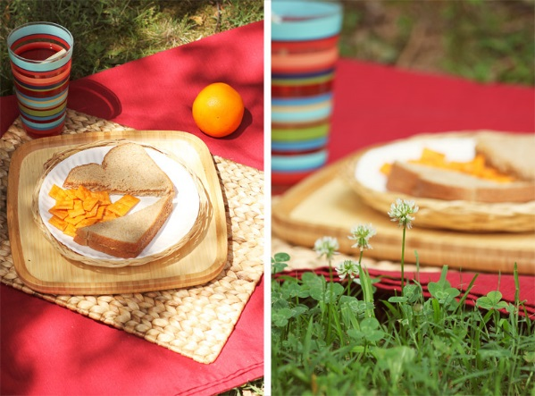
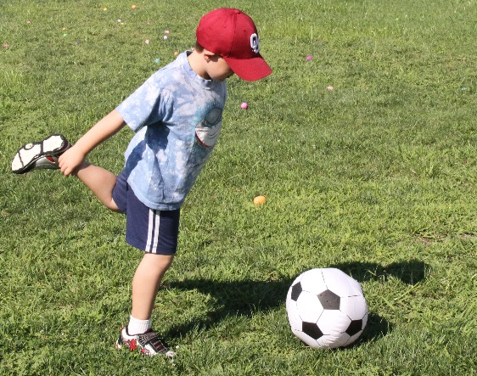
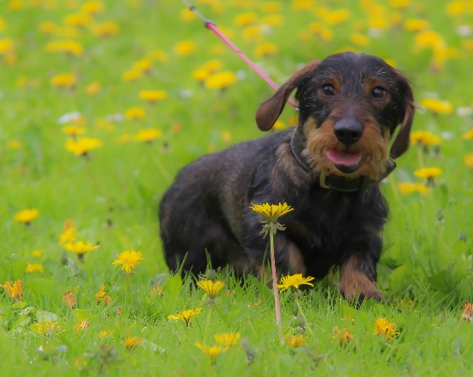
Garden Plants: Grass
Grass is a special kind of plant that looks good and is comfortable to walk on and sit on.
You can have a picnic on the grass.
You can play games on the grass.
You can go for
a walk on the grass.
Photos courtesy of emiline220, usacenad, infomastern (@flickr.com) - granted under creative commons licence – attribution

Slide 6
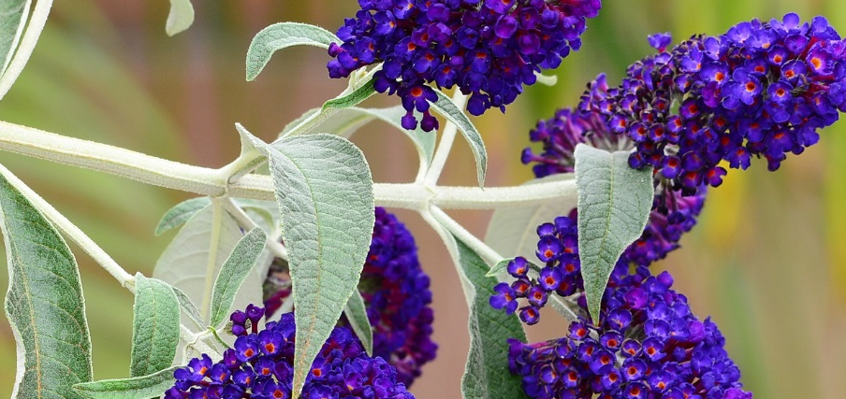
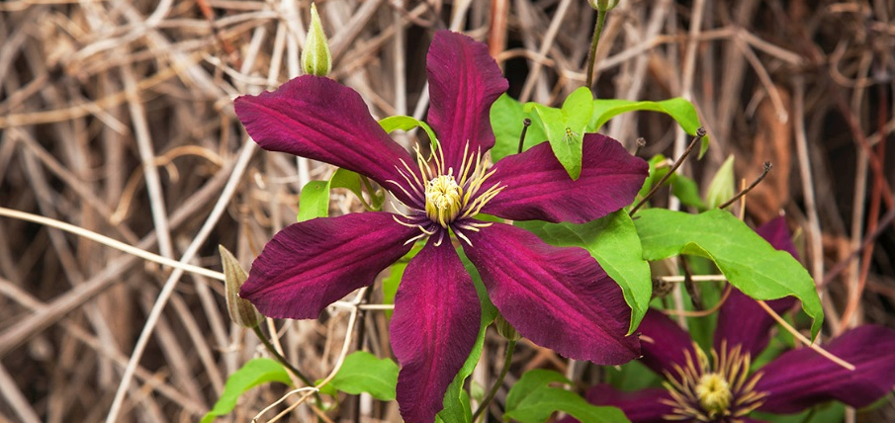
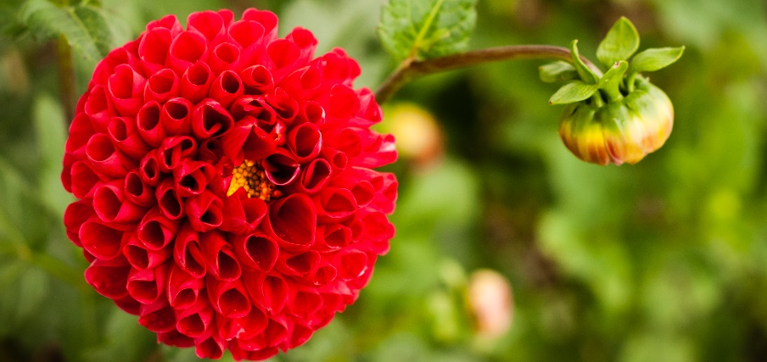
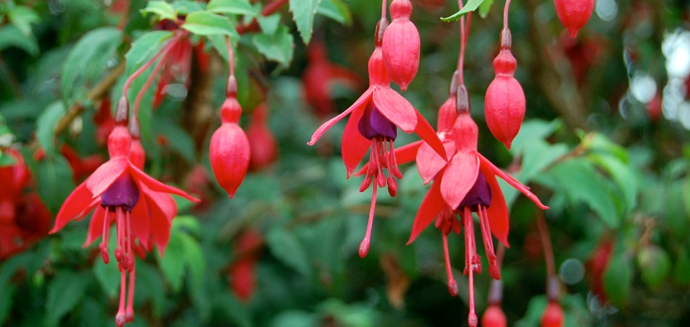
Garden Plants
Here are some garden plants that people grow to look at.
Do you recognise any of these plants?
buddleia
clematis
dahlia
fuschia
Photos courtesy of tdlucas5000, cobalt123, Polo-Foto, pchgorman (@flickr.com) - granted under creative commons licence – attribution

Slide 7
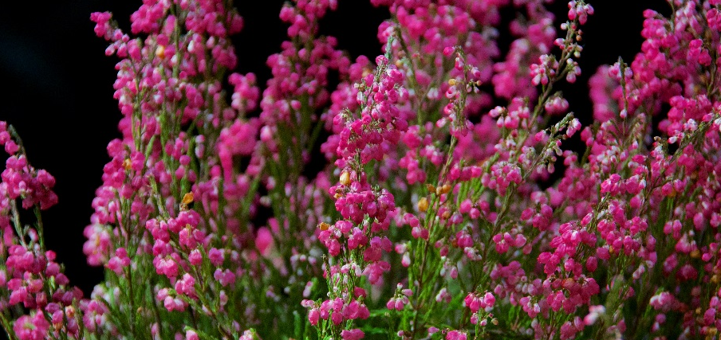
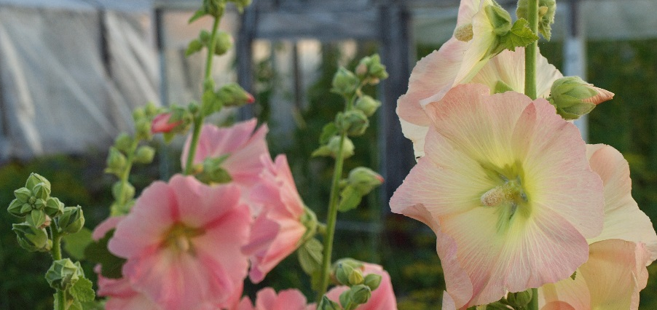
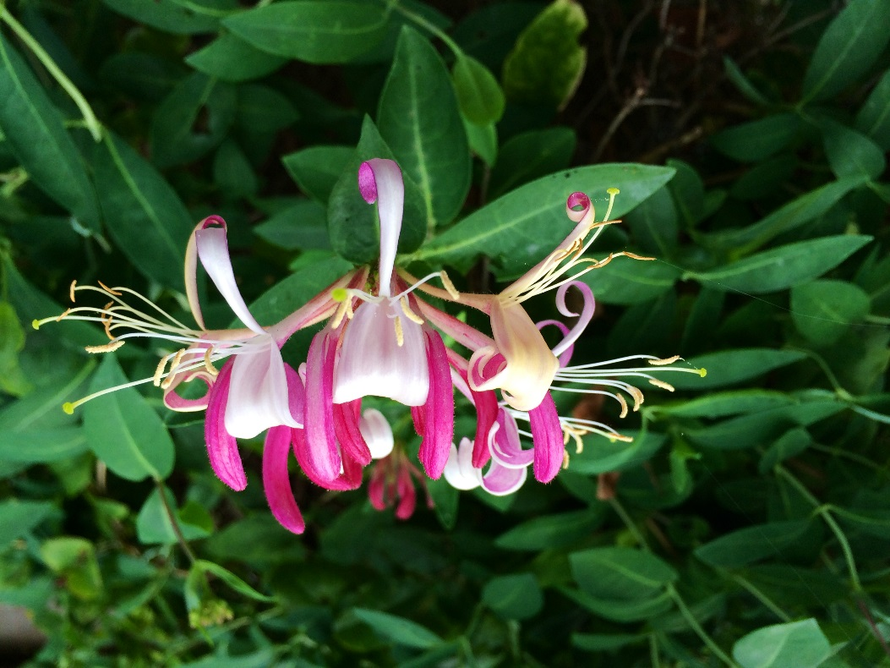
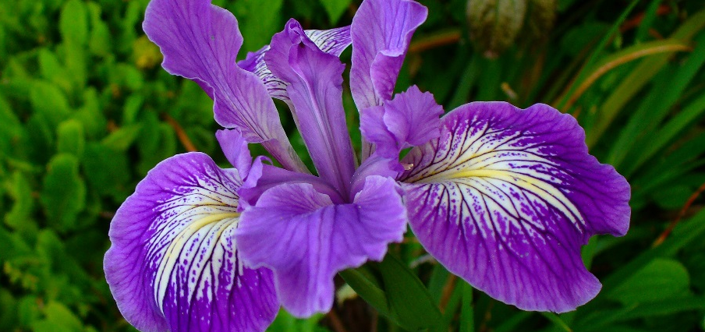
Garden Plants
heather
hollyhock
honeysuckle
iris
Photos courtesy of Ania Mendrek, Axiraa, jenn2d2, serenithyme (@flickr.com) - granted under creative commons licence – attribution

Slide 8
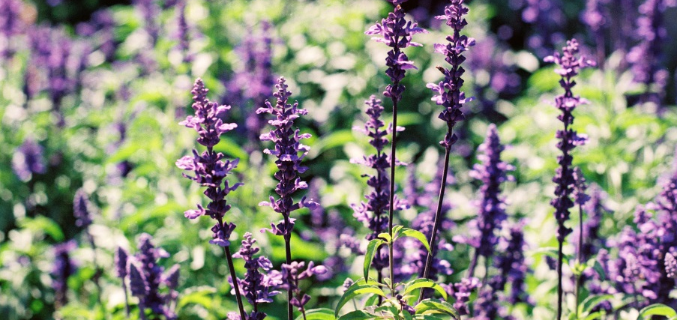
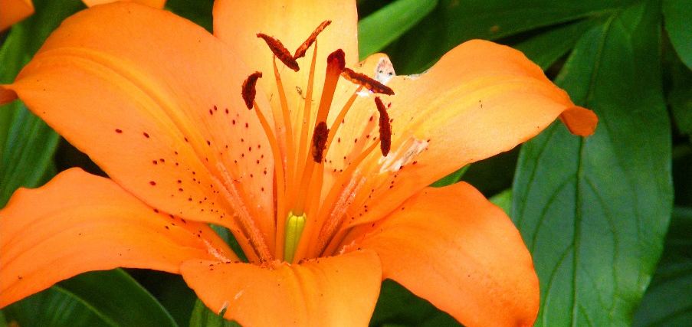
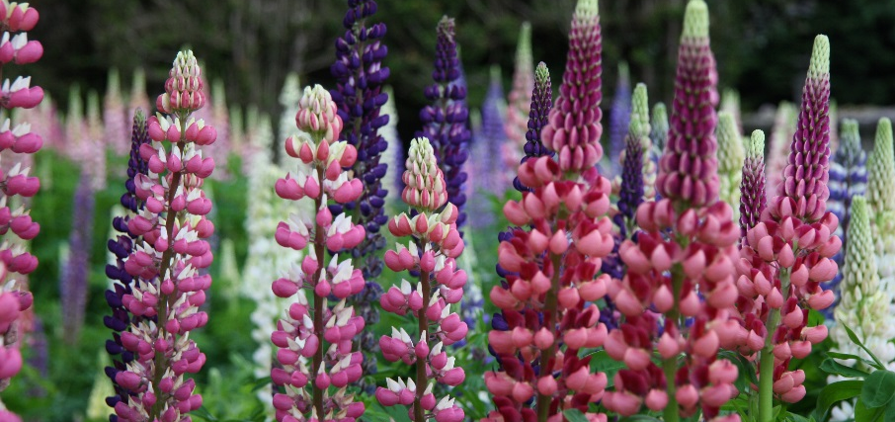
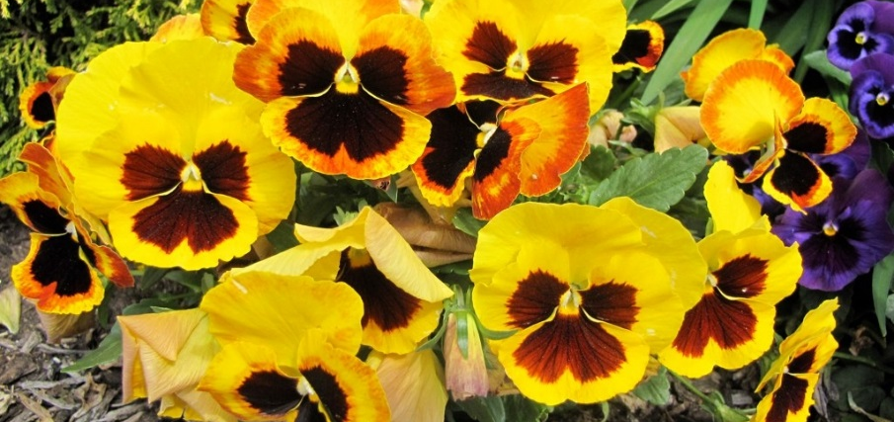
Garden Plants
lavender
lily
lupin
pansy
Photos courtesy of Khánh Hmoong, Stanley Zimny (Thank You for 13 Million views), PHOTOPHANATIC (@flickr.com) - granted under creative commons licence – attribution

Slide 9
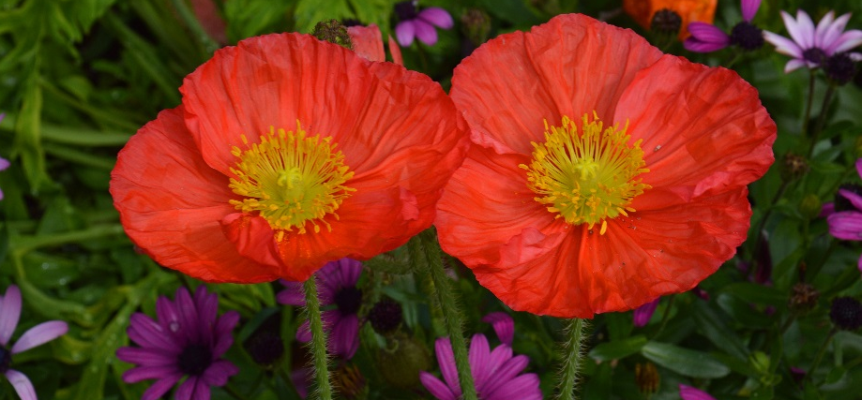
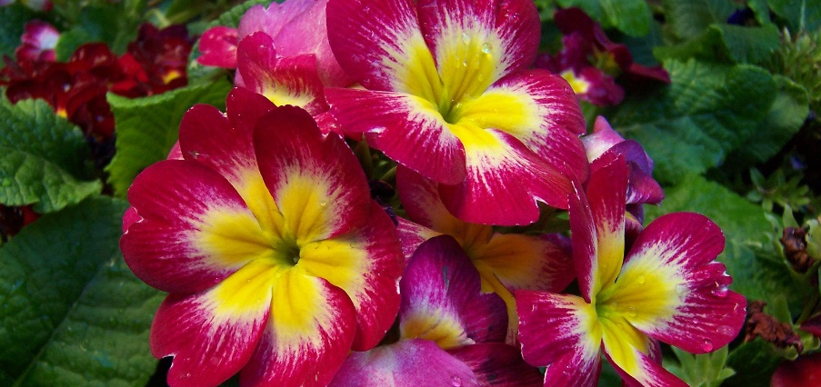
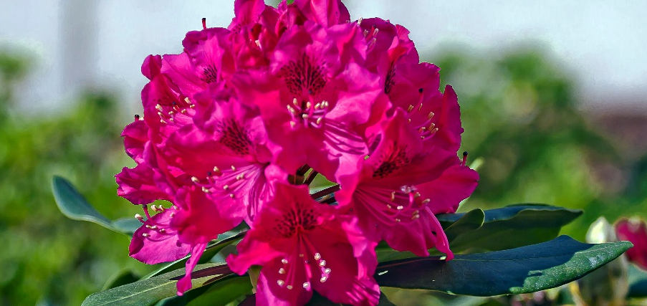
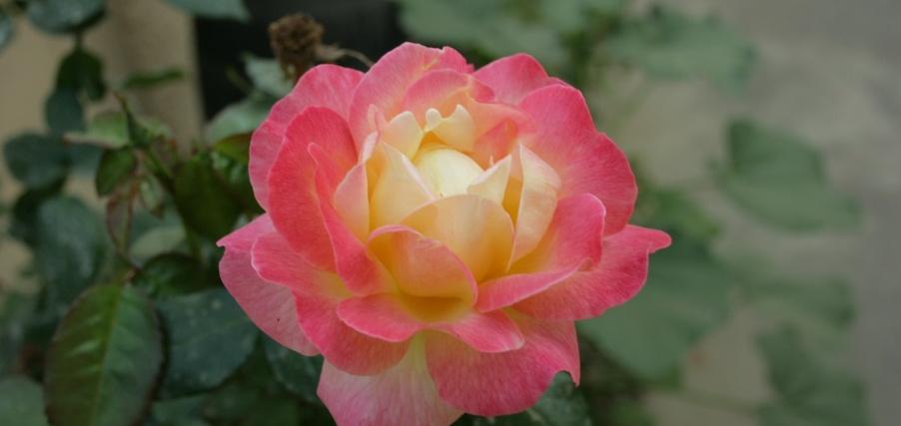
Garden Plants
poppy
primula
rhododendron
rose
Photos courtesy of Irene Grassi (sun sand & sea), Gustavo (lu7frb), Big Grey Mare, Swami Stream (@flickr.com) - granted under creative commons licence – attribution

Slide 10
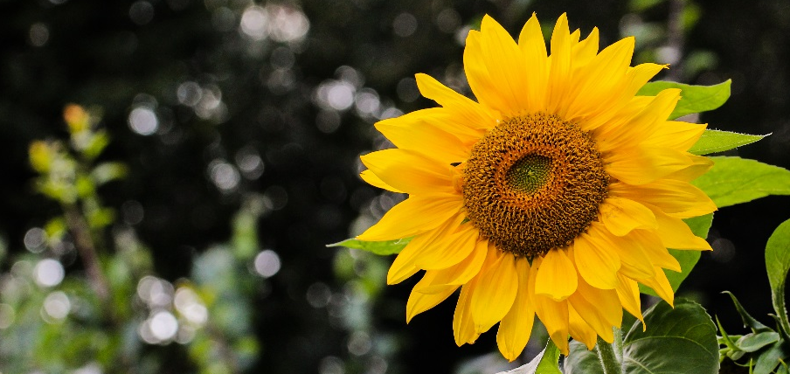
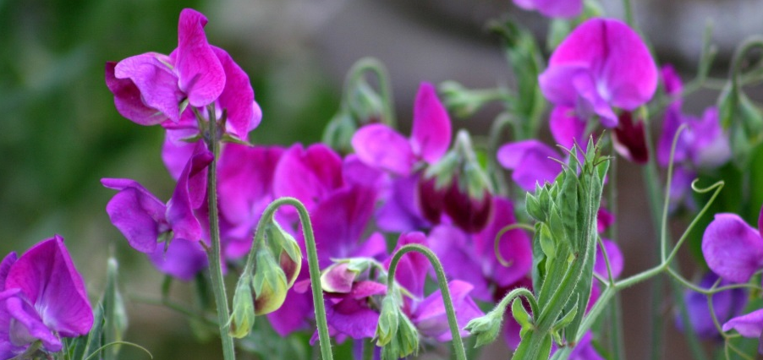
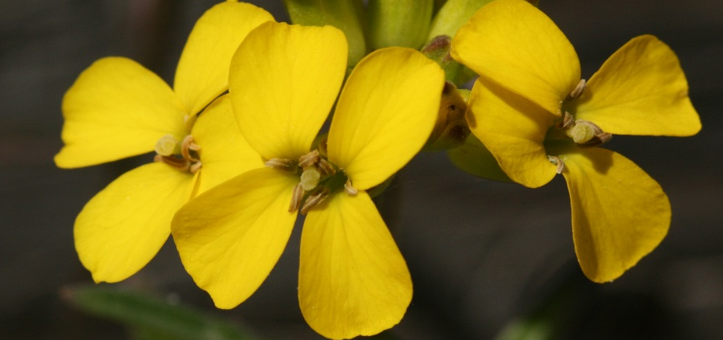
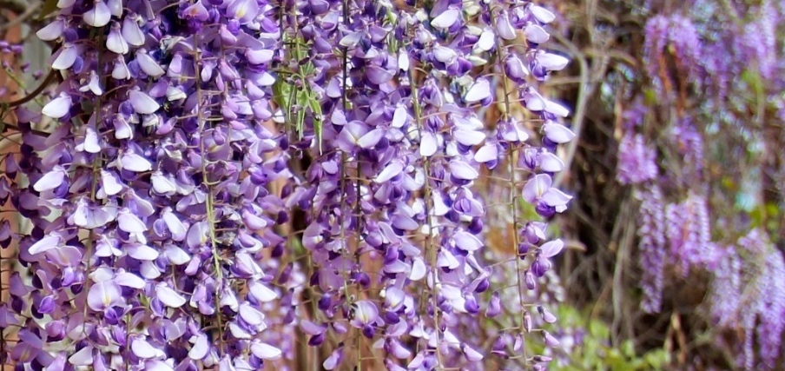
Garden Plants
sunflower
sweetpea
wallflower
wisteria
Photos courtesy of © Axel Naud, pirate_renee, Karol Franks (@flickr.com) - granted under creative commons licence – attribution

Slide 11
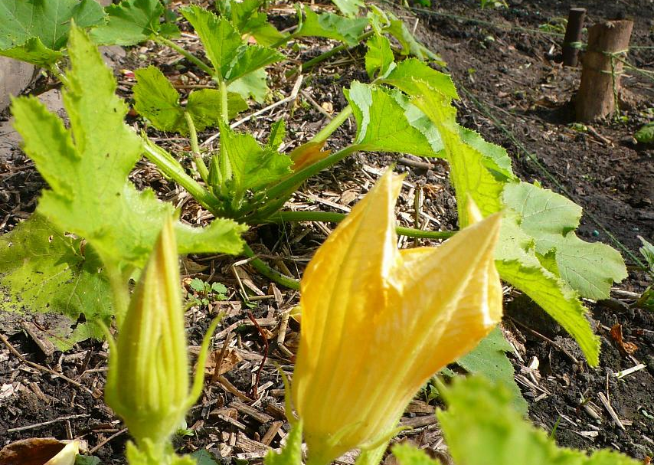
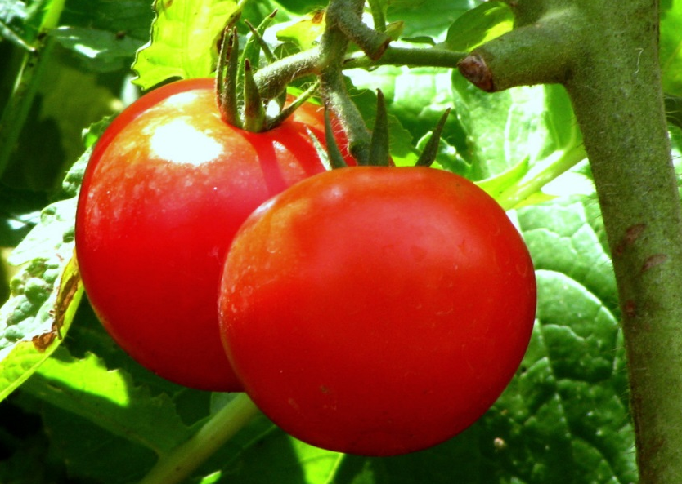
Garden Plants
You can grow lots of fruit and vegetables in the garden too!
Do you recognise either of these plants?
courgettes
tomatoes
Photos courtesy of smoobs and Ajith Kumar (@flickr.com) - granted under creative commons licence – attribution

Slide 12

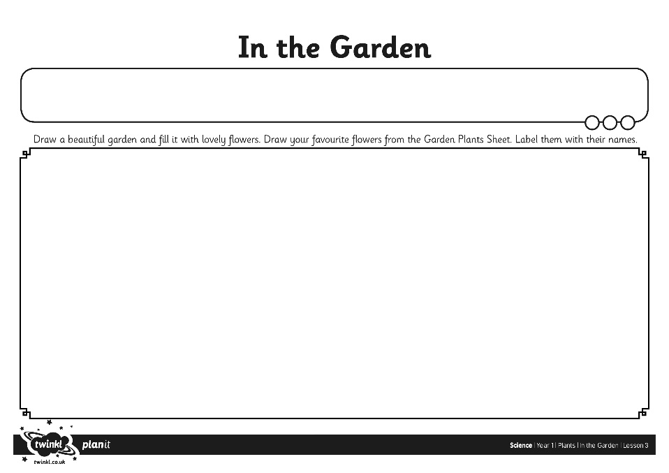
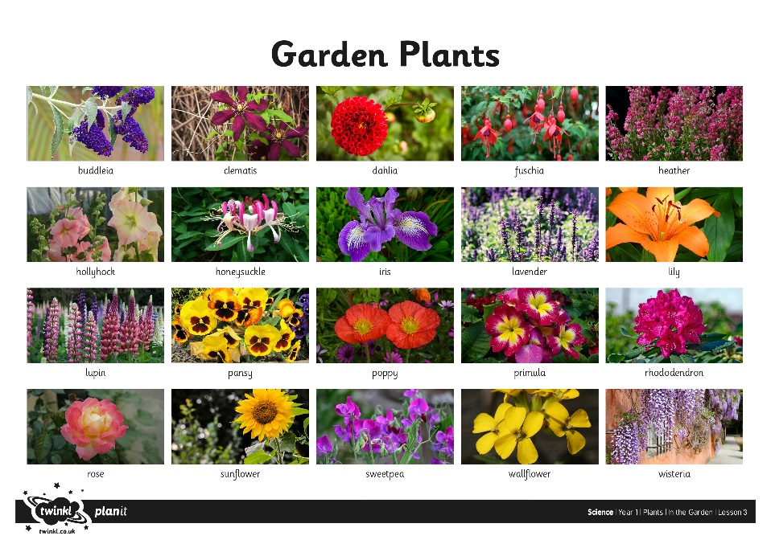
In the Garden
We are going to draw beautiful gardens!
We found lots of wild plants and we took a tally.
How shall we find out which plant was the most common today?

