Slide 2
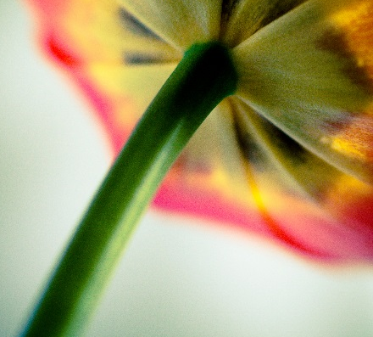
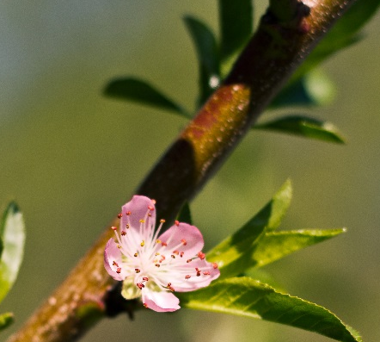
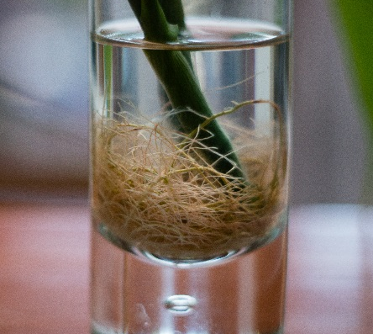
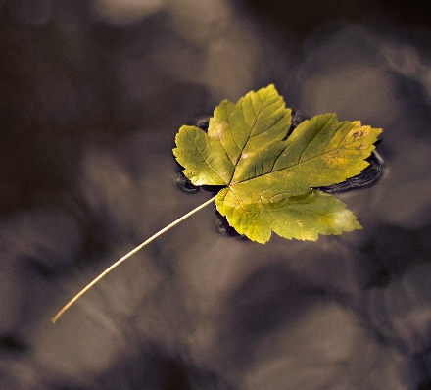
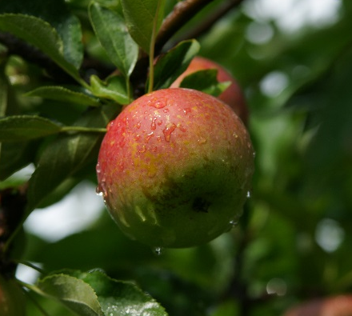
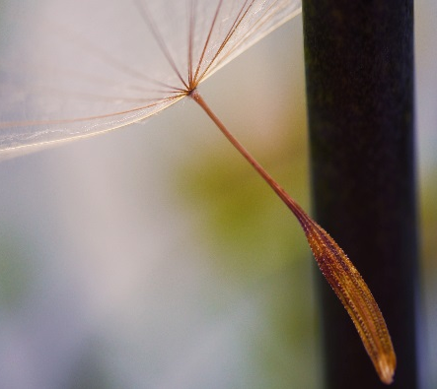
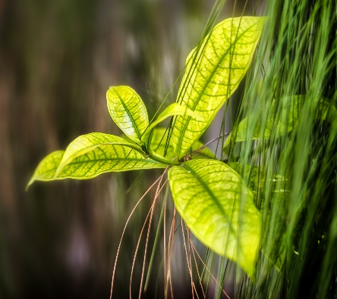
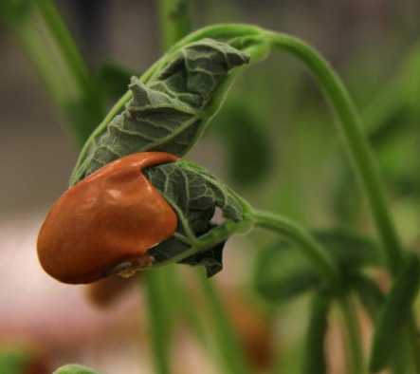
Plants
Today we are going to learn about different parts of plants.
Photos courtesy of Nomadic Lass, Christina Ann VanMeter, coofdy, Herr Olsen, Capt Kodak, fOtOmoth, Sunny_mjx, LadyDragonflyCC - >;< (@flickr.com) - granted under creative commons licence – attribution

Slide 3

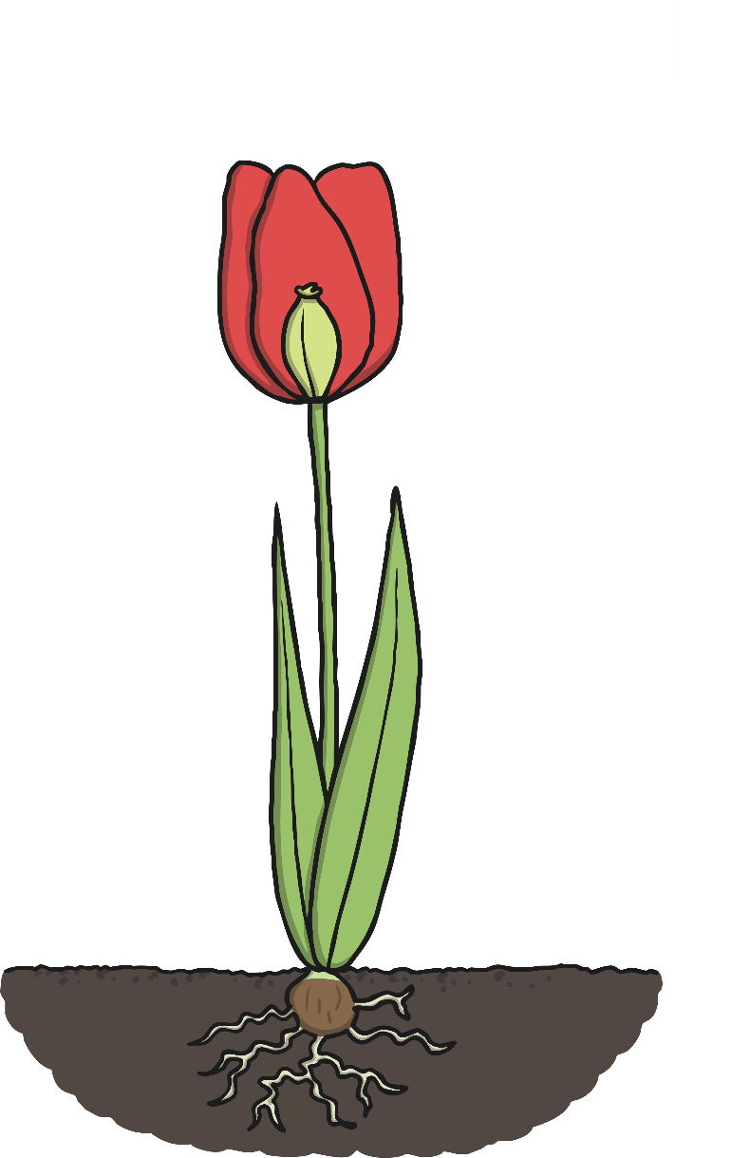
Parts of Plants
Look at this plant.
Do you know what any of the parts are called?

Slide 4
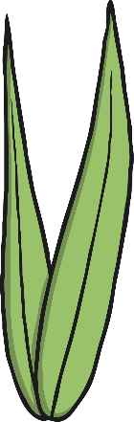

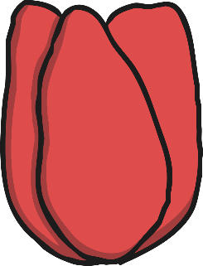
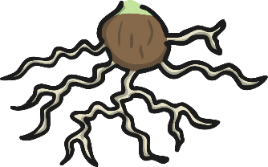
Parts of Plants
Let’s see if we got them all right!
flower
leaves
roots
seed
stem

Slide 5


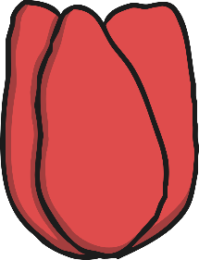
Parts of Plants
What are all the parts of a plant for?
leaves
seed
stem
roots
flower
Attracts insects and birds.
Catches sunlight to make energy.
Takes in water and nutrients from the soil.
Holds the plant up.
Grow into new plants when they fall into the soil.

Slide 6

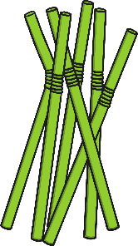

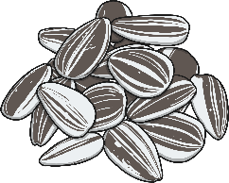





Making a Plant Picture
We are going to make plant pictures!
You will need:
green straws
sunflower seeds
real leaves
brown wool
cup cake cases
glue
blue card
brown card
How could we make a plant picture out of these materials?

Slide 7

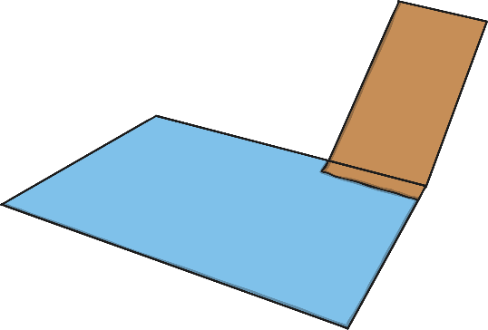
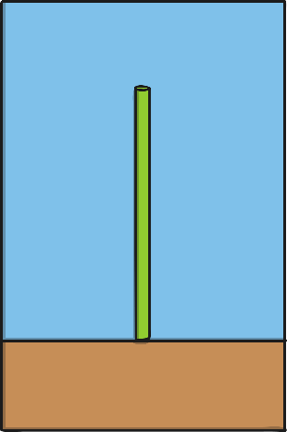
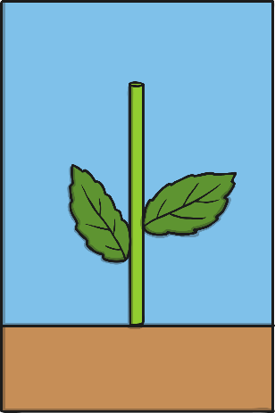
Plant Pictures
Attach the flap of brown card by sticking the small part of the flap to the back of the blue card at the bottom.
What do you think this will be?
Stick the green straw just above the brown flap.
What part of the plant is this?
Stick the leaves to the blue card at the sides of the green straw.

Slide 8
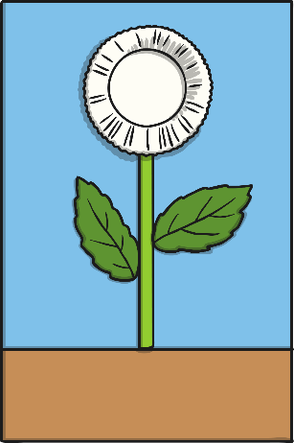
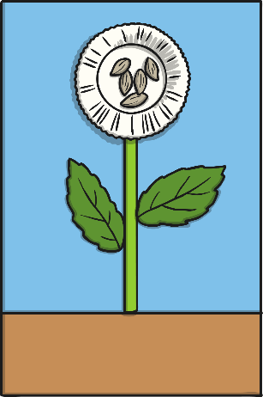
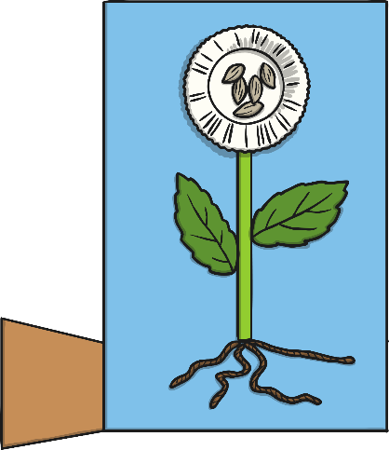
Plant Pictures
Stick the cupcake case at the top of the straw. If you like, you can cut into the cupcake case first to make petal shapes.
Stick some seeds in the middle of the cupcake case.
Stick some pieces of brown wool to the bottom of the straw. Spread them out under the flap.

Slide 9

Plant Pictures
Look at your amazing plant pictures!
Now we need to label the parts of the plant.
Where should these labels go?
seed
leaf
stem
flower
roots
petal

