Slide 1


Slide 3


1) What number is this? thirteen
2) Count from 10 to 20
3) Can you spell 14?
4) How many counters?

Slide 4
1) What number is this? thirteen
2) Count from 10 to 20
3) Can you spell 14?
4) How many counters?
13
10, 11, 12, 13, 14, 15, 16, 17, 18, 19, 20
fourteen
12

Slide 6


Tens and Ones
=
Ten ONES is equal to one TEN.

Slide 7

Tens and Ones
=
One TEN is equal to ten ONES.

Slide 8


This is 10 marbles.
This is 2 marbles.
There are 12 marbles.

Slide 9
Ten and Ones
1
7
There is ten
and ones.
There are marbles.
17

Slide 10

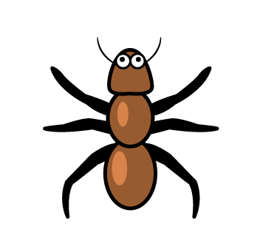
Have a think
Tens and Ones
1
4
There is ten
and ones.
14
There are ants.

Slide 11
Have a go at question 1 on the worksheet

Slide 12
Tens and Ones
1
5
There is ten
and ones.
15
There are blocks.

Slide 13
ten and ones is equal to
1
3
13
ten and ones is equal to
1
6
16

Slide 14
Have a think
ten and ones is equal to
1
7
17
ten and ones is equal to
1
4
14

Slide 15
Have a go at questions 2 and 3 on the worksheet

