Slide 1


Slide 3
1) What number comes next? 16, 17, 18, __
2)
3) What number comes next? 12, 11, 10, __
4) What number is missing?
thirteen
= ten and ones
11 | 12 | 13 | 14 | 15 | 16 | 17 | 18 | 19 | 20

Slide 4
1) What number comes next? 16, 17, 18, __
2)
3) What number comes next? 12, 11, 10, __
4) What number is missing?
19
thirteen
3
= ten and ones
1
9
11 | 12 | 13 | 14 | 15 | 16 | 17 | 18 | 19 | 20

Slide 6

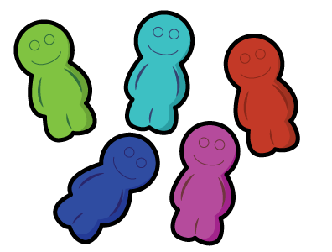
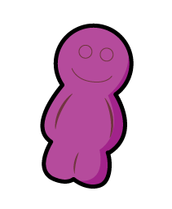
One more
Annie counted 10 gummies in a bag.
She found one more stuck inside.
How many gummies were in the bag?
One more than 10 is 11

Slide 7




One less
Rosie counted 15 birds this morning.
An hour later she counted one less.
How many birds are there now?
One less than 15 is 14

Slide 8
Have a go at question 1 on the worksheet

Slide 9
2 ways to describe a number.
11 | 12 | 13 | 14 | 15 | 16 | 17 | 18 | 19 | 20
17
is one more than
16
17
is one less than
18

Slide 10

Have a think
Can you think of 2 ways to describe this number?
11 | 12 | 13 | 14 | 15 | 16 | 17 | 18 | 19 | 20
12
is one more than
11
12
is one less than
13

Slide 11



Everyone grab a sundae and a spoon!
Have a think
We need one more spoon!
There are 13 sundaes.
How many spoons were there?
One less than 13 is 12

Slide 12
Have a go at questions 2 and 3 on the worksheet

Slide 13
Have a think
16 is one more than
15
19 is one less than
20
Fourteen is one less than
15
Eleven is one more than
10
One ten and 3 ones is one more than
12

Slide 14

Have a think
I am one less than 18
I am also one more than 16
What number am I?
I will try this without a number track…
17

Slide 15
Have a go at questions 4, 5 and 6 on the worksheet

