Slide 1


Slide 3

1) What number is this? six
2) What is one more than
3) What is one less than
4) Count forwards from 5 to 10

Slide 4
1) What number is this? six
2) What is one more than
3) What is one less than
4) Count forwards from 5 to 10
6
4
2
5, 6, 7, 8, 9, 10

Slide 6

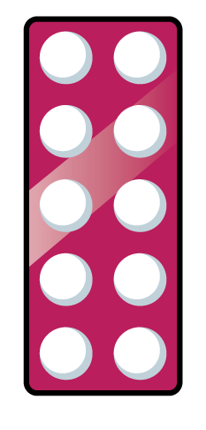




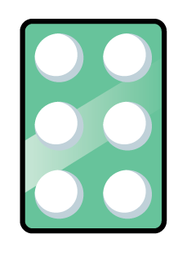



How many different parts can you build?
Have a think
Part
Part

Slide 7
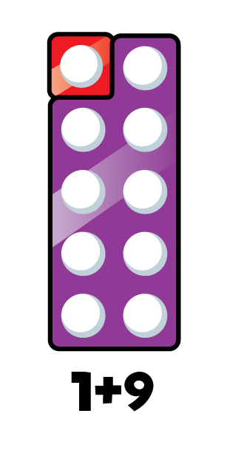
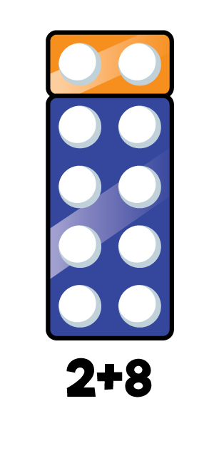
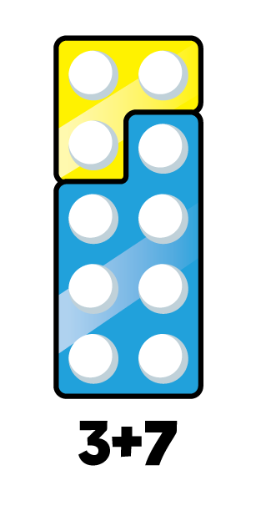
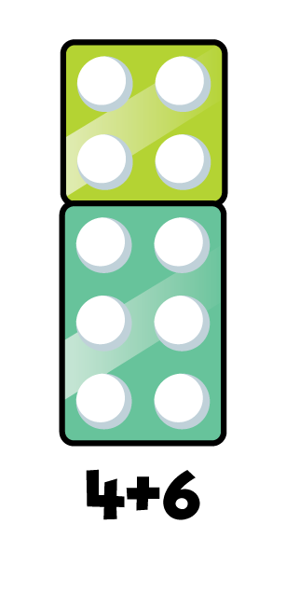
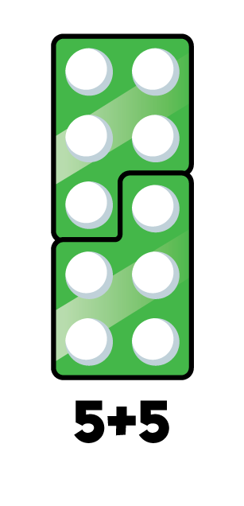
How many different parts can you build?
Have a think
Part
Part

Slide 8
Have a think
Part
Part

Slide 9
Have a think
Part
Part

Slide 10





How many marbles?
Have a think
Part
Part
6
There are marbles.

Slide 11
How many marbles?
Have a think
Part
Part
6
There are marbles.

Slide 12
Have a go making different parts

