Slide 1


Slide 3


1) What is one more than
2) What number is missing? 4 , ___ , 2, 1
3) Can you spell the number 2?
4) Find nine on the number line.
0 | 1 | 2 | 3 | 4 | 5 | 6 | 7 | 8 | 9 | 10

Slide 4
1) What is one more than
2) What number is missing? 4 , ___ , 2, 1
3) Can you spell the number 2?
4) Find nine on the number line.
7
3
two
0 | 1 | 2 | 3 | 4 | 5 | 6 | 7 | 8 | 9 | 10

Slide 6

Part – Whole Model
Whole
Part
Part

Slide 7


7
There are buttons altogether
Whole
3
4
There are green buttons
There are
pink buttons
Part
Part

Slide 8



Have a think
5
There are buttons altogether
Whole
There are yellow buttons
1
4
There is
blue button
Part
Part

Slide 9
Have a go at question 1 on the worksheet

Slide 10
Part – Whole Model
Whole
Part
Part

Slide 11

?

Slide 12
Have a think
?

Slide 13
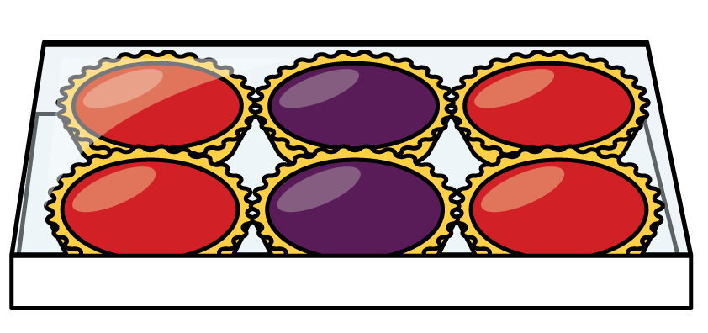



6
There are tarts altogether
Uh Oh!
I forgot how many were in the whole box.

Slide 14
Have a go at question 2 on the worksheet

