Slide 1


Slide 3


1) Find four on the number line
2) What is one more than four?
3) How do you spell 5?
4) How old is Teddy?
0 | 1 | 2 | 3 | 4 | 5 | 6 | 7 | 8 | 9 | 10

Slide 4
1) Find four on the number line
2) What is one more than four?
3) How do you spell 5?
4) How old is Teddy?
0 | 1 | 2 | 3 | 4 | 5 | 6 | 7 | 8 | 9 | 10
5
five
6

Slide 6





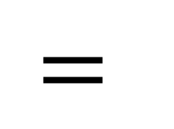
The addition symbol
Add
Plus
$$+$$
Is equal to
Is the same as
$$=$$

Slide 7






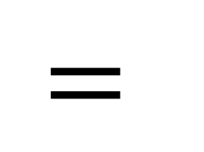
Four add one is equal to five!
$$+$$
$$=$$
Four plus one is equal to five!

Slide 8



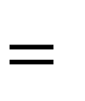
Have a think
2
$$+$$
3
$$=$$
5

Slide 9

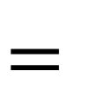

Have a think
7
3
4
3
$$+$$
4
$$=$$
7

Slide 10

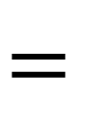

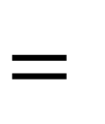
8
6
2
I did it a different way
6
$$+$$
2
$$=$$
8
2
$$+$$
6
$$=$$
8

Slide 11

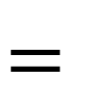

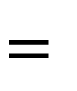
Have a think
4
7
3
4
$$+$$
3
$$=$$
7
3
$$+$$
4
$$=$$
7

Slide 12
Have a go at questions 1 and 2 on the worksheet

Slide 13


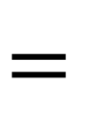
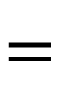


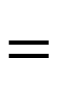
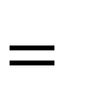
Have a think
4
7
3
4
$$+$$
3
$$=$$
7
2
$$+$$
5
$$=$$
7
3
$$+$$
4
$$=$$
7
6
$$+$$
1
$$=$$
7

Slide 14
Have a go at question 3 on the worksheet

