Slide 1
The Flags of the Britain and Ireland

Slide 2
CfE link: Having selected a significant individual from the past, I can contribute to a discussion on the influence of their actions, then and since. SOC 1-06a
I can discuss why people and events from a particular time in the past were important, placing them within a historical sequence. SOC 2-06a
Aim: I can explain who first thought of a Union Flag, what the Union Flag shows and how it was made.

Slide 3
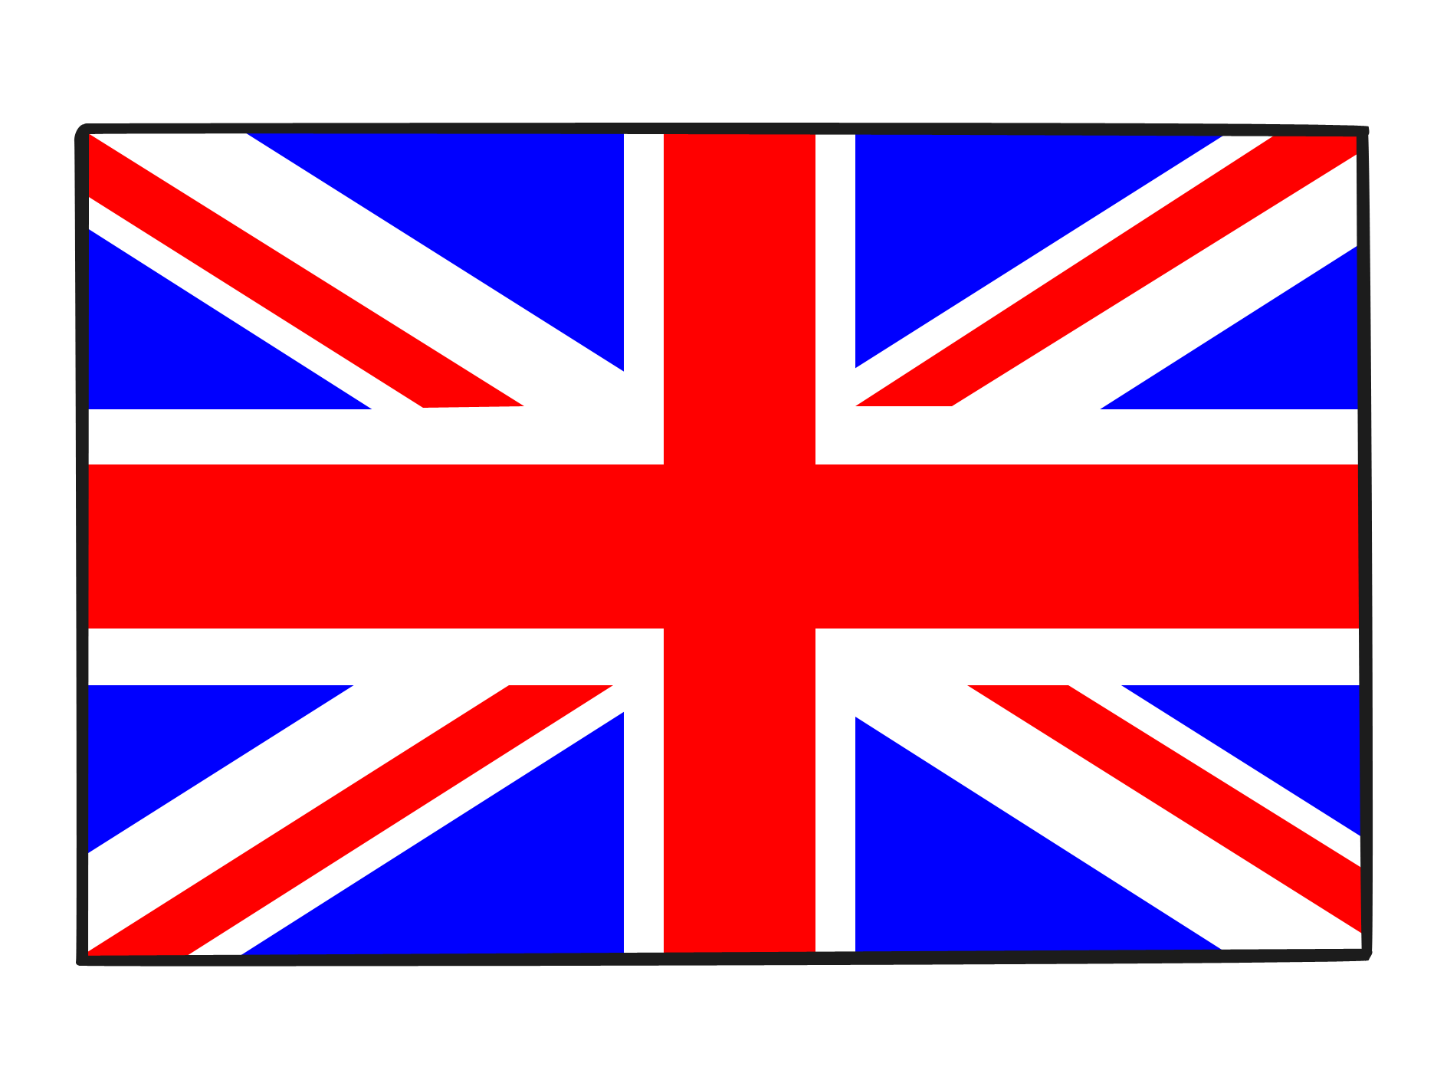
The Union Flag, also known as the Union Jack, is the national flag of the United Kingdom. It is the British flag. It is called the Union Flag because it stands for the union of the countries of the United Kingdom under one King or Queen.

Slide 4
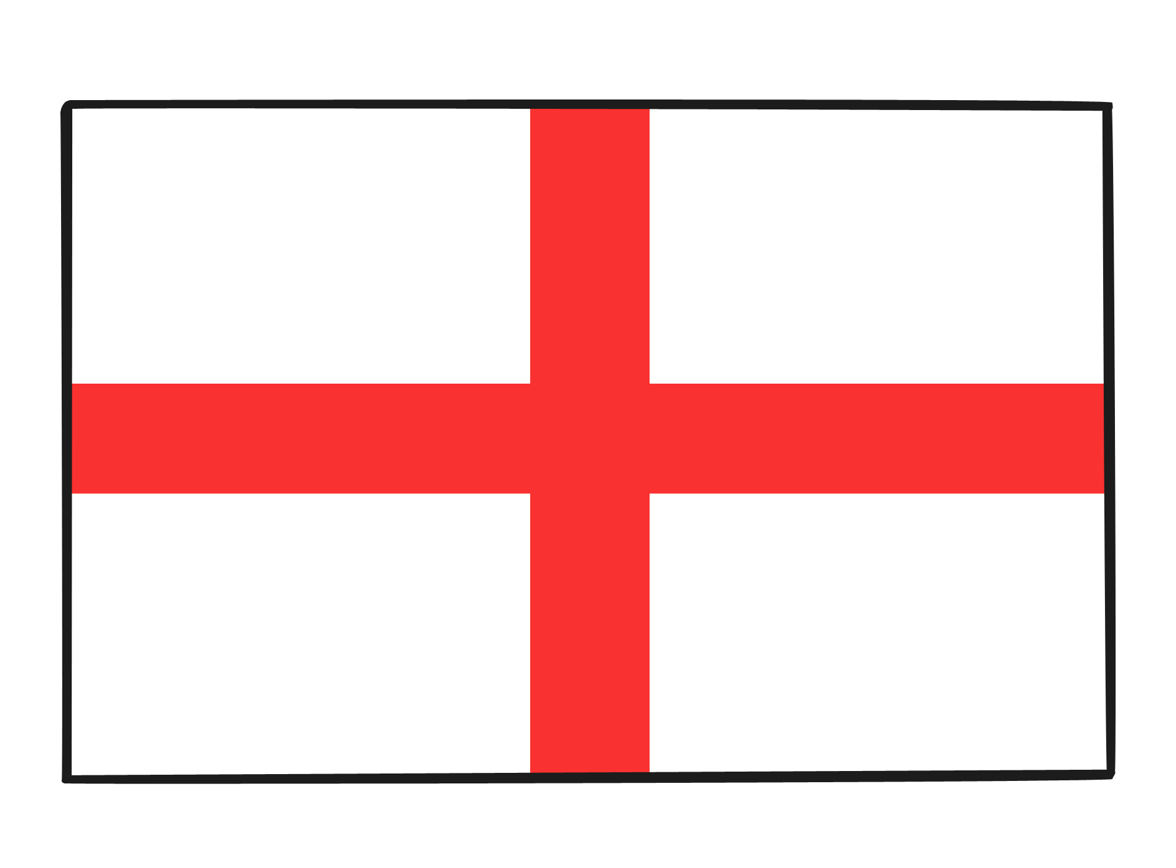
How Was the Union Flag made?
The Union Flag is made up of the flags of three of the United Kingdom's countries; the countries of England, of Scotland and of Northern Ireland.
England is represented by the flag of its patron saint St. George. The Cross of St. George is a red cross on a white background.

Slide 5
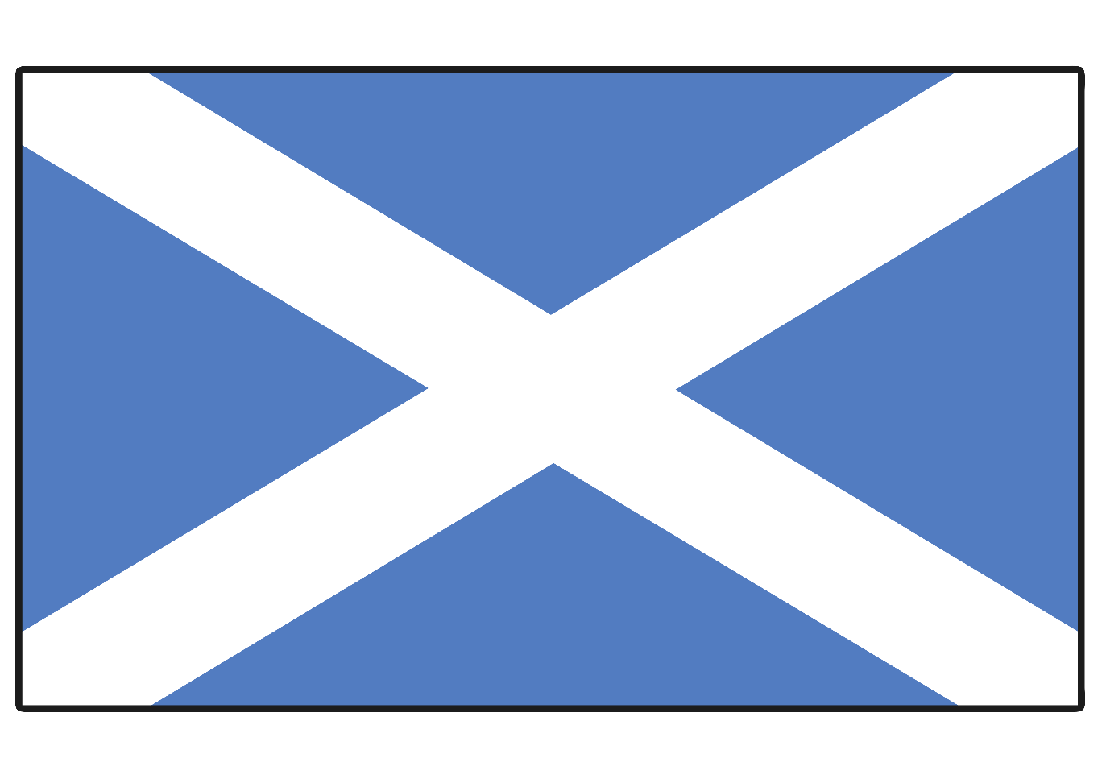
Scotland is represented by the flag of its patron saint St. Andrew. The Cross of St Andrew is a diagonal white cross or saltire on a blue background.

Slide 6
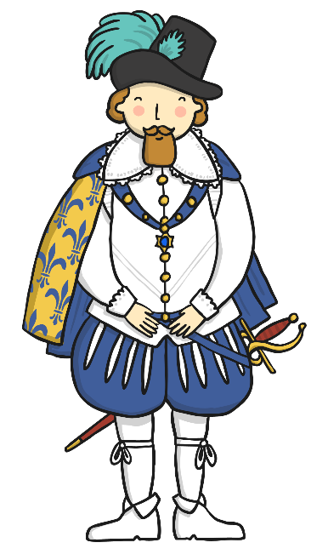
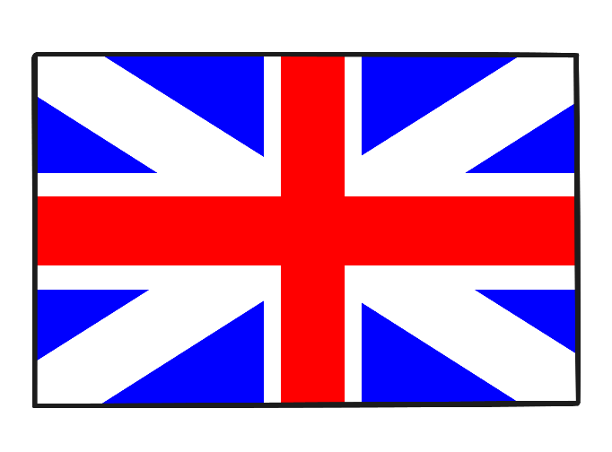
In 1603, when King James VI of Scotland became King James I of England, it was a Union of the Crowns, but not of nations. Each country still kept its own parliament. James wanted England and Scotland to be a united kingdom but which flag would be used? The answer was the creation of the first Union Flag.
On 12 April 1606, the National Flags of Scotland and England were united for use at sea, making the first Union Jack. The reason for the use of the name ‘Jack’ is not certain. It may have been because the jack was a small flag flown from the jack-staff at a ship’s bow or it may have come from the name of King James.

Slide 7
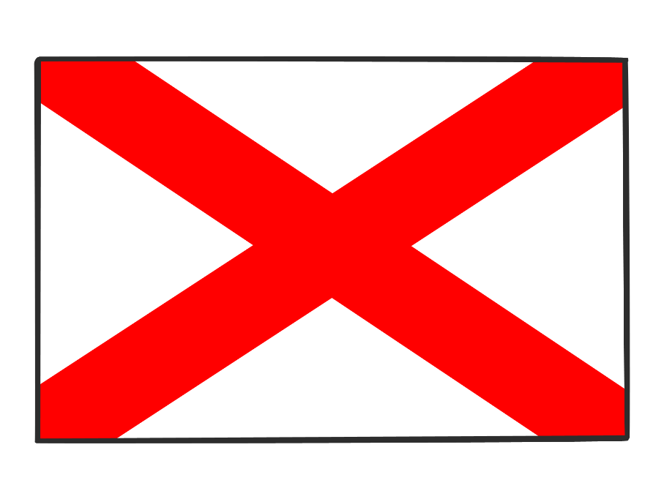
In 1801, Ireland was added to the Union flag. Ireland is represented by the flag of its patron saint St. Patrick. The Cross of St Patrick is a diagonal red cross or saltire on a white background. However, many Irish people do not recognise this flag as an Irish flag, but as a flag designed by the British for Ireland.
Today, this flag is used by some people as the flag for Northern Ireland, though some people in Northern Ireland see the Ulster Banner as the official flag. This is a red cross on a white background with a white, six-pointed star and red hand in the centre.

Slide 8
The cross of St. Patrick was combined with the Union Flag of St. George and St. Andrew, to create the Union Flag that has been flown ever since. This Union Flag was a Royal flag and was ordered to be flown from the King’s castles and properties.

Slide 9
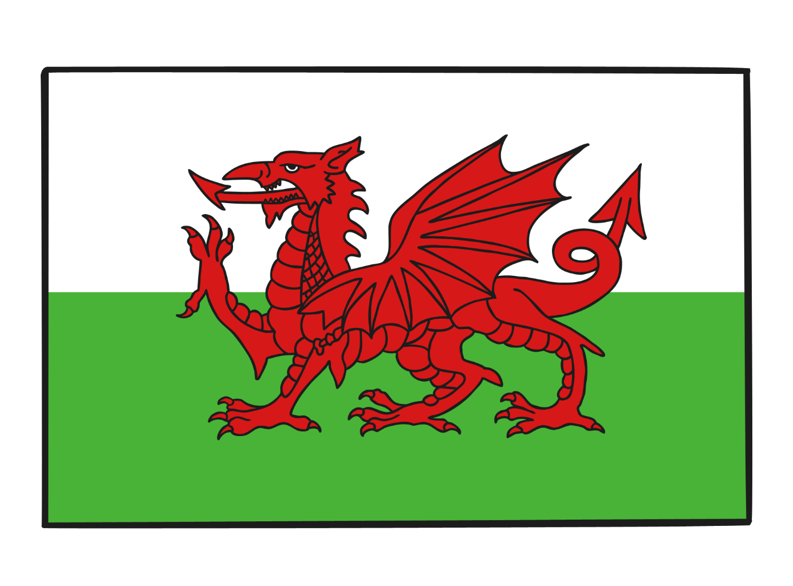
The Welsh dragon does not appear on the Union Flag. This is because when the first Union Flag was created in 1606, the Principality of Wales was by that time already united with England.

Slide 10
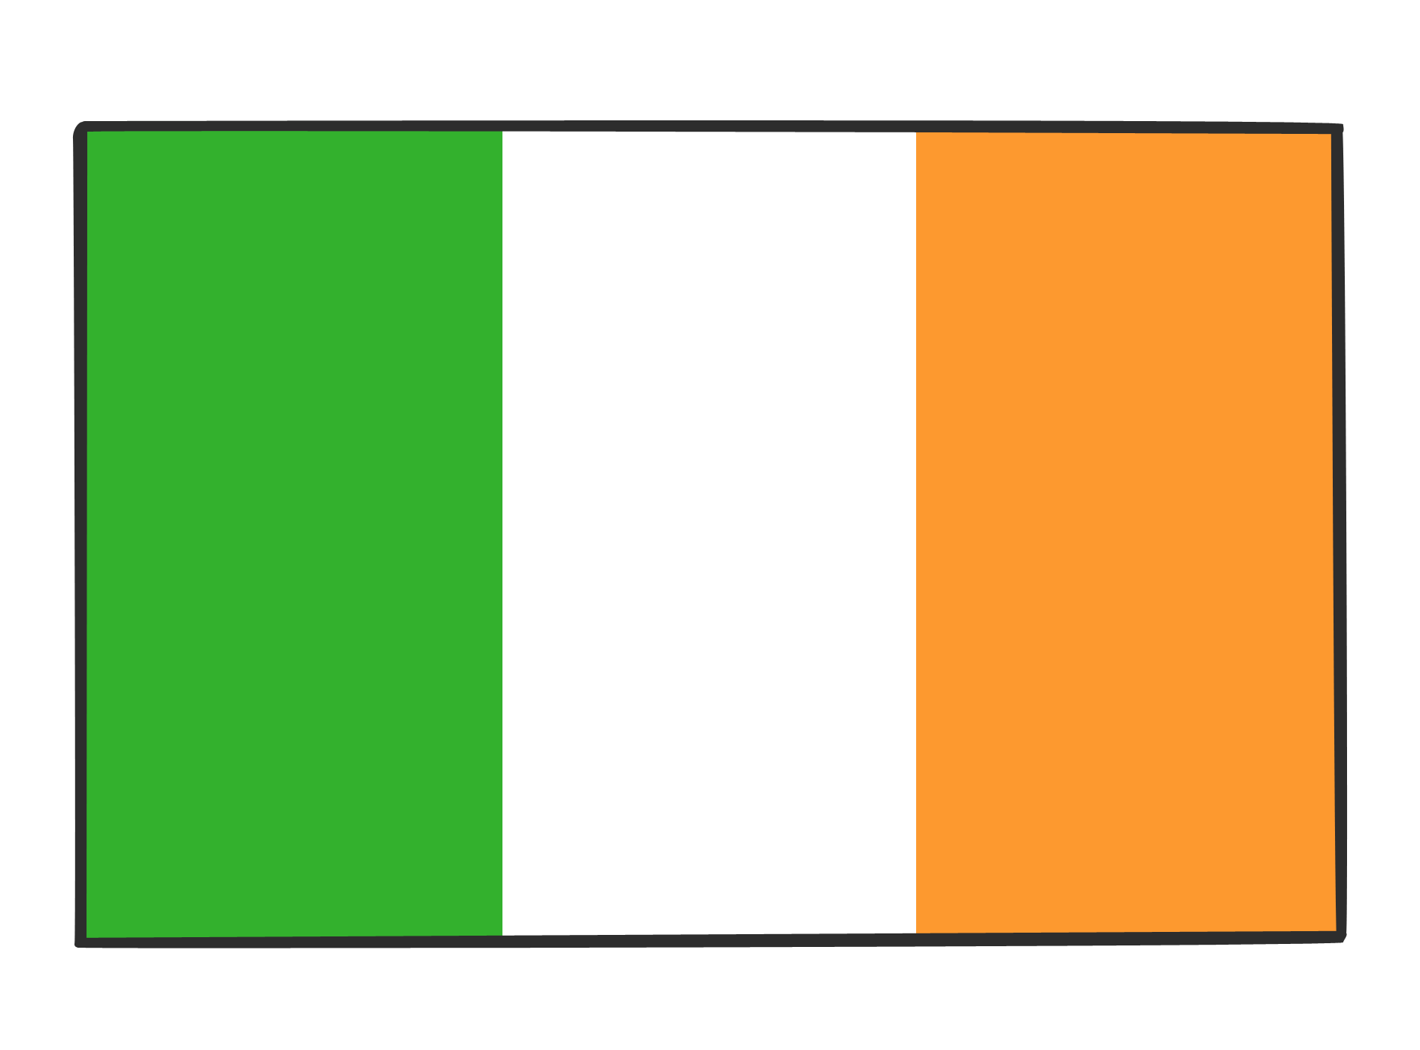
Northern Ireland remains part of the United Kingdom.
The southern part of Ireland is the Republic of Ireland, or Eire. This part of Ireland became a Republic in 1921. This is the flag of the Republic of Ireland.

Slide 11
Can you tell the story of the Union Flag?

Slide 12


