Slide 2


c
a
t

Slide 3

d
o
g

Slide 4

h
a
t

Slide 5
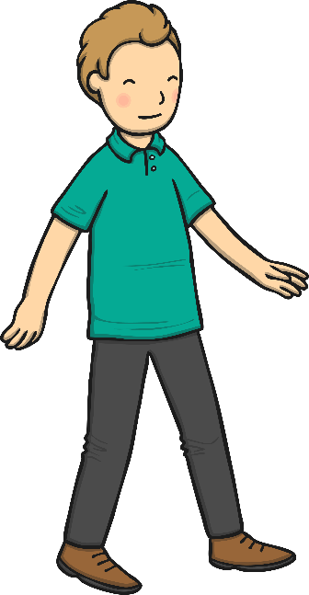
m
a
n

Slide 6

p
i
n

Slide 7
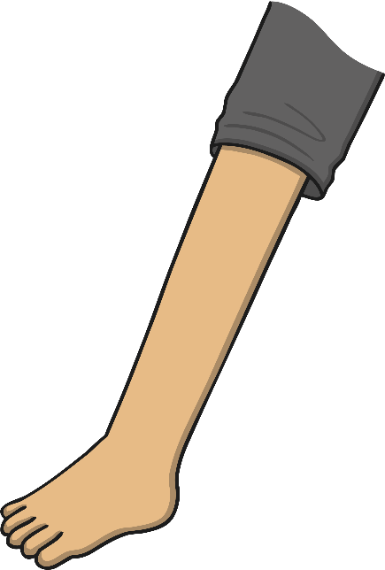
l
e
g

Slide 8
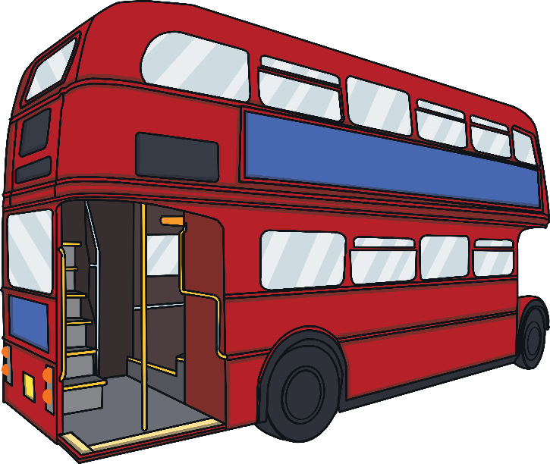
b
u
s

Slide 9
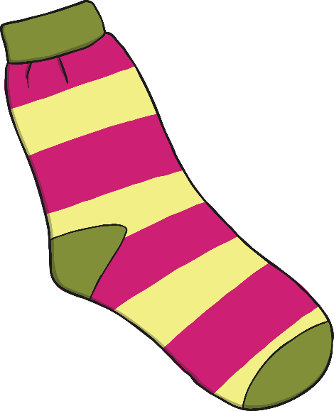
s
o
ck

Slide 10

b
e
ll

Slide 11

t
a
p

Slide 12

s
u
n

Slide 13
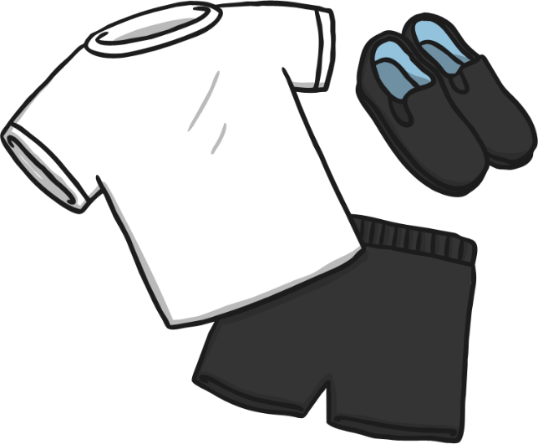
k
i
t

Slide 14

s
a
d

Slide 15

r
a
g

Slide 16
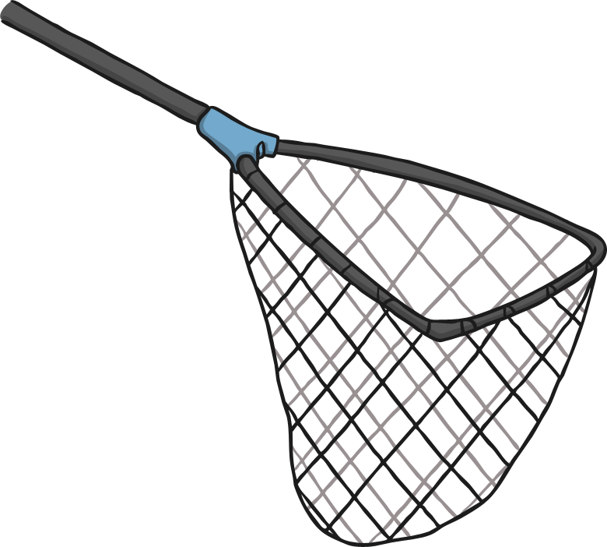
n
e
t

Slide 17

h
i
ss

Slide 18

m
u
g

Slide 19
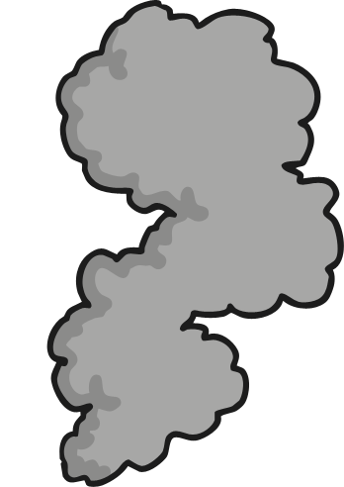
p
u
ff

Slide 20

f
i
n

Slide 21
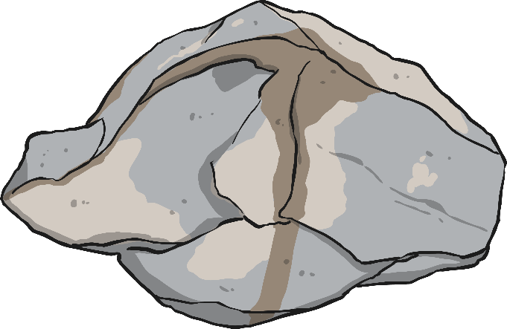
r
o
ck

