Slide 1


Slide 3


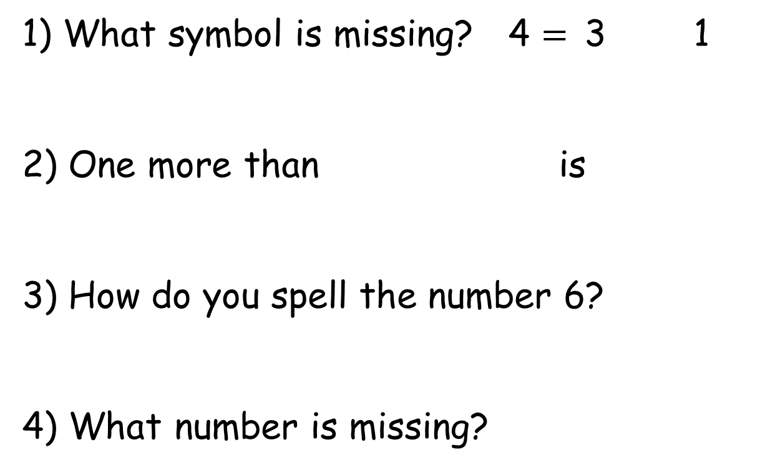
1) What symbol is missing? 4 $=$3 1
2) One more than is
3) How do you spell the number 6?
4) What number is missing?
4
?
5

Slide 4

1) What symbol is missing? 4 $=$3 1
2) One more than is
3) How do you spell the number 6?
4) What number is missing?
$$+$$
5
six
4
9
5

Slide 6
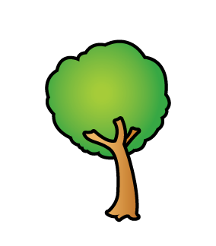
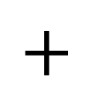


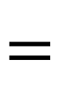
Adding more
3
$$+$$
2
$$=$$
?
5
3
First leaves fell to the ground.
Then more leaves fell.
2

Slide 7
Adding more
7
First leaves fell.
2
Then more fell.
9
Now there are leaves on the ground.

Slide 8


Adding more
Have a think
4
First leaves fell.
3
Then more fell.
7
Now there are leaves on the ground.

Slide 9

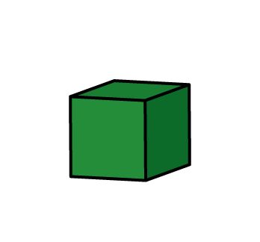
Have a think
I am going to build a tower!
Amir began with 5 blocks.
Then he added 3 more blocks.
How tall is Amir’s tower?
Amir’s tower is 8 blocks tall.

Slide 10

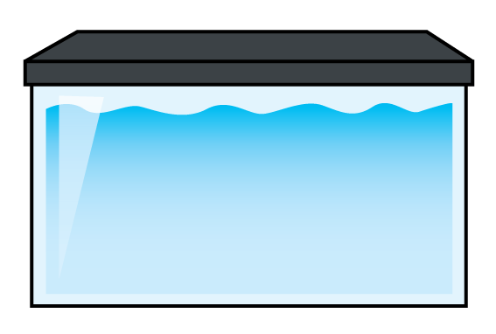

Ron has a new fish tank!
Have a think
Now I have
6 goldfish!
Ron got 4 goldfish for his birthday.
Ron bought 2 more with his birthday money.
How many goldfish does Ron have now?

Slide 11
Have a go at question 1 on the worksheet

