Slide 1


Slide 3

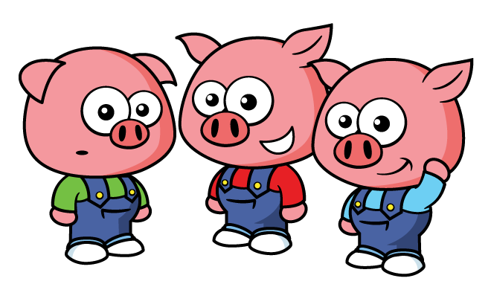
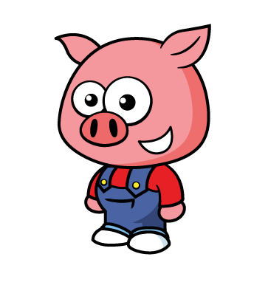
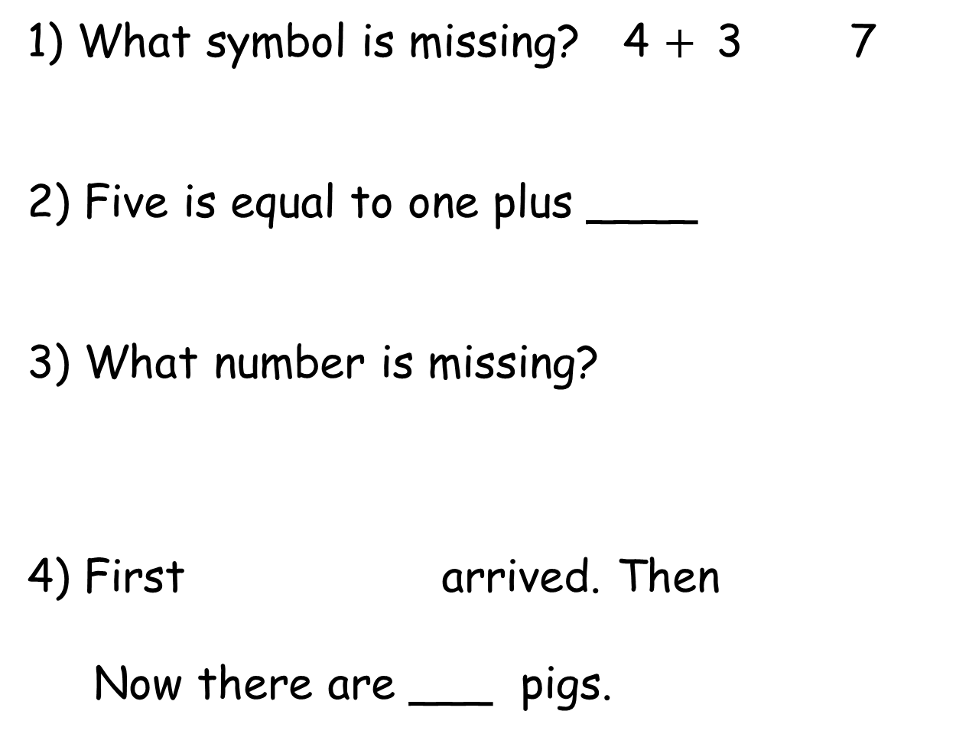
1) What symbol is missing? 4 $+$3 7
2) Five is equal to one plus ____
3) What number is missing?
4) First arrived. Then
Now there are ___ pigs.
4
?
2

Slide 4
1) What symbol is missing? 4 $+$3 7
2) Five is equal to one plus ____
3) What number is missing?
4) First arrived. Then
Now there are ___ pigs.
=
4
4
?
6
2
4

Slide 6
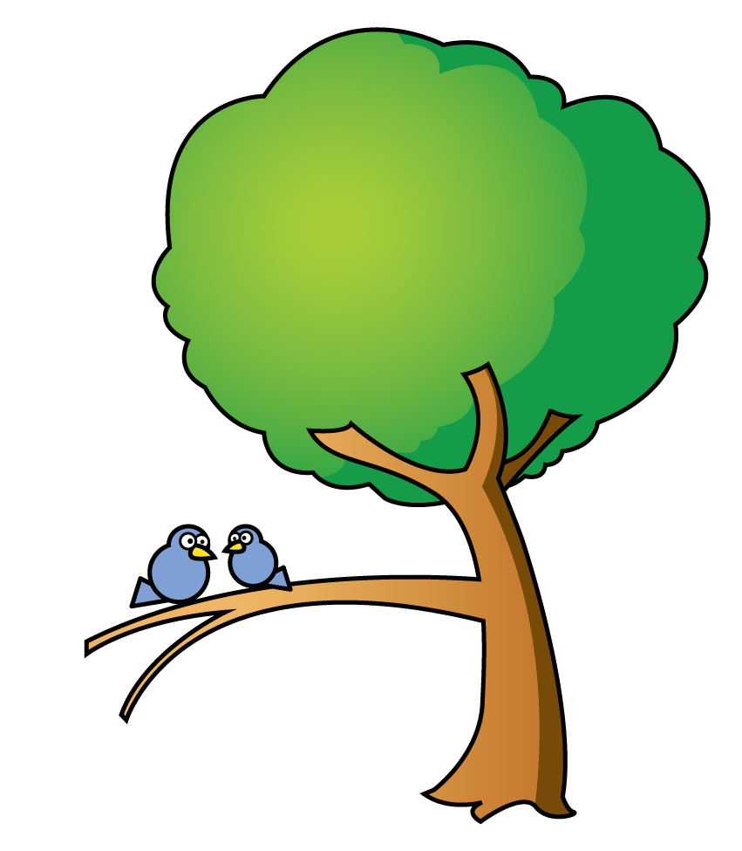



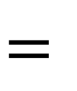
Have a think
A tree had 2 birds.
4 more birds flew in.
Now there are birds on the tree.
6
$$+$$
$$=$$
?
2
4
6

Slide 7

A tree has 3 birds hiding in it.
6 more birds flew in.
Now there are birds on the tree.
9
$$+$$
$$=$$
9
3
6
?

Slide 8
A tree has 3 birds hiding in it.
6 more birds flew in.
Now there are birds on the tree.
9
3
$$+$$
6
$$=$$
9

Slide 9
Have a go at questions 2 and 3 on the worksheet

Slide 10


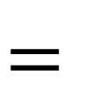

OH NOOOO!
Have a think
?
$$+$$
3
$$=$$
3
6
Amir began with
some blocks.
Then he added 3 more blocks.
Amir’s tower was 6 blocks tall.
3
How many blocks did Amir begin with?

Slide 11





The total is missing.
3
$$+$$
6
$$=$$
9
?
3
Ron got goldfish for his birthday.
He bought more with his birthday money.
6
?
9
Now Ron has goldfish.

Slide 12
Have a think
One part is missing.
7
$$+$$
?
$$=$$
8
1
7
Ron got goldfish for his birthday.
?
1
He bought more with his birthday money.
8
Now Ron has goldfish.

Slide 13
Have a think
One part is missing.
5
$$+$$
$$=$$
6
?
1
?
5
Ron got goldfish for his birthday.
He bought more with his birthday money.
1
6
Now Ron has goldfish.

Slide 14
Have a think
Make your own story
$$+$$
$$=$$
Ron got goldfish for his birthday.
He bought more with his birthday money.
Now Ron has goldfish.

Slide 15
Have a go at the rest of the questions on the worksheet

