Slide 1


Slide 3


1) This is a number bond to ___
6 + 2 =
2) One more than five is __
3) How many counters?
4) Which is correct?
4
1
3
4
1
3

Slide 4
1) This is a number bond to ___
6 + 2 =
2) One more than five is __
3) How many counters?
4) Which is correct?
8
6
9
4
1
3
4
1
3

Slide 6

Have a think
Part – Whole models
?
Part
Part
?
Part
Part
?
?
Whole
Whole
?
Part
?
Part
Whole
Part
Whole

Slide 7


Finding a part
5
The whole is
is a part.
is a part.
3
2

Slide 8


Finding a part
6
0 | 1 | 2 | 3 | 4 | 5 | 6 | 7 | 8 | 9 | 10
?
4
$$+$$
?
$$=$$
2
6

Slide 9
Have a go at questions 1 and 2 on the worksheet

Slide 10





Finding a part
Have a think
3
$$+$$
?
$$=$$
5
8
0 | 1 | 2 | 3 | 4 | 5 | 6 | 7 | 8 | 9 | 10
There are 8 pieces of fruit in the basket.
3 are apples.
5
How many are bananas?

Slide 11
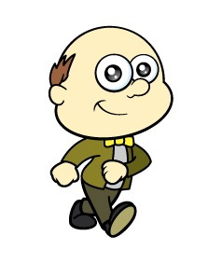




Have a think
4
$$+$$
?
$$=$$
6
10
George bought 10 eggs.
4 are cracked.
6
How many are not cracked?

Slide 12
Have a go at the rest of the questions on the worksheet

