Slide 1
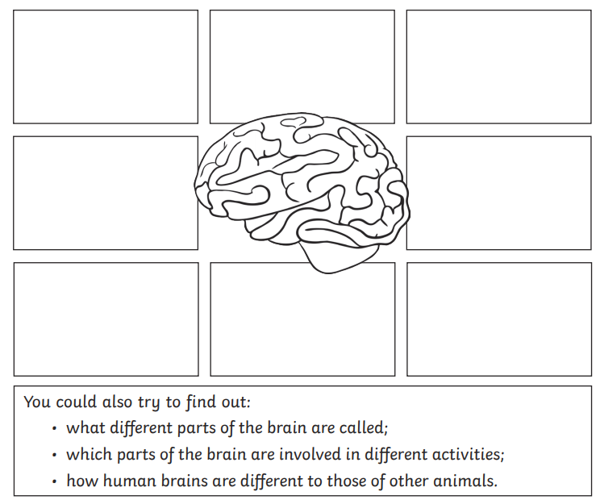
LO: What is the function of the Brain?
The brain is the centre of the human nervous system, controlling our thoughts, movements, memories and decisions. Our nervous system is the message centre of our body. Messages of the nervous system travel throughout the body to help the body function and stay safe.
Task:
Think about some ideas/ activities about what our brain helps us to do and draw or write about each idea in one of the boxes.
Challenge : Can you link some of them to sport or physical activity?

