Slide 1
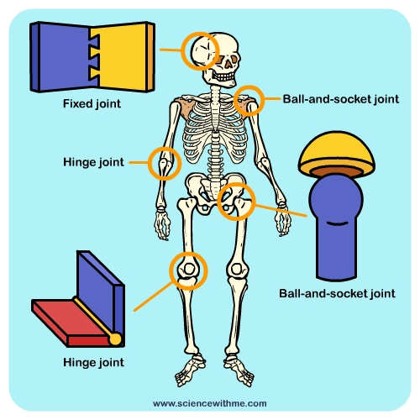
LO: To locate the joints in the body
Last week you were asked to locate the bones in the body. These bones are connected using joints.
Task:
Look at the picture to the right.
Learn the main joints in the body.
List 2-3 areas these bones are found in the body – you
Can research if you have an ipad/laptop.
Use the table below or make your own poster/ diagram.
Fixed Joint | Ball and Socket Joint | Hinge Joint

