Slide 1
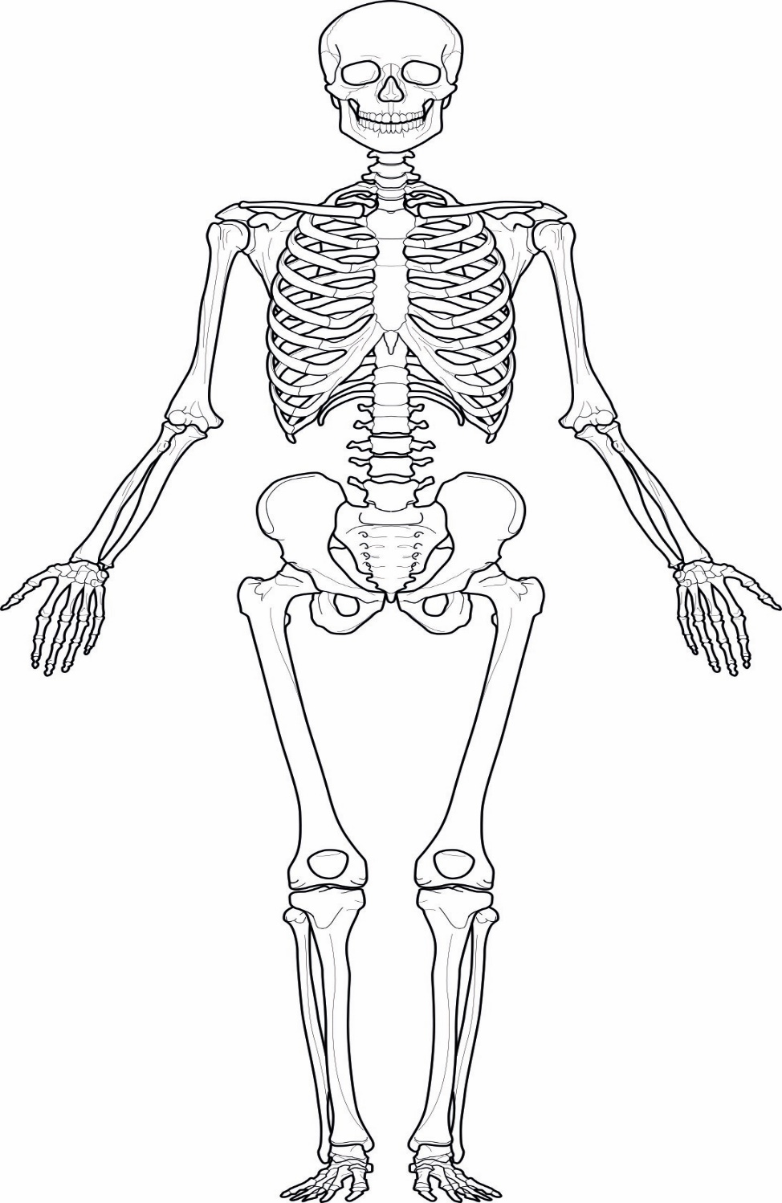
LO: To label the bones of the body
Task :
Print or draw a picture of the Skeleton
List the 3 main functions of the Skeleton
Research and label the bones of the body (using the names in the box)
Femur
Humerus
Scapula
Tibia
Fibula
Cranium
Ulna
Mandible
Rib
Radius
Clavicle
Patella

