Slide 1
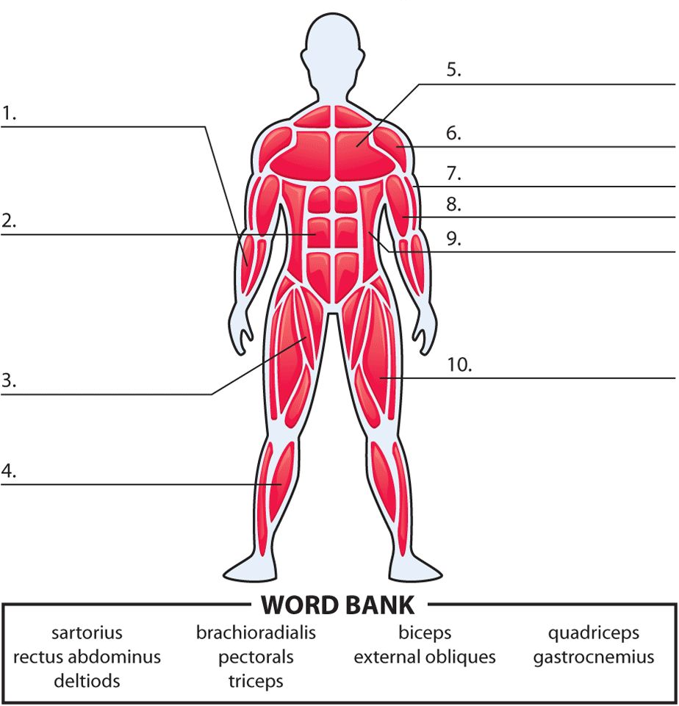
LO: To label the muscles in the body
Task 1: Research how muscles work in pairs
________________________________________________________________________________________________________________________________________________________________________
Task 2: Label the following muscles on the picture

