Slide 1
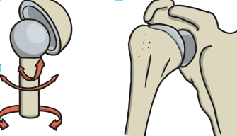
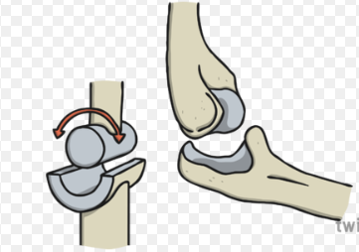
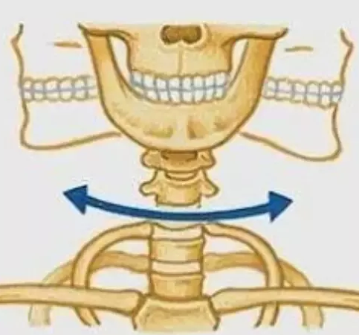
LO: To understand what a joint does and the different types of joints found in the body
Task 1: Find a definition for a joint
______________________________________________________________________________________________________________________________________________________________________________________________________
Task 2: Find where different joints are found in the body
There are 3 main joints in the body;
Draw a picture
of a person and label the picture where the joints are in the body.
Use different colours for the different joints.
Ball and socket joints are the most mobile type of joint in the human body. They allow you to swing your arms and legs in many different directions.
Hinge joints, enable movement similar to the opening and closing of a hinged door
The pivot joint allows you to turn a part of your body from side to side.

