Slide 1




Can shadows make mistakes?
Light And shadow

Slide 2

Success Criteria
1) To know what creates a shadow.
2) To identify shadows made incorrectly.
3) To explain why a mistake has been made.

Slide 3
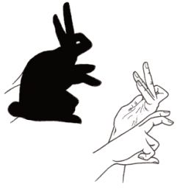
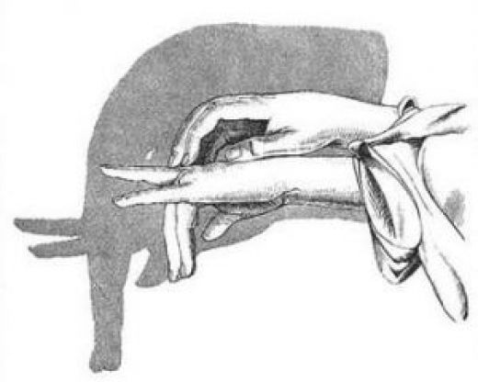


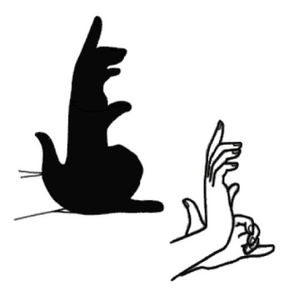
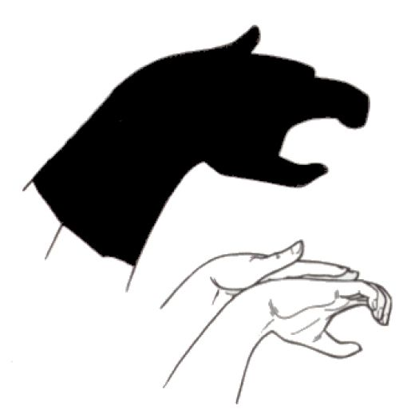

Shadow creations
We know what makes shadows. So can you make these shadows:
Click me to see a master!

Slide 4
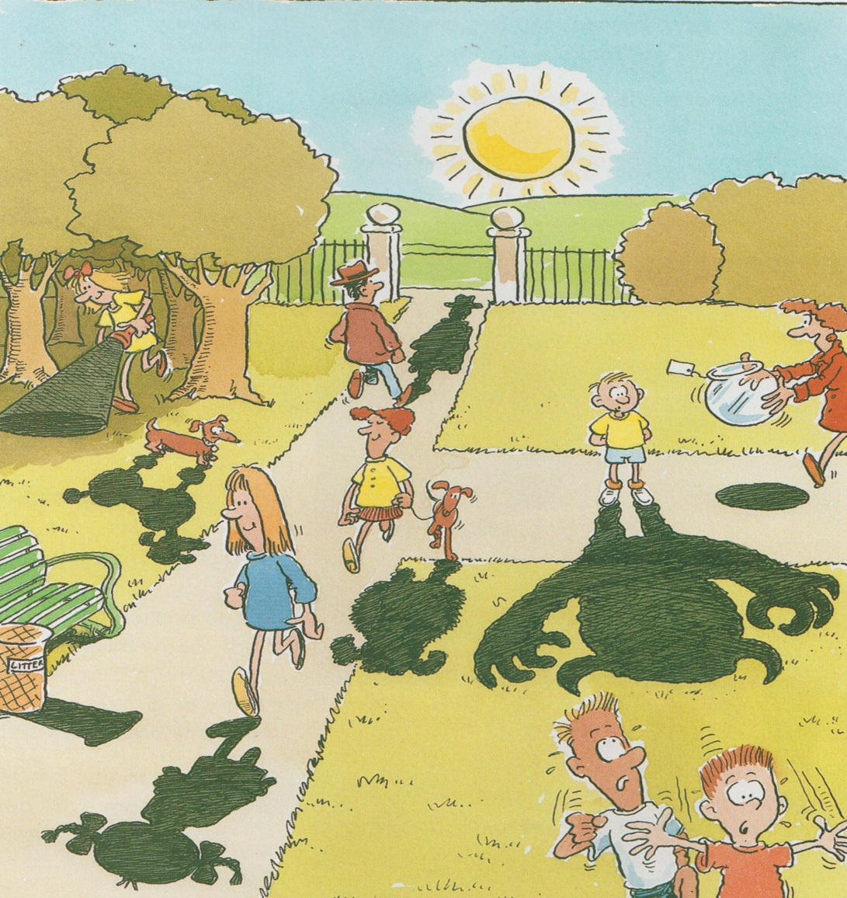
What´s wrong here?
NEXT THING
Choose one example from each colour and explain it.
Example
The boy´s shadow is wrong because his arms are down and he does not have horns on his head.
KEY
Wrong Direction
Wrong shape
Wrong material

Slide 5
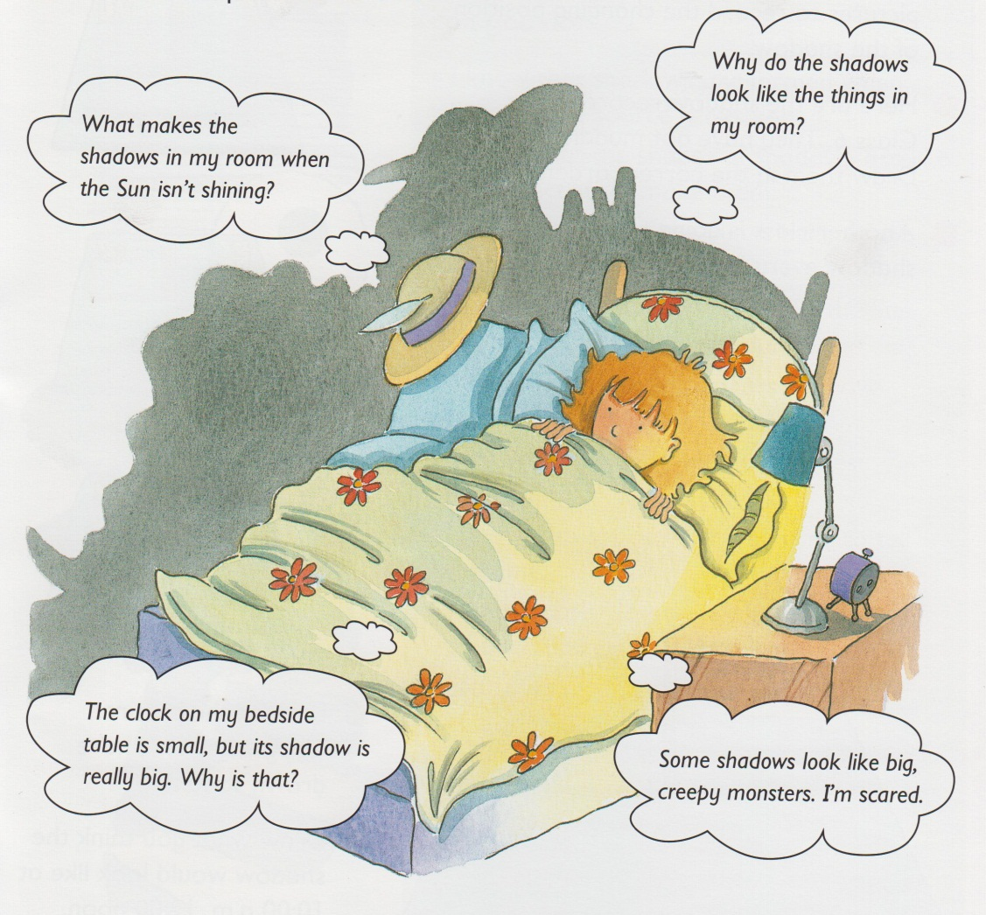

Bedtime shadows
In groups can you create an answer for each question?
Click me to test your knowledge.

