Slide 2
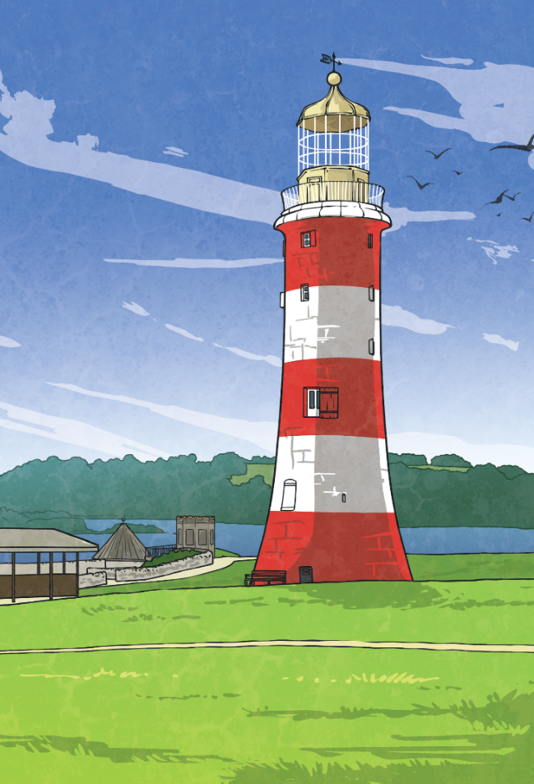
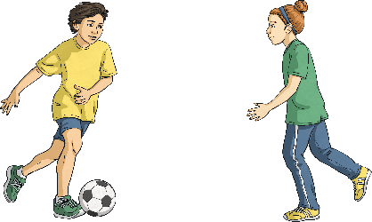
Escape the Lighthouse
You are on holiday with your family and have had a fabulous time on the beach. You notice there is a lighthouse and ask your mum if you can go and explore it. Mum agrees, so you and your sister dash on ahead.
“Race you up to the top!” you shout, as you and your sister Lucy hurtle up the spiral staircase.
After a while, you hear your Mum call up from below, “Come on you two, let’s head back to the beach.”
“OK,” you call back, “won’t be a minute.”
Suddenly, you hear a bang as the door at the bottom of the lighthouse slams shut! You rush down the stairs and realise there is no way to open the door. You are trapped! Luckily, you notice that there is a keypad beside the door which needs a code with six digits.
You must solve the clues hidden around to work out the code and escape the lighthouse. Good luck!

Slide 3
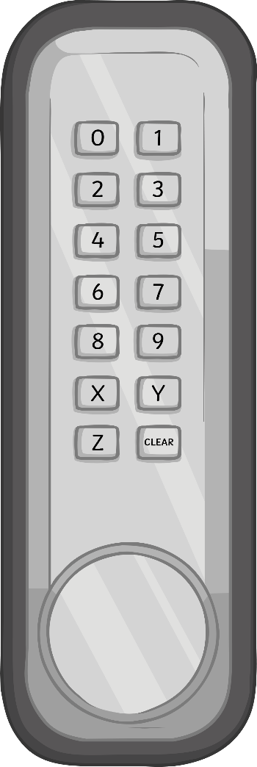
Escape the Lighthouse
The Rules
You can work in small groups.
When you find a clue, work together to solve the puzzle.
Write your answer down on your answer sheet.
Once you have discovered the number for the keypad, check it with your teacher to discover if you can escape the Lighthouse!

Slide 4
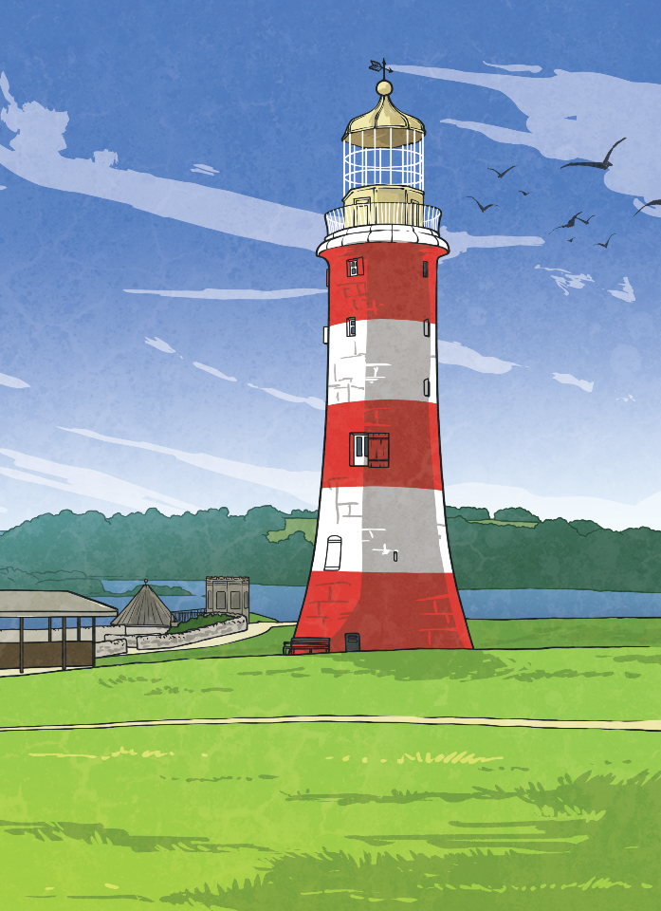
Escape the Lighthouse
Answers to the Clues

Slide 5

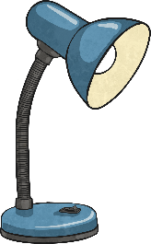


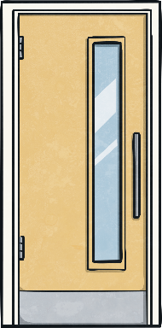

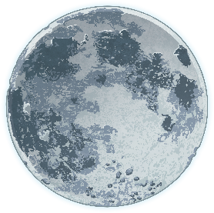



Escape the Lighthouse – Clue 1
How many sources of light are here?
Sources of light
Not sources of light
There are four sources of light so the first digit on the
keypad is 4.
4

Slide 6
Escape the Lighthouse – Clue 2
If you looked directly at this, you would damage your eyes.
s | u | n
Mirrors the light.
r | e | f | l | e | c | t
The pupil in your eye gets in the dark.
l | a | r | g | e | r
An object that blocks the light is .
o | p | a | q | u | e
The letters in the shaded squares spell ‘four’. The second digit on the keypad is 4.
4

Slide 7
Escape the Lighthouse – Clue 3
How many ways can we protect ourselves from the sun?
wear sunglasses | wear a pair of flippers | lie in the sun
cover our shoulders when we are outside | eat more bananas | stay indoors when the sun is at its hottest
wear a hat | sit in the shade | drink milk
There are five ways we can protect ourselves from the sun. The third digit on the keypad is 5.
5

Slide 8

Escape the Lighthouse – Clue 4
Are these statements about objects and light, true or false?
 | True | False
When light shines on a smooth surface, it is reflected.
An object that is translucent will let some light pass through it.
Light can go around corners.
UV light is stronger at night time.
You make a shadow bigger by moving the object further away from the light source.
There are three statements that are false so the fourth digit on the keypad is 3.
3

Slide 9
Escape the Lighthouse – Clue 5
Reflects the Light
Does Not Reflect the Light
There are four pictures showing light being reflected. The fifth digit on the keypad is 4.
4

Slide 10
Escape the Lighthouse – Clue 6
How many of these colours are not in the visible spectrum?
In the visible spectrum
red indigo
orange violet
yellow
green
blue
In the visible spectrum
turquoise purple
white coral
black beige
taupe lime
gold
There are nine colours not in the visible spectrum.
The last digit on the keypad is 9.
9

Slide 11
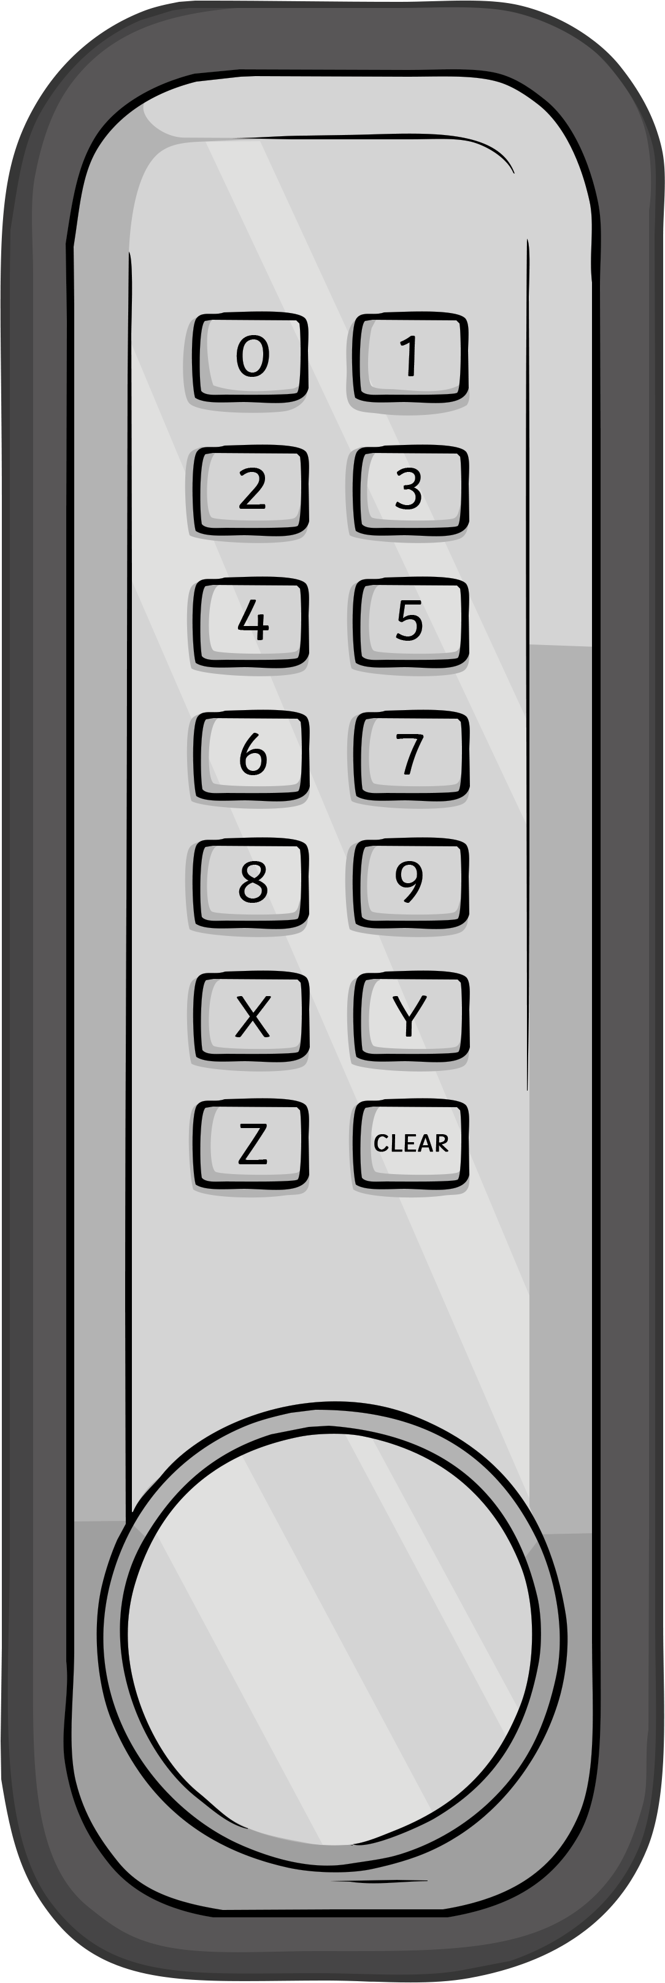
Escape the Lighthouse
Now you’ve solved all the clues, it’s time to enter the code into the keypad and escape the lighthouse!
Digit
1
Digit
2
Digit
3
Digit
4
Digit
5
Digit
6
4
4
5
3
4
9
unlock

